Slide 1

National Core Indicators (NCI)
Board of Directors’ Meeting
December 13, 2023

Slide 2
What is NCI?
The National Core Indicators (NCI) Survey is used by the California Department of Developmental Services and Regional Centers to assess performance in services and supports provided to people with intellectual/developmental disabilities (I/DD).
The NCI survey has been used in California since 2010 as a requirement by the Welfare and Institutions Code, Section 4571 to implement a nation-wide quality assessment survey.

Slide 3


Slide 4
What is the NCI Survey?
The National Core Indicators (NCI) Survey gives individuals with intellectual/developmental disabilities (I/DD) and their families the opportunity to voluntarily and confidentially participate in surveys to share their experiences on access to and use of regional center and community services.
Survey responses help California learn how it is doing compared to other states.
Survey responses help the regional centers see what they are doing well and what they can improve.

Slide 5
There are four types of NCI surveys used in California:
Adult In-Person Survey (formally known as the Adult Consumer Survey)
The Adult In-Person Survey is conducted face-to-face with an individual who is 18 years or older and receives at least one service from the regional center, in addition to case management.
Child Family Survey
The Child Family Survey is a written survey that is completed by families of a child (ages 3-17 years old) who lives with them and receives at least one service from a regional center, in addition to case management.
Adult Family Survey
The Adult Family Survey is written survey that is completed by families of an adult (age 18 and over) who lives with them and receives at least one service from a regional center, in addition to case management.
Family Guardian Survey
The Family Guardian Survey is a written survey that is completed by families and conservators of individuals (age 18 and over) who live in a community placement setting, and receive at least one service from a regional center, in addition to case management.

Slide 6
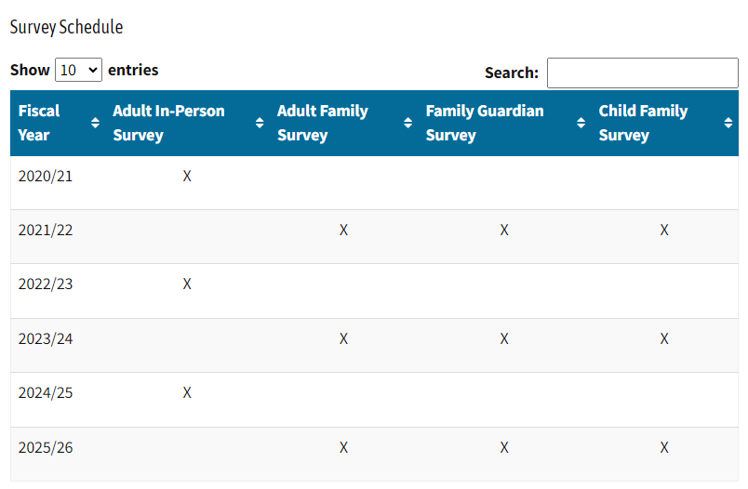
NCI Survey Cycle

Slide 7
2021-2022 Survey
Adult Family Survey
Child Family Survey
Family Guardian Survey
Focus for this presentation is on areas that are 5% above or 5% below the state average.

Slide 8
Adult Family Survey Participants
Adult Family Survey FY 21/22 | AFS FY 19/20 Average | AFS 21/22 CA Average | VMRC AFS 21/22 Average
Total Survey’s Completed | 14621 | 8032 | 334
Does Family Member Live at Home with Respondent
Yes | Data Not Provided | 100% | 100%
No | Data Not Provided | 0% | 0%
Family Member’s Age
Mean | 33 | 34 | 35
Family Member’s Gender
Male | 62% | 59% | 59%
Female | 38% | 40% | 41%
Other | 0% | 0% | 0%

Slide 9
Family Member’s Race and Ethnicity | AFS FY 19/20 Average | AFS 21/22 CA Average | VMRC AFS 21/22 Average
American Indian or Alaska Native | 2% | 2% | 2%
Asian | 16% | 15% | 13%
Black or African American | 9% | 8% | 11%
Pacific Islander | 1% | 1% | 3%
White | 43% | 38% | 43%
Hispanic/Latino | 37% | 41% | 35%
Other | 2% | 2% | 2%
Prefer not to say | Not on FY 19/20 | 3% | 4%
Family Member’s Preferred Language
English | 74% | 70% | 77%
Spanish | 14% | 17% | 12%
Chinese (including Mandarin, Cantonese, and Hokkien) | 1% | 1% | 0%
Tagalog (including Filipino) | 1% | 1% | 1%
Vietnamese | 1% | 1% | 1%
American Sign Language | 1% | 0% | 0%
Hindi | Not on FY 19/20 | 0% | 1%
Other | 8% | 9% | 8%

Slide 10
Adult Family Survey Results
Does your Regional Center keep you informed in your preferred language about programs and services offered
Yes State Average 62% VMRC Average 69%
No State Average 28% VMRC Average 21%
Do you need help in planning for your family members future in any of the following areas
Employment State Average 37% VMCR Average 28%
Financial State Average 35% VMRC Average 30%
Housing State Average 45% VMRC Average 33%
Social/Relationships State Average 36% VMRC Average 29%
Recreation/Having Fun State Average 43% VMRC Average 38%

Slide 11
Adult Family Survey Results
Does your family have an Individual Program Plan (IPP)?
Yes State Average 67% VMRC Average 74%
No State Average 17% VMRC Average 12%
Don’t know State Average 16% VMRC Average 14%
Does the plan include all the services and supports your family member needs?
Yes State Average 57% VMRC Average 68%
No State Average 11% VMRC Average 12%
Don’t know State Average 21% VMRC Average 14%
Does your family member get all the services listed in the IPP?
Yes State Average 54% VMRC Average 62%
No State Average 11% VMRC Average 13%
Don’t know State Average 21% VMRC Average 14%

Slide 12
Child Family Survey Participants
Child Family Survey FY 21/22 | CFS FY 18/19 Average | CFS 21/22 CA Average | CFS VMRC 21/22 Average
Total Survey’s Completed | 10630 | 5589 | 217
Does Family Member Live at Home with Respondent
Yes | Data Not Provided | 100% | 100%
No | Data Not Provided | 0% | 0%
Family Member’s Age
Mean | 11 | 11 | 1
Family Member’s Gender
Male | 72% | 72% | 77%
Female | 28% | 27% | 23%
Other | 0% | 0% | 0%

Slide 13
Child’s Race and Ethnicity | CFS FY 18/19 Average | CFS 21/22 CA Average | CFS VMRC 21/22 Average
American Indian or Alaska Native | 2% | 2% | 2%
Asian | 20% | 17% | 17%
Black or African American | 8% | 6% | 6%
Pacific Islander | 1% | 1% | 1%
White | 26% | 28% | 28%
Hispanic/Latino | 48% | 55% | 62%
Other | 3% | 2% | 3%
Prefer not to say | Not on FY 18/19 | 3% | 1%
Child’s Preferred Language
English | 90% | 73% | 72%
Spanish | 22% | 12% | 9%
Chinese (including Mandarin, Cantonese, and Hokkien) | 1% | 1% | 0%
Tagalog (including Filipino) | 1% | 1% | 0%
Vietnamese | 1% | 0% | 0%
American Sign Language | 1% | 0% | 0%
Other | 2% | 13% | 17%

Slide 14
Child Family Survey Results
Do you get enough information to take part in planning services for your child?
Always State Average 20% VMRC Average 21%
Usually State Average 25% VMRC Average 17%
Sometimes State Average 27% VMRC Average 35%
Does your Regional Center keep you informed, in your preferred language about programs and services it offers?
Yes State Average 31% VMRC Average 27%
No State Average 59% VMRC Average 66%

Slide 15
Child Family Survey Results
Do you have enough information about other public services your family can get (food stamps, SSI, housing subsidies etc.)?
Always State Average 18% VMRC Average 19%
Usually State Average 19% VMRC Average 14%
Sometimes State Average 22% VMRC Average 17%
Seldom/Never State Average 22% VMRC Average 30%
Does your child’s case manager/service coordinator speak to you in your preferred language?
Yes State Average 90% VMRC Average 77%
Yes But only through a translator
State Average 4% VMRC Average 13%

Slide 16
Child Family Survey Results
What additional serviced does your family member need?
Respite
State Average 46% VMRC Average 30%
Regularly scheduled support for child
State Average 42% VMRC Average 48%
Homemaker services
State Average 22% VMRC Average 28%
Home and/or vehicle modifications
State Average 13% VMRC Average 22%
Family to family networks
State Average 27% VMRC Average 34%
Support/training to use child’s assistive technology
State Average 21% VMRC Average 30%

Slide 17
Family Guardian Survey Participants
Family Guardian Survey FY 21/22 | FGS FY 19/20 Average | FGS 21/22 CA Average | FGS VMRC 21/22 Average
Total Survey’s Completed | 5317 | 4670 | 124
Does Family Member Live at Home with Respondent
Yes | Data Not Provided | 0% | 0%
No | Data Not Provided | 100% | 100%
Family Member’s Age
Mean | 43 | 44 | 43
Family Member’s Gender
Male | 61% | 61% | 61%
Female | 39% | 39% | 39%
Other | 0% | 0% | 0%

Slide 18
Family Member’s Race and Ethnicity | FGS FY 19/20 Average | FGS 21/22 CA Average | FGS VMRC 21/22 Average
American Indian or Alaska Native | 2% | 2% | 3%
Asian | 8% | 9% | 11%
Black or African American | 7% | 6% | 4%
Pacific Islander | 1% | 0% | 0%
White | 76% | 73% | 75%
Hispanic/Latino | 12% | 13% | 10%
Other | 3% | 2% | 1%
Prefer not to say | Data not provided | 2% | 4%
Family Member’s Preferred Language
English | 94% | 93% | 95%
Spanish | 2% | 2% | 1%
Chinese (including Mandarin, Cantonese, and Hokkien) | 0% | 1% | 0%
Tagalog (including Filipino) | 0% | 0% | 0%
Vietnamese | 0% | 0% | 0%
American Sign Language | 1% | 1% | 2%
Other | 3% | 3% | 3%

Slide 19
Family Guardian Survey Results
Does the case manager/service coordinator listen to your family’s choices and opinions?
Always State Average 48% VMRC Average 54%
Usually State Average 24% VMRC Average 14%
Seldom/never State Average 9% VMRC Average 7%
Do the support workers speak to you in your preferred language?
Yes, they speak in preferred language
State Average 84% VMRC Average 76%
Yes, but only through a translator
State Average 1% VMRC Average 1%
No State Average 2% VMRC Average 1%
Don’t Know State Average 3% VMRC Average 11%

Slide 20
Family Guardian Survey Results
Does your family member do things in the community?
Yes State Average 76% VMRC Average 65%
No State Average 18% VMRC Average 26%
Do you feel that services and supports have made a positive difference in the life of your family member?
Yes State Average 88% VMRC Average 83%
No State Average 5% VMRC Average 6%
Are services and supports helping your family member to live a good life?
Yes State Average 85% VMRC Average 74%
No State Average 5% VMRC Average 4%

Slide 21
Areas for Planning and Improvement
Information and Planning
Access and Delivery of Support
Choices Decision-Making and Control
Community Participation
Satisfaction

Slide 22
Strategic Planning
VMRC values NCI as a way to support long term planning
Ideas for improvement
Engage our DEI incitive agency wide to help improve communication, understanding lived experiences
Focus on hiring new staff that are diverse in languages spoke and have different lived experiences
Hiring a Benefits Counselor to expand understand access to community recourses
Expand developing Service Coordinator training
Collaborate with SAC6 for trainings
Collaborate with CHOICES conference to provide training on focused topics
Collaborate to create media informational clips
Continue to encourage Person Centered Planning for everyone
Engage Person Centered Thinking Trainers to assist with trainings

Slide 23
Additional NCI Resources
NCI Information Portal
https://www.dds.ca.gov/rc/nci/
Frequently Asked Questions
https://www.dds.ca.gov/rc/nci/quality-assessment-faq/
10 Easy Steps User-Friendly Guide
https://www.dds.ca.gov/wpcontent/uploads/2019/02/NCI_TenEasySteps_20190212.pdf
Interactive Dashboards
Overview - https://www.dds.ca.gov/rc/nci/nci-domain-dashboards
Comprehensive - https://www.dds.ca.gov/rc/nci/nci-interactive-dashboard/
Regional Center NCI Reports
https://www.dds.ca.gov/rc/nci/reports/

Slide 24


