Slide 1

Mid-Year Performance Contract Report
Presentation on the Spring Letter 2023
(December 2023)
Tony Anderson
Executive Director
Valley Mountain Regional Center

Slide 2
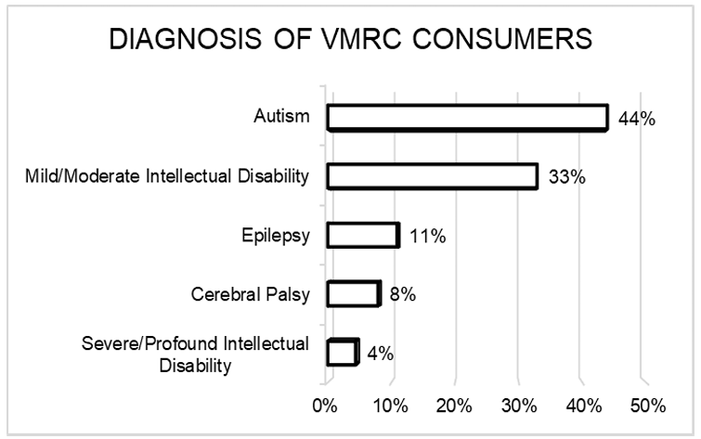
Diagnosis of People Served

Slide 3
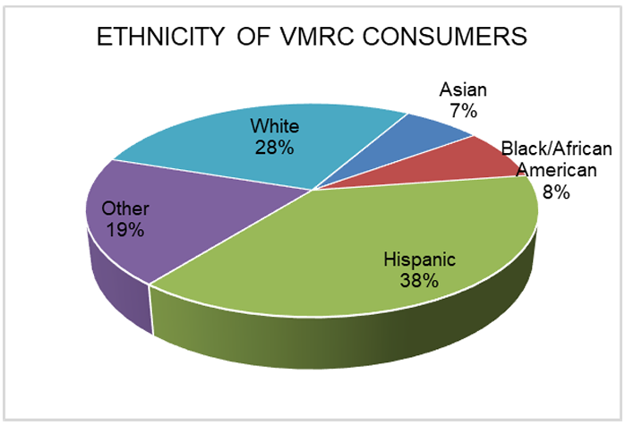
Ethnicity of People Served

Slide 4
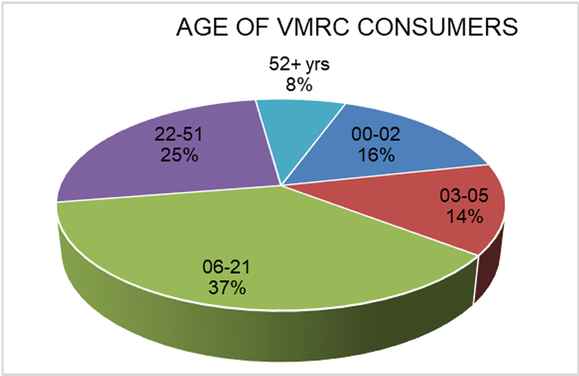
Ages of People Served

Slide 5
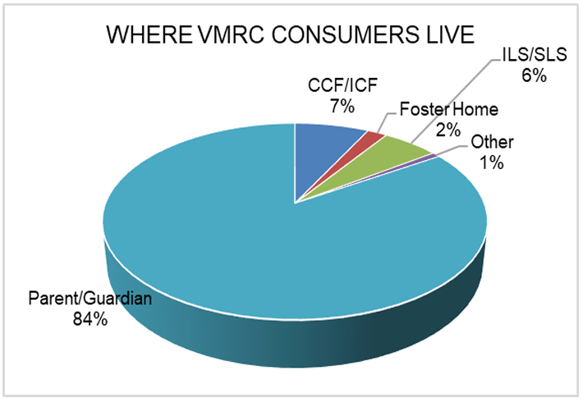
Where People Live

Slide 6
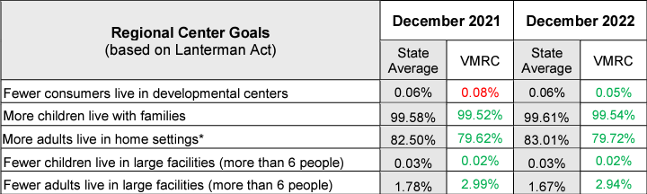
Areas of Improvement
As you can see in this report, we did well in the goals of:
More children live with families,
More adults live in home settings*,
Fewer children live in large facilities (more than 6 people), and
Fewer adults live in large facilities (more than 6 people).

Slide 7
Below the State Average
Although we met our goals each of these areas we were below the state average in the following areas:
More adults live in home settings*, and
Fewer adults live in large facilities (more than 6 people).

Slide 8

Barriers to Community Services
One barrier to the community has been the workforce shortage as our providers struggle to attract and hire direct support professionals.
While we make progress every month in the area of transportation, we continue to have many people on an unmet needs list for commercial and supplemental transportation.
Last year our transportation broker was reporting we had 350 people on a waiting list but today we have about 45 people waiting in San Joaquin County and no waiting lists in the other counties.

Slide 9
Not Ready Yet…
And finally, there remains a small percentage, about 10% of the consumers, who are either not ready to return to day programs or no longer desire these services but have not replaced the service with another option yet.

Slide 10
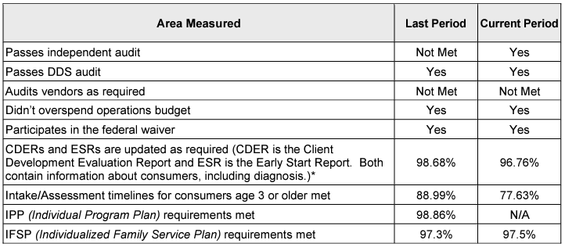
DDS Compliance Standards

Slide 11
VMRC Comments:
During the last period reporting we did not pass the independent auditor's requirement, not because we did not a have an independent audit.
The reason for this previous finding was that the California Public Employees’ Retirement System (CalPERS), does not conform to accounting principles generally accepted in the United States of America (GAAP) under the Financial Accounting Standards Board (FASB) standards.
Our current and new auditor’s process does meet this requirement.

Slide 12
VMRC Comments
Our reduced scores in the Intake/Assessment measure is the result of two significant factors.
First our grow rate is just over 11%, representing the 5th largest growth rate in the state.
In addition, our assessment capacity is significantly impacted because our provider rates are lower than our nearest regional center that received a 637 authority to increase their rates and we still have the same low rates.

Slide 13
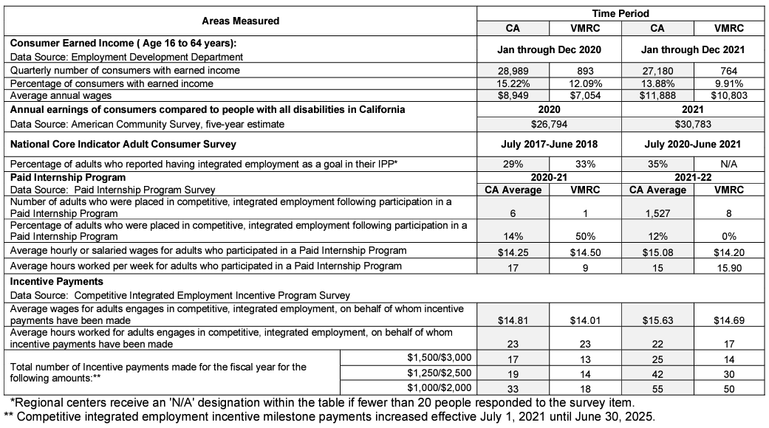
Getting People to Work

Slide 14
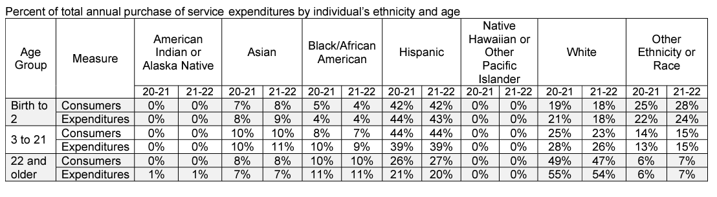
Reducing Disparities

Slide 15
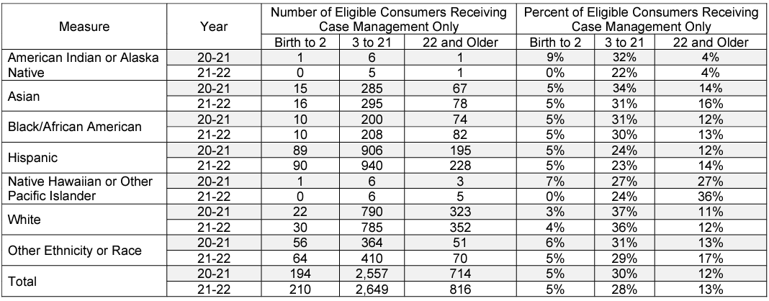
Only Case Management by Age and Ethnicity

Slide 16
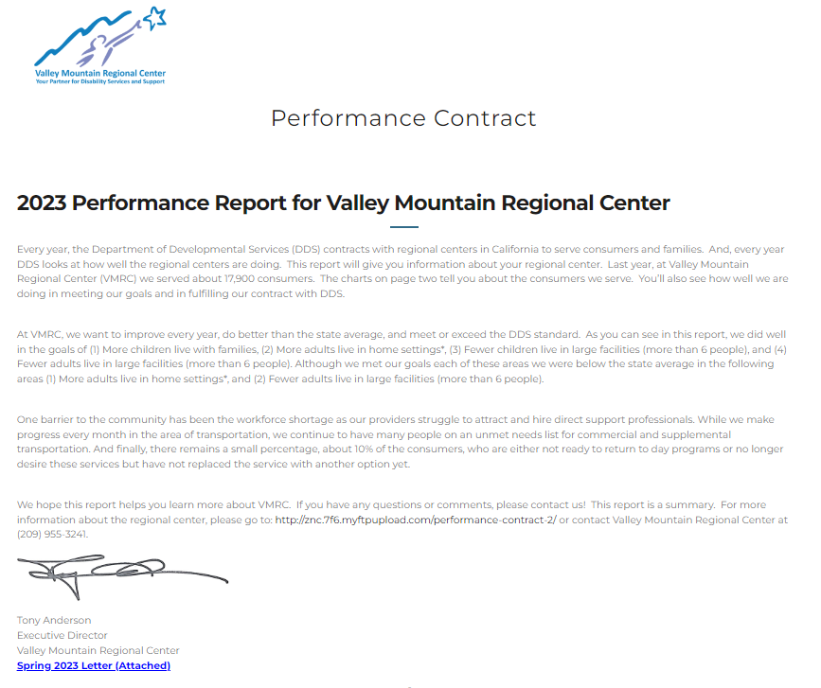

Slide 17

Questions

