Slide 1
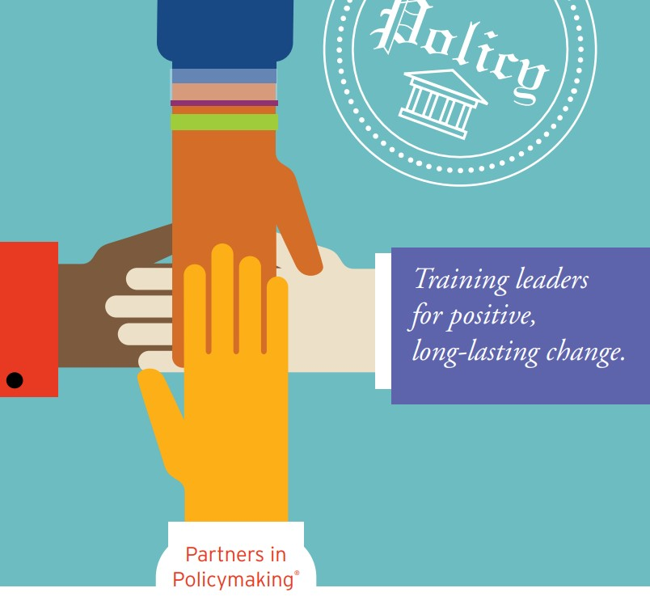
Information Session on Partners in Policymaking
Valley Mountain Regional Center
2022 – 2023 Disparity Grant Project funded by the California Department of Developmental Services

Slide 2
Overview
Who we are?
What is it?
What’s expected of the participants?
What’s in it for you?
What do others say about their experience?
Questions?

Slide 3
Project Coordination
Erica Fernandez Zamora, Project Coordinator
Agency Sponsors: Valley Mountain Regional Center
Gaby Lopez, Cultural Specialist
Tony Anderson, Executive Director
Partners in Policymaking Coordinator, Fuerzas Unidas, Senior Organizer

Slide 4
The Organizing Committee
Christine Couch
VMRC - Director of Consumer Services Adults
1
Doug Bonnet
VMRC - Special Asst to the Director
2
Dena Hernandez, Local Manager
State Council on Developmental Disabilities North Valley Hills
3
Lisa Culley
Executive Director Family Resource Network
4
Dora Contreras
Region Manager Integrated Collaboration Coalition
5
Patricia Albeno
Director of Projects & Outreach, The Arc CA
6
Mariza Ochoa
Director Escucha Mi Voz
7
Self-Advocacy Council 6
TBD
8

Slide 5
Responsibilities of the Organizing Committee
Content Experts
Connected Professionals
Community Leaders
Event Volunteers
Applicant Evaluators

Slide 6
Partners FOUNDATIONAL Principles
Partnerships with Policymakers
State-of-the-Art and Best Practices
Systems Change
Quality Principles: Process, Approach, and Outcomes
Core Values

Slide 7
SPEAKERS: Experts in…
Government and public policy
State-of-the-art best practices
Core values
Adult learning methods
Motivational presentation

Slide 8
CURRICULUM
Competencies
Integrating Online Learning
Skill-Building Activities & Homework
Notes:
Competencies: Knowledge, Skills, and Abilities Every Partners in Policymaking training session is a laser-focused effort to develop competencies. A quality Partner program acquires funding, recruits participants and, most importantly, delivers results. The results you promise—to your participants and to your funder(s)—are that, after the session topics have been presented, participants will be able to: • Describe the history of services for, and perceptions of, people with developmental disabilities. • Describe the history and the role of the Parent Movement. • Describe the history and the role of the Independent Living Movement. • Describe the history and the role of the Self-Advocacy/People First Movement. • Describe the benefits and values supporting inclusion and quality education, including early intervention and inclusive post-secondary education, for individuals with and without disabilities. • Outline specific strategies to achieve quality, inclusive education and lifelong learning. • Demonstrate how to be effective in team meetings. • Demonstrate knowledge of the service coordination system and what services may be available. CURRICULUM All aspects of any Partners in Policymaking program need to reflect and reinforce: The outcomes of the DD Act (Developmental Disabilities Assistance and Bill of Rights Act) of independence, productivity, self-determination, integration, and inclusion (IPSII) The Core Values about People with Disabilities (on page 9) The competencies of Partners in Policymaking (detailed below) 27 • Understand the principles of choice and control, and their application to self-directed and/or person-centered planning for people with developmental disabilities. • Understand that a flexible, responsive system of supports for the families of children with disabilities is the cornerstone for a true system of community supports for people with developmental disabilities and families. • Understand the need for all individuals to experience regular and ordinary changes in lifestyle across the lifespan. • Know/understand the importance of home ownership/control as one of the defining characteristics of adult life in our culture and the types of lifelong supports necessary for creating a positive home environment for people with developmental disabilities. • Describe the importance of supported, competitive, and customized employment opportunities for people with disabilities. • Describe examples of state-of-the-art technologies that can benefit people with disabilities. • Create a shared vision for the year 2030 (and beyond) for people with disabilities. • Learn how to meet a public official and discuss issues. • Understand how a bill becomes a law at the state level. • Draft and deliver testimony for legislative hearings or public meetings. • Identify critical federal issues and the process by which participants can personally address their concerns. • Understand how a bill becomes a law at the federal level. • Demonstrate successful techniques for advocating for services to meet the needs of unserved and underserved individuals. • Identify strategies for beginning and sustaining grassroots organizing around specific issues. • Understand the role of, and how to use, the media (including social media) to effectively promote issues. • Demonstrate proper procedures for conducting a meeting. • Understand the protocols of parliamentary procedure and serving on boards.

Slide 9
The Eight Sessions
History
Inclusive Education
Service Coordination: & Case Management
Self-Directed & Person-Centered Planning
Employment
Supported Living/Home of Your Own
Community Organizing & Advocacy
Meeting a Public Official, and Vision
State Legislation
Federal Legislation
Parliamentary Procedure &
Serving on Boards
Assistive Technology & Positioning
Positive Behavior Supports
Media Skills
Graduation Ceremony

Slide 10
Competencies: Describe, Demonstrate, Understand…
History
Parent Movement
Independent Living Movement
Self-Advocacy Movement
Inclusive Education
Lifelong Learning
Effective Meetings
The DD Act
Choice & Person-Centered
Responsive Service Systems
Regular and ordinary changes in lifestyle across the lifespan.
Principle of Control of Your Home
Supported, competitive, and customized employment
Technology as Support
Vision
Participating in Public Policy decisions
How a bill becomes a law (state)
Legislative hearings & public meetings.
Federal Public Policy
How a bill becomes a law (federal)
Advocacy techniques for underserved individuals.
Grassroots organizing
Media (including social media) to effectively promote issues.
Serving on boards
Parliamentary procedure and serving on boards.

Slide 11
PARTICIPANTS
Participant Criteria
Recruitment and Selection
Responsibilities of Participants
Notes:
20% Monolingual Spanish Speaking
20% Adult Self-Advocates
10% Bilingual English/Spanish Speakers
50% Other family members with children or young adults with developmental disabilities
Information and promotion
Application Process
Interview process

Slide 12
Participant Criteria
20% Monolingual Spanish Speaking
20% Adult Self-Advocates
10% Bilingual English/Spanish Speakers
50% Other family members with children or young adults with developmental disabilities

Slide 13
Recruitment and Selection
Information and Promotion
Application Process
Interview Process
Commitments and Agreements

Slide 14
What’s Expected of the Participants
A Commitment to Attend – One Weekend a Month for 8 Months
Participation Agreement – Willingness to Engage and learn
Continuous Learning Assessment Surveys
Secure the supports needed through the IPP
Session Evaluation Forms
Graduate Project
Notes:
Responsibilities of Participants The Partners Coordinator and funding agency bear many responsibilities for the success of the Partners program. But it’s not a one-way street; participants have responsibilities, too. In order to meet those responsibilities, participants need to first know what they are.
• A Commitment to Attend: The Partners application form needs to include the dates, times, and location of the training sessions, along with a query: “Will you make a commitment to attend…” That’s the first responsibility of a participant: to attend all the sessions. But they can’t make that commitment if they don’t know the “when” and “where.”
• Participation Agreement: As noted previously, the applicants that are selected for the class need to complete and return a Participation Agreement that outlines what the Partners program will do (provide training, cover expenses, etc.) and what the participant will do (attend all sessions, comply with policies and procedures, etc.).
• Quality Improvement Surveys: Complete and return the Initial Survey, Six-Month Survey, and Long-Term Survey (see p. 56).
• Time-Match Forms: If your program needs time match (for grant purposes) from participants, they need to complete a time match form at the end of every session, detailing how much time they have contributed to the program.
• Session Evaluation Forms: Every participant needs to complete the Session Evaluation form(s) for every training session and/or speaker; these provide valuable information to the Coordinator on the program’s effectiveness.
• Graduate Project: Each participant needs to complete a post-graduate project, of his/her choosing, within the parameters set by the Coordinator, within six months of graduation. Projects should be a natural extension of both the Core Values, Principles and Competencies, coupled with what participants have learned, related to changes in the system, public policies, attitudes and perceptions, inclusive practices, employment, etc. In some states, participants join together in twos or threes for their project; other participants work solo. The Coordinator should ask participants to start thinking about their project by the 5th or 6th training session, and the decision should be finalized by graduation. Consider these examples: become a mentee of a policymaker; organize/plan a conference on inclusive education or some other issue; organize/raise funds for an inclusive community playground; start a Facebook/social media page on an issue of interest. These are just a few ideas; the sky is the limit

Slide 15
Graduates become…
Leaders in the advocacy movement
Leaders in parent support and advocacy movement
Leaders in self-advocacy on the local, state and national level
Directors of boards, commissions, councils, advisory committees, etc.
Leaders in the service provider community
Bridge builders connecting the disability community with all parts of society
Policymakers and government officials

Slide 16
Testimonials
Linda Landry Parent - Family Resource Centers California
Debbie Sarmento, Parent - Family Resource Centers California
Yvette Batista, Parent - Family Empowerment Center Los Angeles
Raymond Hamptson, Parent - The Arc California Board Member

Slide 17
Fernando & Elizabeth class of 2008
My husband and I participated in the Partners in Policymaking course in 2008. This was early on in our journey to advocate for our Son who then was only 1 year old.
The last 14 years have been a whirlwind of advocating and due to this important and life changing training, we have been able to help thousands of families address barriers and roadblocks and navigate the complex systems of support, Co-Founded 2 state wide organizations (one of which I am the Director), introduced a new organic Peer-to-Peer outreach protocol and participated in countless statewide and local committees and boards. PIP brought focus to our journey and empowered us with the pathway to help our community unite and lift their voices.

Slide 18
Raymond Hampson Parent/ Dad-vocate PiP Class of 2007
Partners in Policymaking (PiP) changed my life, changed my thinking about what is possible for my son.
My son now has a parent with better advocacy skills. I have a much better idea on what questions to ask.
I was involved in my son’s advocacy before PiP and now after PiP, I am much more comfortable in advocacy and I am able to talk with other parents about advocacy.
PiP challenged our class to get more involved in the advocacy movement. Two of my classmates and myself are now Board Members of the Arc of California.
Advocacy for my son, his peers and others is now my passion. PiP gave me my passion!

Slide 19
Debbie Sarmento, Parent - Family Resource Centers California
It was the most important thing I’ve ever done in my career.

Slide 20
Yvette Batiste, East Los Angeles Family Resource Center
I participated in the Partners in Policymaking Training just as I started working with families in a parent to parent capacity. I had spent much of my time in the system providing services and Partners in Policymaking helped me to shed a great deal of inaccurate information about the system, individuals with disabilities and their families, especially, my understanding of the capacity of self-advocates and families to create change. Partners in Policymaking will always be that watershed training for me and my fellow "PIPs" will always be dear friends. I am very proud of my graduation pin from Shirley Dove.

Slide 22
California Testimony
Partners has made me critically think about how I need to raise my son so that he will achieve independence and a richer, fuller life.
Senate Bill 807 was passed because of the persistence of a Partners graduate. This law allows students to remain in school and graduate with their class even though they reach age 22 years.
I have been in an institution for most of my life. I got myself, a job at the local shopping mall. (He now works at one of his regular "hangout" stores).
Cinda-Rae has taken off! She facilitated a meeting with staff from Congressman George Miller's office addressing child care and respite issues; she also has been active in a program in Solano County working with families who have young children with disabilities.

Slide 23
Questions

