Slide 1
Fiscal Year 2020-2021
PURCHASE OF SERVICES
How does VMRC serve its community?

Slide 2
Why Does Regional Center Have To Present This Information?
Lanterman Act Requirement: Sec. 4519.5 & 4511.6 of the W&I Code
All Regional Centers to report data on Purchase of Service (POS) authorizations, utilization, and expenditures
Regional Centers to hold at least 1 public meeting

Slide 3
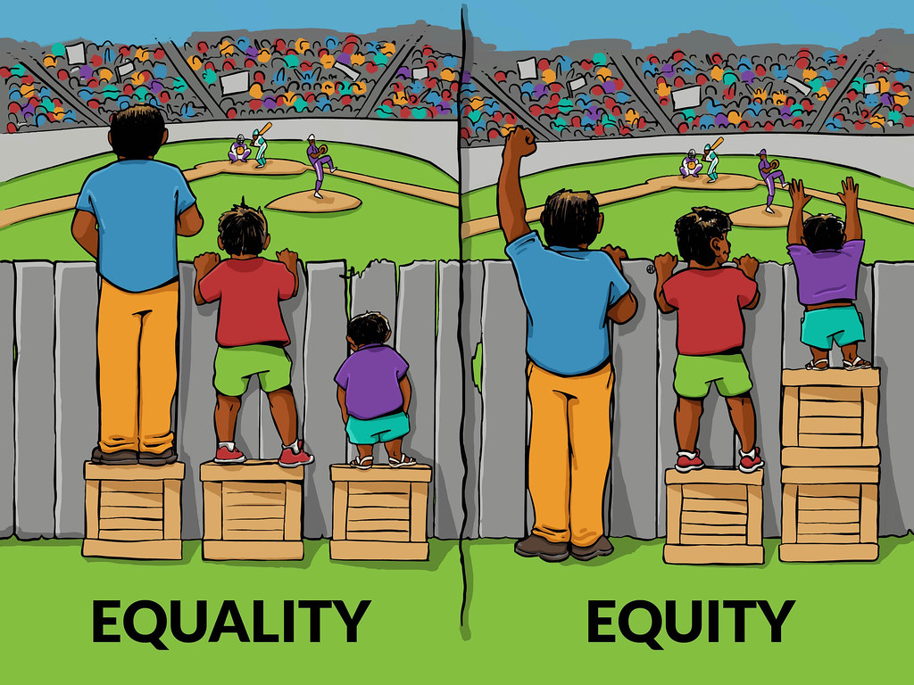
What Is a Disparity?
-Implies a Difference
-Being Fair and Impartial, basing on need
What is Equity?
What is the GOAL?
-Reduce Disparities
-Increase Equity

Slide 4
Purpose of Meeting
Present how the money from the FY 2020-2021 was utilized
Indicate data categorized by age, ethnicity, language, diagnosis, residence and various service types
Review authorized and actual consumer expenditures and utilization rates based on certain key characteristics in multiple fiscal years
Provide the data in a manner to better analyze the information
Identify potential barriers to equitable access to services and support
Identify best practices to reduce disparity

Slide 5
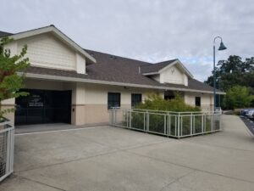
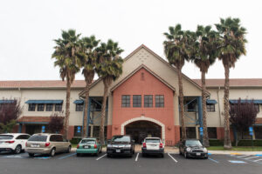
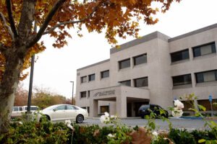
VMRC
Where do we fit into the picture?
Valley Mountain Regional Center (VMRC) is one of 21 regional centers in the state
VMRC serves about 4.5% of the regional center population in California in a 5-county catchment area
We are a non-profit agency operating with state and federal funds

Slide 6
Who Are We?
VMRC serves approximately 18,401 individuals
We serve residents of San Joaquin, Stanislaus, Amador, Calaveras and Tuolumne Counties
Offices in Stockton, Modesto and San Andreas with 389 staff

Slide 7
Total Individuals Served by Diagnosis Fiscal Year 2020-2021, all Ages

Slide 8
Total Expenditures by Ethnicity or Race Fiscal Year 2020-2021 for all Ages

Slide 10
Total Annual Expenditures Authorized Services Per Capita by Ethnicity or Race FY 2020-2021

Slide 11
Consumers with No Purchase of Services by Ethnicity or Race FY 2020-2021

Slide 12
Consumers with No Purchase of Services compare to Consumers who Received Purchase of Service by Ethnicity or Race FY 2020-2021

Slide 13
What Does This Mean?
Areas of accessibility to services include Respite, Family Supports, Behavioral Services, Early Start Services
Areas of Service Disparities include Residential Services, Day Programs, Transportation, Behavioral Management (Non-Family Home), and Supported Living Services
Age appears to be a significant driver of expenditures as well
Notes:
I need to double check data on highlighted area.

Slide 14
VMRC Activities to Address Disparities
Continue to probe for the answers by analyzing data and offering solutions
To continue the support for the Cultural Specialist to continue collaborating with families and individuals that we serve
Continue collaborating with parent groups to bring accessible training through their preferred language
Consumers and families will continue to receive cultural and linguistic competent information such as Individual Program Plan (IPP) and Individual Family Service Plan (IFSP) in their preferred language

Slide 15
Development of the Diversity, Equity and Inclusion Committee (DEI) to further identify barriers and eliminate biases
Continue to offer a Bilingual stipend for staff.
Staff training focused on Cultural Competence and knowledge of services
Meeting translation equipment needs and training interpreters in processes
Person-Centered Planning—invested in training all staff and developed four certified trainers to serve consumers and families
Created a Health Advisory to provide current information to the community
Developing information/public service announcements in various languages in lobby areas when public access occurs
Community outreach efforts—Cultural Fair, informational campaigns, COVID testing
Increased consumer contact and Everbridge messaging in preferred language

Slide 16
VMRC Collaboration with Parent Groups and Community Stakeholders
Parent Groups: Integrated Community Collaborative (ICC), Hear my Voice, Families First
Provide support to families during their IPP meeting and through the process of accessing Generic Resources.
Provide Trainings for Parents.
Collaborate during outreach events.
Community Stakeholders: Family Resource Network, Congreso Familiar, UC Davis Health, SAC 6, DRC, Autism Society of Los Angeles
Provide training to families and Clients of the Regional Center
Provide resources with technology to families.
Collaborate during Outreach events.
Independent Facilitator Mentor Training.

Slide 17
Focus Groups
Hear my Voice (Escucha mi Voz)
March 1st
12 participants
SAC 6
March 4th
39 participants
Families First (Familias Primero)
March 7th
4 participants
Integrated Community Collaborative (ICC)
March 18th
23 participants

Slide 18
Focus Groups Feedback
Vendors:
Rural areas don’t have a lot of services at all.
To have a better quality of Vendors
Reach out to other Regional Centers to get information about their providers and try to recruit them to provide services in our area.
Case Management:
More bilingual Service Coordinators
Lack of information on services available for families or do not share any information on events, meetings that VMRC has.
More training for Service Coordinators.
Provide a contact list of who we can call if our Service Coordinator is not getting back to us.
Return calls in a timely manner.
Service Coordinators must have more empathy towards families.
Provide Service based on Needs, not on opinion.
Provide a Survey to evaluate the meeting with the Service Coordinator.

Slide 19
Focus Group Feedback
Website:
VMRC website should be easier to navigate.
Hispanic families should be represented more on the Health Advisory.
Services:
That the services be approved based on the area where families live and make exceptions since some areas do not have generic services.
It is difficult for us to drive a long distance just to obtain the generic services available in other areas.
Parents should not have to return every three months to ask for extended services.
Every Service Coordinator should provide a list of all the services available to families.
Service Coordinators should follow up on Services offered during IPP to make sure the family is accessing and, if not, ask question on why they are not accessing the Service. They should not wait a year to find out if service have started or not.
The reimbursement really hurts, and it takes 2-3 months to get paid back.
We are learning about Social and Recreational Services by the parents' groups who are supporting us.
The Olders the child gets the harder it is to get Community Services.
Interpreters:
Have more training for Interpreters.
Interpreters should be Certified.

