Slide 1
Fiscal Year 2019-2020
PURCHASE OF SERVICES
How does VMRC serve its community?

Slide 2
Why Are We Presenting This Information?
Lanterman Act Requirement: Sec. 4519.5 & 4511.6 of the W&I Code
All Regional Centers to report data on Purchase of Service (POS) authorizations, utilization, and expenditures
Regional Centers to hold at least 1 public meeting

Slide 3
What Is a Disparity?
-Implies a Difference
What is Equity?
-Being Fair and Impartial, basing on need
What is the GOAL?
-Reduce Disparities
-Increase Equity

Slide 4
How the Money Flows
State of California and Federal Government
Gives money to the budget of Health and Human Services
21 regional centers…
covers our area!

Slide 5
Purpose of Meeting
Present key consumer characteristics from FY 2019-2020
Indicate data categorized by age, ethnicity, language, diagnosis, residence and various service types
Review authorized and actual consumer expenditures and utilization rates based on certain key characteristics in multiple fiscal years
Provide the data in a manner to better analyze the information
Identify potential barriers to equitable access to services and support
Identify best practices to reduce disparity

Slide 6
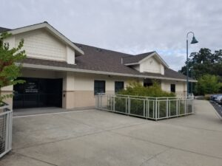
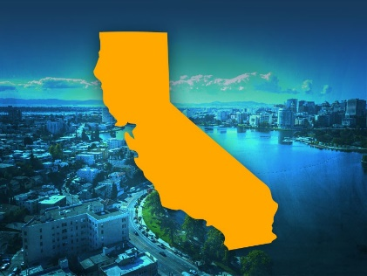
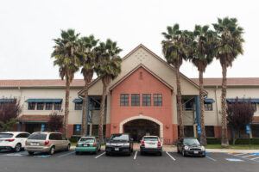
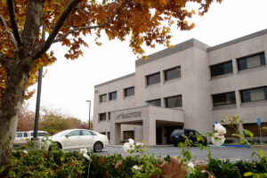
VMRC
Where do we fit into the picture?
Valley Mountain Regional Center (VMRC) is one of 21 regional centers in the state
VMRC serves about 4.5% of the regional center population in California in a 5-county catchment area
We are a non-profit agency operating with state and federal funds

Slide 7
Who Are We?
VMRC serves approximately 16,000 individuals
We serve residents of San Joaquin, Stanislaus, Amador, Calaveras and Tuolumne Counties
Our Purchase of Service (POS) allocation (money) in fiscal year 2019-2020 was $233 million and the amount of money spent to date is $230 million
Offices in Stockton, Modesto and San Andreas with 371 staff

Slide 8
VMRC Staff Ethnicity by Percent FY2019-20

Slide 9
San Joaquin Valley College Graduates
White | 61%
Black or African American | 13%
American Indian and Alaska Native | 1%
Asian | 6%
Native Hawaiian and Other Pacific Islander | .02%
Hispanic or Latino | 19%
Mixed Race | 3%

Slide 10
Total Individuals Served by Diagnosis Fiscal Year 2019-2020, all Ages

Slide 11
Total Individuals Served by Ethnicity or Race Fiscal Year 2019-2020, all Ages

Slide 12
Total Individuals Served by Language Fiscal Year 2019-2020, all Ages

Slide 14
Total Expenditures by Ethnicity or Race Fiscal Year 2019-2020 for all Ages

Slide 16
VMRC Expenditures Per Capita By Diagnosis
Eligible Diagnosis | POS Expenditure Per Person
Autism | $ 8,200
Cerebral Palsy | $ 24,000
Epilepsy | $ 28,000
Intellectual Disability | $ 22,000
Fifth Category | $ 18,000

Slide 19
Total Expenditure Paid by Ethnicity or Race FY 2014-2015 / 2019-2020

Slide 20
Behavioral Management/Intervention
By Ethnicity or Race

Slide 21
Day Program by Ethnicity or Race FY 2014-2015 / 2019-2020

Slide 22
Group Homes by Ethnicity or Race FY 2014-2015 / 2019-2020

Slide 23
Personal Assistance by Ethnicity or Race FY 2014-2015 / 2019-2020

Slide 24
Respite by Ethnicity or Race FY 2014-2015 / 2019-2020

Slide 25
By Age and Ethnicity
Ethnic Group | 00-02 |  | 3 - 4 yro |  | 5-12 yro |  | 13-17
AFRICAN-AMERICAN | 119 | 6% | 82 | 6% | 292 | 8% | 116 | 8%
ASIAN | 94 | 4% | 77 | 6% | 283 | 8% | 99 | 7%
ASIAN INDIAN | 74 | 3% | 52 | 4% | 121 | 3% | 34 | 2%
HISPANIC | 947 | 44% | 588 | 44% | 1,556 | 44% | 685 | 45%
NATIVE AMERICAN | 4 | 0% |  | 0% | 8 | 0% | 4 | 0%
OTHER | 292 | 14% | 175 | 13% | 407 | 12% | 133 | 9%
POLYNESIAN | 5 | 0% | 2 | 0% | 12 | 0% | 2 | 0%
UNKNOWN | 164 | 8% | 61 | 5% | 29 | 1% | 5 | 0%
WHITE | 432 | 20% | 300 | 22% | 830 | 23% | 440 | 29%
Total | 2,131 | 1 | 1,337 |  | 3,538 |  | 1,518
Ethnic Group
AFRICAN-AMERICAN
ASIAN
ASIAN INDIAN
HISPANIC
NATIVE AMERICAN
OTHER
POLYNESIAN
UNKNOWN
WHITE
Total
18-25 |  | 26-40 |  | 41-70 |  | 71-90+ |  | Total
179 | 9% | 298 | 12% | 209 | 9% | 9 | 5% | 1,304 | 8%
168 | 8% | 178 | 7% | 121 | 5% | 5 | 3% | 1,025 | 7%
38 | 2% | 25 | 1% | 13 | 1% |  | 0% | 357 | 2%
779 | 38% | 733 | 30% | 413 | 19% | 38 | 19% | 5,739 | 37%
6 | 0% | 6 | 0% | 15 | 1% | 1 | 1% | 44 | 0%
197 | 10% | 172 | 7% | 93 | 4% | 2 | 1% | 1,471 | 10%
4 | 0% | 7 | 0% | 2 | 0% |  | 0% | 34 | 0%
12 | 1% | 3 | 0% | 4 | 0% |  | 0% | 278 | 2%
683 | 33% | 1,058 | 43% | 1,334 | 61% | 140 | 72% | 5,217 | 34%
2,066 |  | 2,480 |  | 2,204 |  | 195 |  | 15,469 | 100%

Slide 26
What Does This Mean?
Areas of accessibility to services include: Respite, Family Supports, Behavioral Services, Early Start Services
Areas of Service Disparities include: Residential Services, Day Programs, Transportation, Behavioral Management (Non-Family Home), and Supported Living Services
Age appears to be a significant driver of expenditures as well
While 71% identify as either White (34%) or Hispanic (37%) the Hispanic population is on average much younger and disparities trend larger in key areas
Notes:
I need to double check data on highlighted area.

Slide 27
VMRC Activities to Address Disparities
Continue to probe for the answers by analyzing data and offering solutions
VMRC’s 2019-2021 Goals and Strategy Plan for the Cultural Specialist was created to continue collaborating with families and individuals that we serve
Continue collaborating with parent groups to bring accessible training through their preferred language
Consumers and families will continue to receive cultural and linguistic competent information such as Individual Program Plan (IPP) and Individual Family Service Plan (IFSP) in their preferred language

Slide 28
Development of the Cultural & Linguistic Committee (CLC) to further identify barriers and eliminate biases
Introduced Bilingual stipend for staff—48 staff now qualify
Staff training focused on Cultural Competence and knowledge of services
Meeting translation equipment needs and training interpreters in processes
Person-Centered Planning—invested in training all staff and developed four certified trainers to serve consumers and families
Created a Health Advisory to provide current information to the community
Developing information/public service announcements in various languages in lobby areas when public access occurs
Community outreach efforts—Cultural Fair, informational campaigns, COVID testing
Increased consumer contact and Everbridge messaging in preferred language

