Slide 1
2020 Report, Feedback, and Plan of Correction for Non-Compliance of the Required Caseload Ratios
Public Presentation of the Valley Mountain Regional Center Caseload Ratios
By Tony Anderson, Executive Director

Slide 2
VMRC did not meet the required caseload ratios
Consumers enrolled on the Home and Community-Based Services Waiver (The state average is one better than VMRC though we are out of compliance by 14);
Consumers not enrolled on the Home and Community-Based Services Waiver (worse than state average by 5 and out of compliance by 18);
Consumers under the age of three in the early Start program (worse than state average by 16).
We are in compliance for All Complex Needs and Institutional Deflection caseloads - four subcategories (best in the state in all but one category)

Slide 3
DDS Letter. . .
This letter is to notify you that, as specified in WIC section 4640.6, subd. (f), a plan of correction is required since VMRC failed to maintain the required service coordinator caseload ratios for two consecutive reporting periods.
The plan of correction must be developed following input from the state council, local organizations representing consumers, family members, regional center employees, including recognized labor organizations, service providers, and other interested parties.
With the plan of correction, please describe how input was incorporated from interested parties.

Slide 4
Systemic in Nature
As reported in previous years the problem is systemic as the Valley Mountain Regional Center, and our sister regional centers, have inadequate funding to offer a competitive wage to recruit and retain sufficient numbers of Service Coordinators to comply with case load average ratios.
In 2016 we received a significant increase in our funding which has enabled us to get closer to the wages and benefits of our employers in our region that hire social workers such as county government, hospitals and managed care organizations, schools, and community providers.
Since that budget allocation in 2016 we have maintained our Service coordinators starting salaries at $39,728 (about $19.11 an hour) which is still far under the average for our largest county.

Slide 5
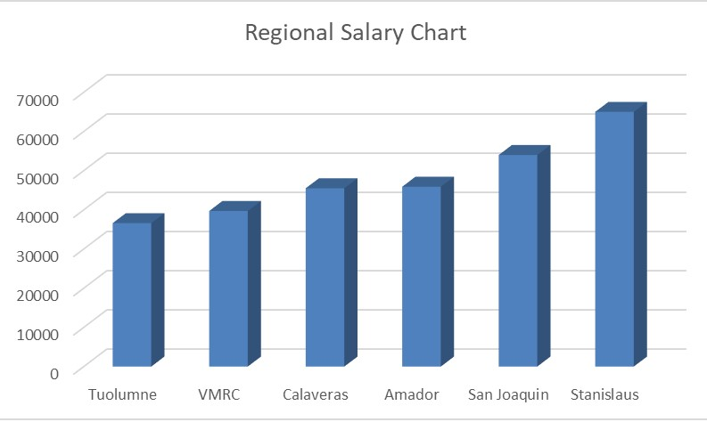
Regional Social Worker Salary Chart
VMRC | San Joaquin | Stanislaus | Amador | Calaveras | Tuolumne
39700 | 54000 | 65000 | 45900 | 45500 | 36600

Slide 6
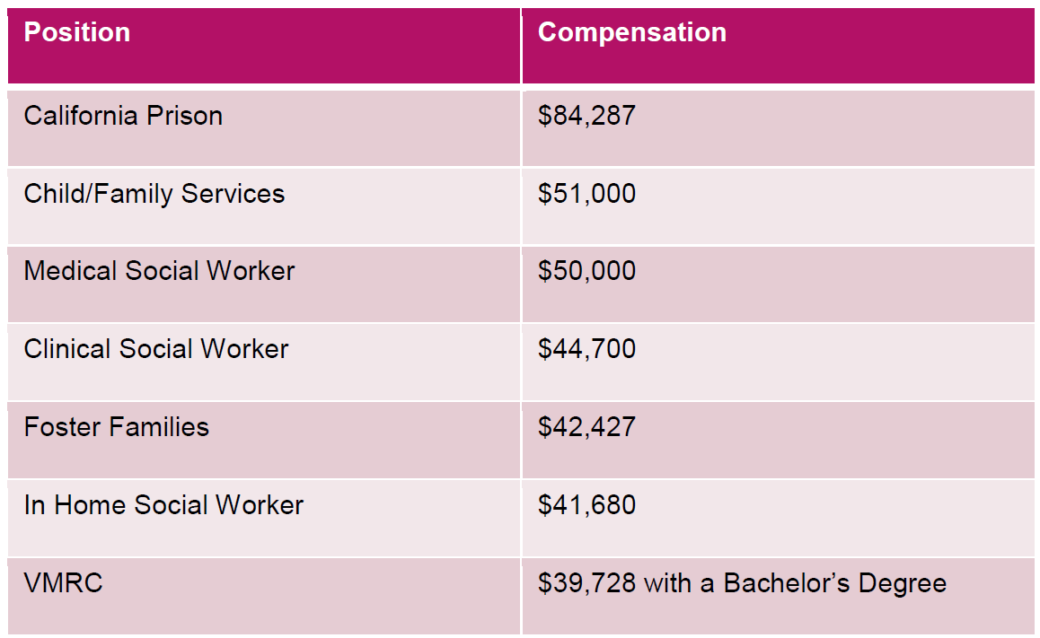
Regional Social Worker Salary Chart

Slide 7
Recruitment Campaigns
In 2017 VMRC employed 319 people and as of today we employ 375 and we had hoped to hire 17 more but we ran out of money. We now have just enough funds to cover our employees we currently have for the year.
In 2018 we completed our two year expansion hiring campaign culminating in the hiring of 25 more case managers.
In 2019 we added five case managers and 1200 new consumers
In 2020 VMRC hired 20 more case managers and backfilled 17 case managers and added a new team.
Every month we report on the caseload status to our Finance and Personnel Committee.
This issue is also discussed at VMRC Board meetings and also reported at several community meetings with parents, vendors and advocates.

Slide 8
Caseload and Consumer Census
In July 2016 we had an average of 1:80, with the same ratio in July 2017, in 2018 our ratio report was at 1:75, in 2019 we were up to 1:79 and as of today we are at 1:82.
On June 1, 2016 VMRC had 12,886 consumers. As of June 1, 2017 VMRC had 13,697 consumers, a difference of 811 consumers in a 1 year period and in 2018 we served 14014 (317 added), in 2019 our census was 14850 (not including intake) and in 2020 our census was 15739 which is an additional 889 .
We have grown 22% percent in our total population of people served we have only added 16% more staff.
Although we have expanded the number of case carrying positions our growth appears to outpace our ability to maintain ratios.

Slide 9
Our Hiring Outcomes
It would take 21 new staff to match our anticipated new census just to keep us in the same size noncompliance that we are in today.

Slide 10
Other Factors Impacting the Ratios
It has been a constant struggle to not only recruit more Service Coordinators, but also to retain them. Our average tenure is up .2% to 9.2 years and our turnover rate for the past year has improved to 8.5% (down from 10.1%).
Last year DDS expanded non-case management staffing resulting in oversight for Enhanced Behavioral Support Homes (BCBA), compliance and disclosures, forensics, family home agency oversight, foster care coordination, etc. but no new targeted funds for Case management
In addition to the internal promotions we have had some staff leaving for a variety of reasons including retirement, aggressive and disrespectful advocacy leading to poor morale and resignations, the need for a better paying job and the need to find a job with less pressure and rigid documentation timelines.

Slide 11
Public Input . . .
My case worker is awesome I don’t feel an impact
We have never had an issue so far in the last 13 years our case worker Benicia Moore was awesome. Just currently with COVID-19 we have not had much communication other than phone calls. I don't know where my son case stands.
Sc are no help at all. They don’t return resident calls the paperwork is always late and they use covid or high case numbers as an excuse. It is useless to have a Sc assigned to a client.
I have had nothing but positive experiences with case management. All of the employees get back to us in a timely manner and are helpful and courteous with any questions that we may have.
High caseload and the constant addition of tasks to the already long list of case management duties, are not only affecting deadlines attainability but also my overall mental health at work and off work.

Slide 12
Public Input . . .
With larger caseloads SC's are very overwhelmed. there are so many that are not caught up on reports or holding meetings that reports are unable to be submitted in a timely manner.
The stress level used to be high when caseloads were in the 70-80 range and now the word "high" does not even come close where stress levels are at now.
So many families are not getting the service that they need/deserve because SC's are required to do an extreme amount of follow up and paperwork with other consumers that things get put on the back burner.
This will lead to negative feedback from families, caregivers, and venders. SC's are very overwhelmed and underpaid. this will lead to high turnover rates and/or lack of motivation to comply with deadlines and productivity.
Since Aaron does not require much, his case management is satisfactory. When I call or text, his case manager takes care of things.
My experience with my son's case manager Casey Robertshaw has been great. She has followed through with all of our ideas and has kept me informed. She attended his IEP meeting in December.
So far our experience has been ok. My cm gets back to me in a timely manner. However there are no check ins or info given about services offered. Eg I have to ask for waiver forms that I only know exist from another parent when I feel my cm should have informed me of them

Slide 13
Ideas . . .
Hold them accountable to serving clients. Give them training on how to do the job effectively and how you with providers. They are not of support to the clients that deserve to be served. One of the biggest complaints from clients and families is Sc and their lack of knowledge and work ethics.
All of your positions require a BA? Why cant that be reached with experience in the field?
With larger caseloads SC's have NO time to be proactive. we barely have time to complete meetings, IPP and quarterly reports on time (or completing 'catch up' tasks) that we have no time to anticipate issues until they are emergencies. this does a large disservice to the consumers and their support team outside VMRC (family or vendors).
Larger caseloads are likely contributing to rapid turnover and burnout in SC's
Lower caseloads or less continuous addition to the tremendous tasks list that I already have.
Larger case caseloads prevent us from giving our families the time each family deserve, plus it makes services instead of supreme with regards to the attention they deserve. The individualized attention is cut short when cases are larger.
Continue to hire as appropriate to maintain the numbers of caseloads at a desired rate.

Slide 14
Ideas . . .
Increase wages and lower caseloads numbers. Individuals with bachelor's degrees are able to get better paying jobs with county programs, school districts, state jobs.
VMRC has a lot of power to help others and employees are so "appreciated" but are very low on the income scale. yeah, VMRC has amazing perks to being an employee, but most people will chase money and are reminded of higher paying jobs with monthly bills.
keeping employees and/or hiring new ones with wages that match perks will keep employment and increase productivity. Not so many will leave VMRC for an increase of wages to support their families.
Personally, i know a lot of people who would make great service coordinators (and would want to be one) but will never apply because the pay is not worth it for them.

Slide 15
Ideas . . .
the Regional Centers need more funds to be able to hire enough staff to actually slim down the caseloads. just filling the open spots does not do enough for the caseload sizes. plus once an employee quits or takes a long term leave the whole team is back in the same position of being more overworked then they are already over worked and overwhelmed.
There needs to also be interns or lower level employees that could assist with mundane tasks that occupy large amount of time but really provide no quality to the case management such as scheduling meetings, entering SIRs (depending on the severity of the issue), and completing most information on the MANY different referral forms.
Also, the process for locating vacancies at care homes is very time consuming and not effective. a better process would greatly cut down on the time this requires. an online portal where care homes could list their vacancies (single, shared room and for which gender) and their acceptance criteria (ages, behaviors, conditions they will work with, amb or non amb) and a way for SCs to submit referrals right there and the care homes are alerted would make things faster than calling and being told the home has no vacancies even though the vacancy list states otherwise. this way the home only adds themselves to the portal when they are ready and willing to take referrals. this would also place more responsibility on the home for communicating with VMRC staff when they have openings so were more aware.

Slide 16
Our Plan for Correction . . .
Our plan is to continue our recruiting efforts to fill backfill vacancies as fast as possible to reduce the burden on case managers who have to cover for uncovered caseloads.
Continue to identify time saving tools for Service Coordinators to meet increasing expectations (resource for telecommuting to reduce travel and other non-direct activities).
Provide training and consistent policy oversight to assure they have the tools and inspiration necessary to be productive, happy, and efficient in their case management duties.
Continue to provide supports to minimize the non-case management core functions (quality assurance, provider development, communications to inform their consumers of resources and events, and remove as many administrative functions as we can).
The VMRC IT Department is looking at several software programs that can assist Service Coordinators in doing their work.
We will also continue to solicit ideas from the community to improve our recruitment and employee retention efforts.
The success of our plan will depend, in large part, on receiving sufficient funding from the DDS to keep our salaries and benefits competitive with other social services agencies in our area.

Slide 17
Public Input . . .
What Do Think?
Any other ideas besides increasing funding?
What’s your experience with high caseloads.

