Slide 1
Early Start Program
Serves infants and toddlers from birth to 36 months of age - services ends on 3rd birthday
Need is established for early intervention services by formal evaluation
To Be eligible a child must meet one of 3 eligibility criteria

Slide 2
Early Start Eligibility
Eligibility Criteria
A child with a 33% or greater delay in at least one area of development (cognitive, social-emotional, adaptive, motor, communication
Established risk condition (diagnosis that can lead to intellectual delay)
High risk criteria – must have at least 2 (factors that can lead to delays in development such as premature birth)
This Photo by Unknown Author is licensed under CC BY-SA

Slide 3
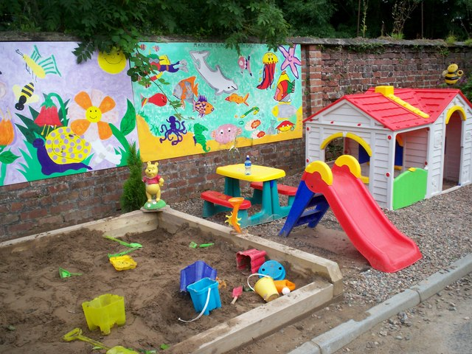
Early start Services
Early start services should be provided in a child’s natural environment
Home
Daycare
Community setting
This Photo by Unknown Author is licensed under CC BY-SA
This Photo by Unknown Author is licensed under CC BY-SA

Slide 4
Early Start Services
Services are based on assessed need and may include
Infant teacher
Speech therapy
Physical therapy
Occupational therapy
Diagnostic Assessments
Services needs must be based on
Professional assessment of the
Child and family priorities for child’s growth and development
This Photo by Unknown Author is licensed under CC BY-NC-ND

Slide 5
Transition From Early Start
27-33 months of age - meeting with family and LEA
Referral to LEA
Eligibility review for Lanterman
3rd birthday End of Early start
This Photo by Unknown Author is licensed under CC BY-SA

