Slide 1
VMRC Case Management
Demographics & Trends
9/26/20

Slide 2
Case Carrying Staff
17 teams—Children (8), Transition,(2) Adult (6), Deflection (1)
Staffing—Program Managers, Senior Service Coordinators, Service Coordinators, OT staff
Caseload Avg.— approximately1:85
Service Coordination —Primary Contact, Facilitate Planning Team, Person-Centered Planning, Ensure Purchase of Service, Provide Information and Resources, Advocate, Collaborate with Community Agencies, Needs Assessment

Slide 3
Caseload Ratios
Caseload Ratios by Team
(as of 3/12/18)
Early Start Teams:
Stockton—N. Gillespie—83
Stockton—T. Simmons—82
Modesto—L. Barr—91
San Andreas—T. Simmons—69
Avg. caseload—81
Children Teams:
SA—988 / 11.5 =86
SD—167 --*Deflection numbers not used in caseload ratio calculation
SG—953 / 12.5 = 76
SN—987 /12 = 82
ST—1,062 / 12.5 = 85
SC—633 / 6.5 = 97
SK—976 / 10.5 = 93
SS—681/ 5.5=124
SY—1,105 /11.5 = 96
AM—944 /13 = 73
MA—911 / 11.5 =79
MG—939 / 13.5=70
MT—816 / 10.5=78
MK—845 / 11.5=73
MY—1,047 / 12.5=84
Caseload Ratio Average: 1:85

Slide 4
Transfer Ins/Transfer Outs
2015—
Files Received—369
Files Sent Out—248
Net Gain—121
2016—
Files Received—392
Files Sent Out—292
Net Gain— 100
2017—
Files Received—390
Files Sent Out—270
Net Gain— 120
2018—
Files Received—465
Files Sent Out—323
Net Gain— 142
2019—
Files Received—416
Files Sent Out—346
Net Gain— 70
2020— through Aug
Files Received—281
Files Sent Out—208
Net Gain— 73
Total: 626 Net Gain Cases

Slide 5
Age and Ethnic Statistics
Ethnic Group | 00-02 |  | 3 - 4 yro |  | 5-12 yro |  | 13-17
AFRICAN-AMERICAN | 119 | 6% | 82 | 6% | 292 | 8% | 116 | 8%
ASIAN | 94 | 4% | 77 | 6% | 283 | 8% | 99 | 7%
ASIAN INDIAN | 74 | 3% | 52 | 4% | 121 | 3% | 34 | 2%
HISPANIC | 947 | 44% | 588 | 44% | 1,556 | 44% | 685 | 45%
NATIVE AMERICAN | 4 | 0% |  | 0% | 8 | 0% | 4 | 0%
OTHER | 292 | 14% | 175 | 13% | 407 | 12% | 133 | 9%
POLYNESIAN | 5 | 0% | 2 | 0% | 12 | 0% | 2 | 0%
UNKNOWN | 164 | 8% | 61 | 5% | 29 | 1% | 5 | 0%
WHITE | 432 | 20% | 300 | 22% | 830 | 23% | 440 | 29%
Total | 2,131 |  | 1,337 |  | 3,538 |  | 1,518
Ethnic Group
AFRICAN-AMERICAN
ASIAN
ASIAN INDIAN
HISPANIC
NATIVE AMERICAN
OTHER
POLYNESIAN
UNKNOWN
WHITE
Total
18-25 |  | 26-40 |  | 41-70 |  | 71-90+ |  | Total
179 | 9% | 298 | 12% | 209 | 9% | 9 | 5% | 1,304 | 8%
168 | 8% | 178 | 7% | 121 | 5% | 5 | 3% | 1,025 | 7%
38 | 2% | 25 | 1% | 13 | 1% |  | 0% | 357 | 2%
779 | 38% | 733 | 30% | 413 | 19% | 38 | 19% | 5,739 | 37%
6 | 0% | 6 | 0% | 15 | 1% | 1 | 1% | 44 | 0%
197 | 10% | 172 | 7% | 93 | 4% | 2 | 1% | 1,471 | 10%
4 | 0% | 7 | 0% | 2 | 0% |  | 0% | 34 | 0%
12 | 1% | 3 | 0% | 4 | 0% |  | 0% | 278 | 2%
683 | 33% | 1,058 | 43% | 1,334 | 61% | 140 | 72% | 5,217 | 34%
2,066 |  | 2,480 |  | 2,204 |  | 195 |  | 15,469 | 100%

Slide 6
County Breakdowns
San Joaquin | 56.8%
Stanislaus | 35.5%
Tuolumne County | 3.1%
Calaveras | 2.1%
Amador | 2.0%
Other | 0.6%

Slide 7
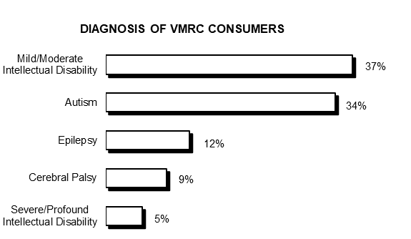
Who We Serve—Dx

Slide 8
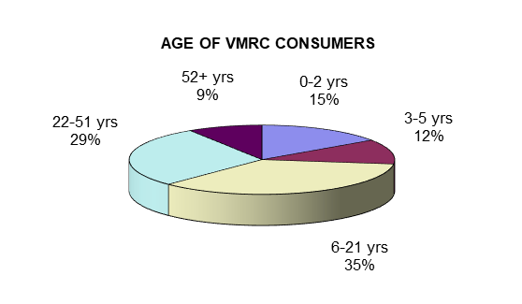
Who We Serve—Age & Gender
64% Male and 36% Female

Slide 9
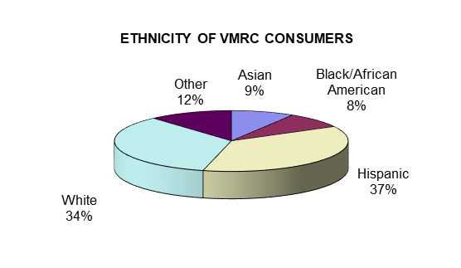
Who We Serve—Ethnicity

Slide 10
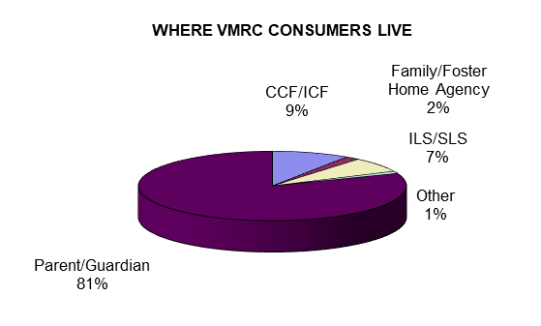
Who We Serve—Residence

Slide 11
Noted Trends in VMRC’s Area
Younger Hispanic Population Growth
Dramatic Rise in Autism Continues
Seeking Services to Match Cultural Values
Aging of Consumers and Caregivers
Lack of Direct Service Staff
Migration to Area Due to Services and Cost of Living
High Cost of Housing and Labor Costs
Rates/Salaries not Competitive
Access to Health Care is Lacking
Expectation and Need for Different Types of Services
Crisis Level Services on the Increase for Younger
Intensive Level of School Placements
COVID Burnout
Need for Mental Health Services

