Slide 1
2019 New laws impacting the Idd community
Valley Mountain Regional Center
Board Legislative Committee
Lynda Mendoza, Chair
NOVEMBER 2019

Slide 2
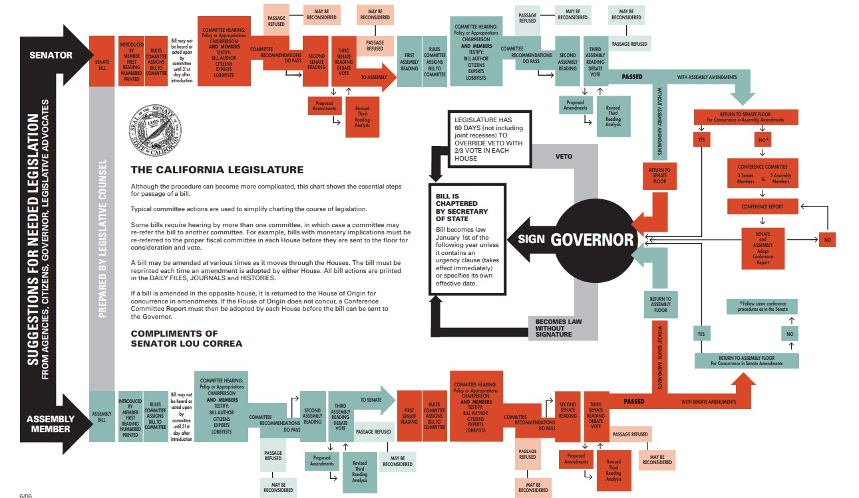
Developmental Services Trailer Bill (TBL) AB 81 (Committee on Budget)
TBL: Assembly Bill 81 is this year’s developmental services “Trailer Bill.” A summary of this year’s TBL is provided here, with reference to the sections of law being changed. All changes will go into effect immediately upon signing by Governor Gavin Newsome (by/before July 1, 2019).
CHAPTERED BILLS - After a bill has been signed by the Governor, the Secretary of State assigns the bill a Chapter Number, for example, “Chapter 123, Statutes of 1998,” which subsequently may be used to refer to the measure.
VETOED BILLS - The formal action of the Governor disapproving a measure by returning it to its House of origin. The Governor’s veto may be overridden by a two-thirds vote of each House. The Governor can also exercise a line-item veto, where the amount of an appropriation is reduced or eliminated, while the rest of the bill is approved. A line-item veto may also be overridden by a two-thirds vote in each House (see Blue Pencil).

Slide 4
Community Safety
CHAPTERED BILLS
AB 189 (Kamlager-Dove D) Child abuse or neglect: mandated reporters: autism service personnel. Support
AB 439 (Stone, Mark D) Juveniles: competency. Support
AB 640 (Frazier D) Sex crimes: investigation and prosecution. Support
SB 338 (Hueso D) Senior and disability victimization: law enforcement policies. Support
SB 735 (Leyva D) Public social services: accommodation: notification. Support

Slide 5
Safety Net and Developmental Centers
TBL
Health and Safety Code (HSC) §1180.4 – Restraints will be limited in Community Crisis Homes.
HSC § 1567.70, Welfare & Institutions Code (W&I) § 4684.82, 4684.87 – The EBSH sunset has been changed from 2020 to 2021.
W&I § 4474.16 – DDS will update its safety net plan by January 10, 2020.
W&I § 4640.6 – Certain consumers must be on caseloads of 1:25.
W&I §§4648, 6500 – Individuals may be placed in IMDs for up to 13 months in certain cases.
W&I § 4696.3 – RCs to notify Clients’ Rights Advocate of psychiatric hold or LPS conservatorship.
W&I §§ 6509, 7505, unknown – Expands time-limited usage of PDC and Canyon Springs for crisis for RC-served individuals and clarifies RC role. Includes funding for PDC acute crisis homes.

Slide 6
Children
Chaptered Bills
AB 781 (Maienschein D) Medi-Cal: family respite care. Support
AB 1004 (McCarty D) Developmental screening services. Support
TBL
HSC § 1567.62 – Time limits for placement of foster children will apply to EBSHs.
HSC § 1567.81, W&I 4698 – Expands Community Crisis Homes to include children.

Slide 7
Civil Rights and Recognitions
Chaptered Bills
ACR 1 (Bonta D) Immigration: public charges. Support
ACR 53 (Grayson D) California Down Syndrome Awareness Week and Day. Support
ACR 58 (Grayson D) Special Olympics Day. Support
AJR 14 (Lackey R) Special Olympics. Support
HR 21 (Frazier D) Relative to Developmental Disabilities Awareness Month. Support
SCR 57 (Hueso D) 50th anniversary of the Special Olympics. Support
Recognition
and
Awareness Bills

Slide 8
Transparency
TBL
W&I § 4434 – DDS to review RC assessment tools; public availability required.
W&I § 4571 – RCs will meet, post, and report on NCI outcomes and next steps.
W&I § 4572 – RCs must post individual dashboards and link to the DDS dashboard for all RCs.
W&I § 4629.5 – RCs must post transportation, personal assistant, SLS, and ILS assessment tools.
W&I § 4639.6 – DDS may issue directives to protect rights, health, safety, or welfare.
W&I § 4640.9 – RCs must give DDS copies of vendor corrective action plans and sanctions.
W&I § 4642 – DDS will develop, and RCs must issue, intake packets for Early Start/Lanterman.
W&I § 4646 – RCs to provide IPP agreement forms for RC and consumer/representative to sign.

Slide 9
Diversity
CHAPTERED BILLS
AB 242 (Kamlager-Dove D) Courts: attorneys: implicit bias: training. Support
SB 160 (Jackson D) Emergency services: cultural competence. Support

Slide 10
Education
CHAPTERED BILLS
AB 605 (Maienschein D) Special education: assistive technology devices. Support
AB 1172 (Frazier D) Special education: nonpublic, nonsectarian schools or agencies. Support if Amended
SJR 8 (Wilk R) Special education funding. Support

Slide 11
Employment
VETOED BILLS
AB 365 (Garcia, Cristina D) State civil service: examination and hiring processes. Support
“Governor's Message: To the Members of the California State Assembly: I am returning Assembly Bill 365 without my signature. Being inclusive and accommodating of people with disabilities is critical to creating a diverse workforce. Assembly Bill 365, however, would make permanent, at a significant cost, a pilot program that is still in need of improvement. Furthermore, this effort can be addressed administratively. As a result, I am directing the Government Operations Agency, in collaboration with CalHR, to ensure that disability policies are included in the newly established Diversity Taskforce. This Taskforce has been created in order to ensure we achieve a state workforce that reflects the Californians we serve. The Taskforce will bring together civil and public servants to improve the State's hiring and retention of persons with disabilities, among other diversity issues. For these reasons, I am unable to sign this bill but remain determined in our efforts to address this important issue. Sincerely, Gavin Newsom.”

Slide 12
Health
CHAPTERED BILLS
AB 744 (Aguiar-Curry D) Health care coverage: telehealth. Support
AB 1128 (Petrie-Norris D) Program of All-Inclusive Care for the Elderly. Support
VETOED BILLS
SB 154 (Pan D) Medi-Cal: restorative dental services. Support
Governor's Message: To the Members of the California State Senate: I am returning Senate Bill 154 without my signature This bill would allow Medi-Cal dental providers to provide and be reimbursed for the application of silver diamine fluoride when used as an arresting agent for cavities on a per-tooth basis to prevent further decay, and under specified conditions. Expanding the options available for treating dental decay is a worthwhile policy goal, but this bill would require significant General Fund spending not included in the state budget. As such, this change should be considered in the annual budget process. Sincerely, Gavin Newsom

Slide 13
Mental Health
CHAPTERED BILLS
SB 389 (Hertzberg D) Mental Health Services Support
VETOED BILLS
SB 10 (Beall D) Mental health services: peer support specialist certification. Support
Governor's Message: To the Members of the California State Senate: I am returning Senate Bill 10 without my signature. This bill would require the Department of Health Care Services (DHCS) to establish a new state certification program for mental health and substance use disorder peer support specialists. Peer support services can play an important role in meeting individuals' behavioral health care needs by pairing those individuals with trained "peers" who offer assistance with navigating local community behavioral health systems and provide needed support. Currently, counties may opt to use peer support services for the delivery of Medicaid specialty mental health services. As the Administration, in partnership with the Legislature and counties, works to transform the state's behavioral health care delivery system, we have an opportunity to more comprehensively include peer support services in these transformation plans. I look forward to working with you on these transformations efforts in the budget process and future legislation, as improving the state of the state's behavioral health system is a critical priority for me. This proposal comes with significant costs that should be considered in the budget process. Sincerely, Gavin Newsom
SB 163 (Portantino D) Health care coverage: pervasive developmental disorder or autism. Concerns
Governor's Message: To the Members of the California State Senate: I am returning Senate Bill 163 without my signature. This bill seeks to change the qualification standards necessary to be a qualified autism service professional or paraprofessional. When the Legislature enacted SB 946 (Steinberg, Chapter 650, Statutes of 2011), it clearly anticipated subsequent action to develop a comprehensive structure to license providers of behavioral health treatment to individuals with autism spectrum disorder. A formal licensing scheme that includes clinical expertise and administrative oversight is a more appropriate venue to address qualification standards for practitioners, ensure quality of care, and provide effective consumer protection. I encourage the Legislature to complete the work begun by SB 946. In addition, by removing the health plan coverage exemption for contracts in the Medi-Cal program, this bill inadvertently creates conflicting requirements within the Medi-Cal program that could result in unintentional delays in access to care and jeopardizes continued receipt of federal financial participation for behavioral health treatment. Sincerely, Gavin Newsom

Slide 14
Housing
CHAPTERED BILLS
SB 329 (Mitchell D) Discrimination: housing: source of income. Support
SB 450 (Umberg D) California Environmental Quality Act exemption: supportive and transitional housing: motel conversion. Support if Amended
VETOED BILLS
SB 611 (Caballero D) Housing: elderly and individuals with disabilities. Support if Amended
Governor's Message: To the Members of the California State Senate: I am returning the following bills without my signature: AB 1382 SB 611 These bills create an aging housing task force and a master plan for aging that focuses on workforce priorities, and require the state to consider applying to join a voluntary network. Earlier this year, I issued Executive Order N-14-19, which directs the Secretary of the Health and Human Services Agency to work with a broad array of stakeholders, including the Legislature, to develop a Master Plan for Aging to serve as a blueprint that can be used by state government, local communities, private organizations and philanthropy to build environments that promote healthy aging. Issues relating to workforce and affordable housing needs, as well as opportunities to engage with other jurisdictions, will be considered as part of this holistic approach to addressing the needs of older Californians. When the Master Plan is completed, I look forward to working with the Legislature to evaluate and implement its recommendations. Sincerely, Gavin Newsom

Slide 15
Board Governance
TBL
W&I § 4622 – RC boards must include financial and governance or management expertise.
W&I § 4622.5 – RC boards not in compliance with composition requirements must submit plan.
W&I § 4625.6 – RC board attorneys cannot be regional center staff.
W&I § 4625.7 – RC boards must meet with DDS upon request.
W&I § 4629 – RC boards must annually meet on performance contract, and plan based on input.

Slide 16
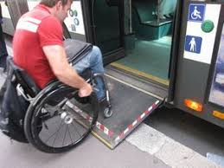
Community Access
Chaptered Bills
AB 169 (Lackey R) Guide, signal, and service dogs: injury or death. Support
AB 426(Maienschein D) In-Home Supportive Services program. Support
AB 439 (Stone, Mark D) Juveniles: competency. Support
AB 497 (Santiago D) Deaf and Disabled Telecommunications Program. Support
AB 737 (Eggman D) Residential care facilities for the elderly: licensing and regulation. Support
AB 1128 (Petrie-Norris D) Program of All-Inclusive Care for the Elderly. Support
AB 1351 (Lackey R) Transit operators: paratransit and dial-a-ride services: assessment. Support
AB 1514 (Patterson R) Deaf and Disabled Telecommunications Program. Support
ACR 59 (Grayson D) Autism: sensory-friendly movie screenings. Support
SB 735 (Leyva D) Public social services: accommodation: notification. Support
SB 744 (Caballero D) Planning and zoning: California Environmental Quality Act: permanent supportive housing. Support
SJR 5 (Beall D) California transportation infrastructure. Support

Slide 17
Systemic Improvement
TBL
W&I § 4519.4 – DDS will consult with stakeholders to “discuss system reforms.” DDS will respond to rate study comments and update the models as needed.
W&I § 4659.1 – RCs payment of copays, coinsurance, and deductibles for all Early Start services.
W&I §4691.12 – Vendor rates to be increased from 1/1/20-12/31/21; extra year if state surplus.
W&I § 4692 – Uniform Holiday Schedule suspended until 12/31/21; extra year if state surplus.

Slide 18
DDS and the Legislature
TBL
W&I § 4474.17 – DDS will brief the Legislature quarterly on community topics beginning in 2020.
W&I § 4519.2 – DDS will identify key regional center indicators. DDS and regional centers will report or post information about HCBS, complaints, appeals, and advocacy assistance.

Slide 19
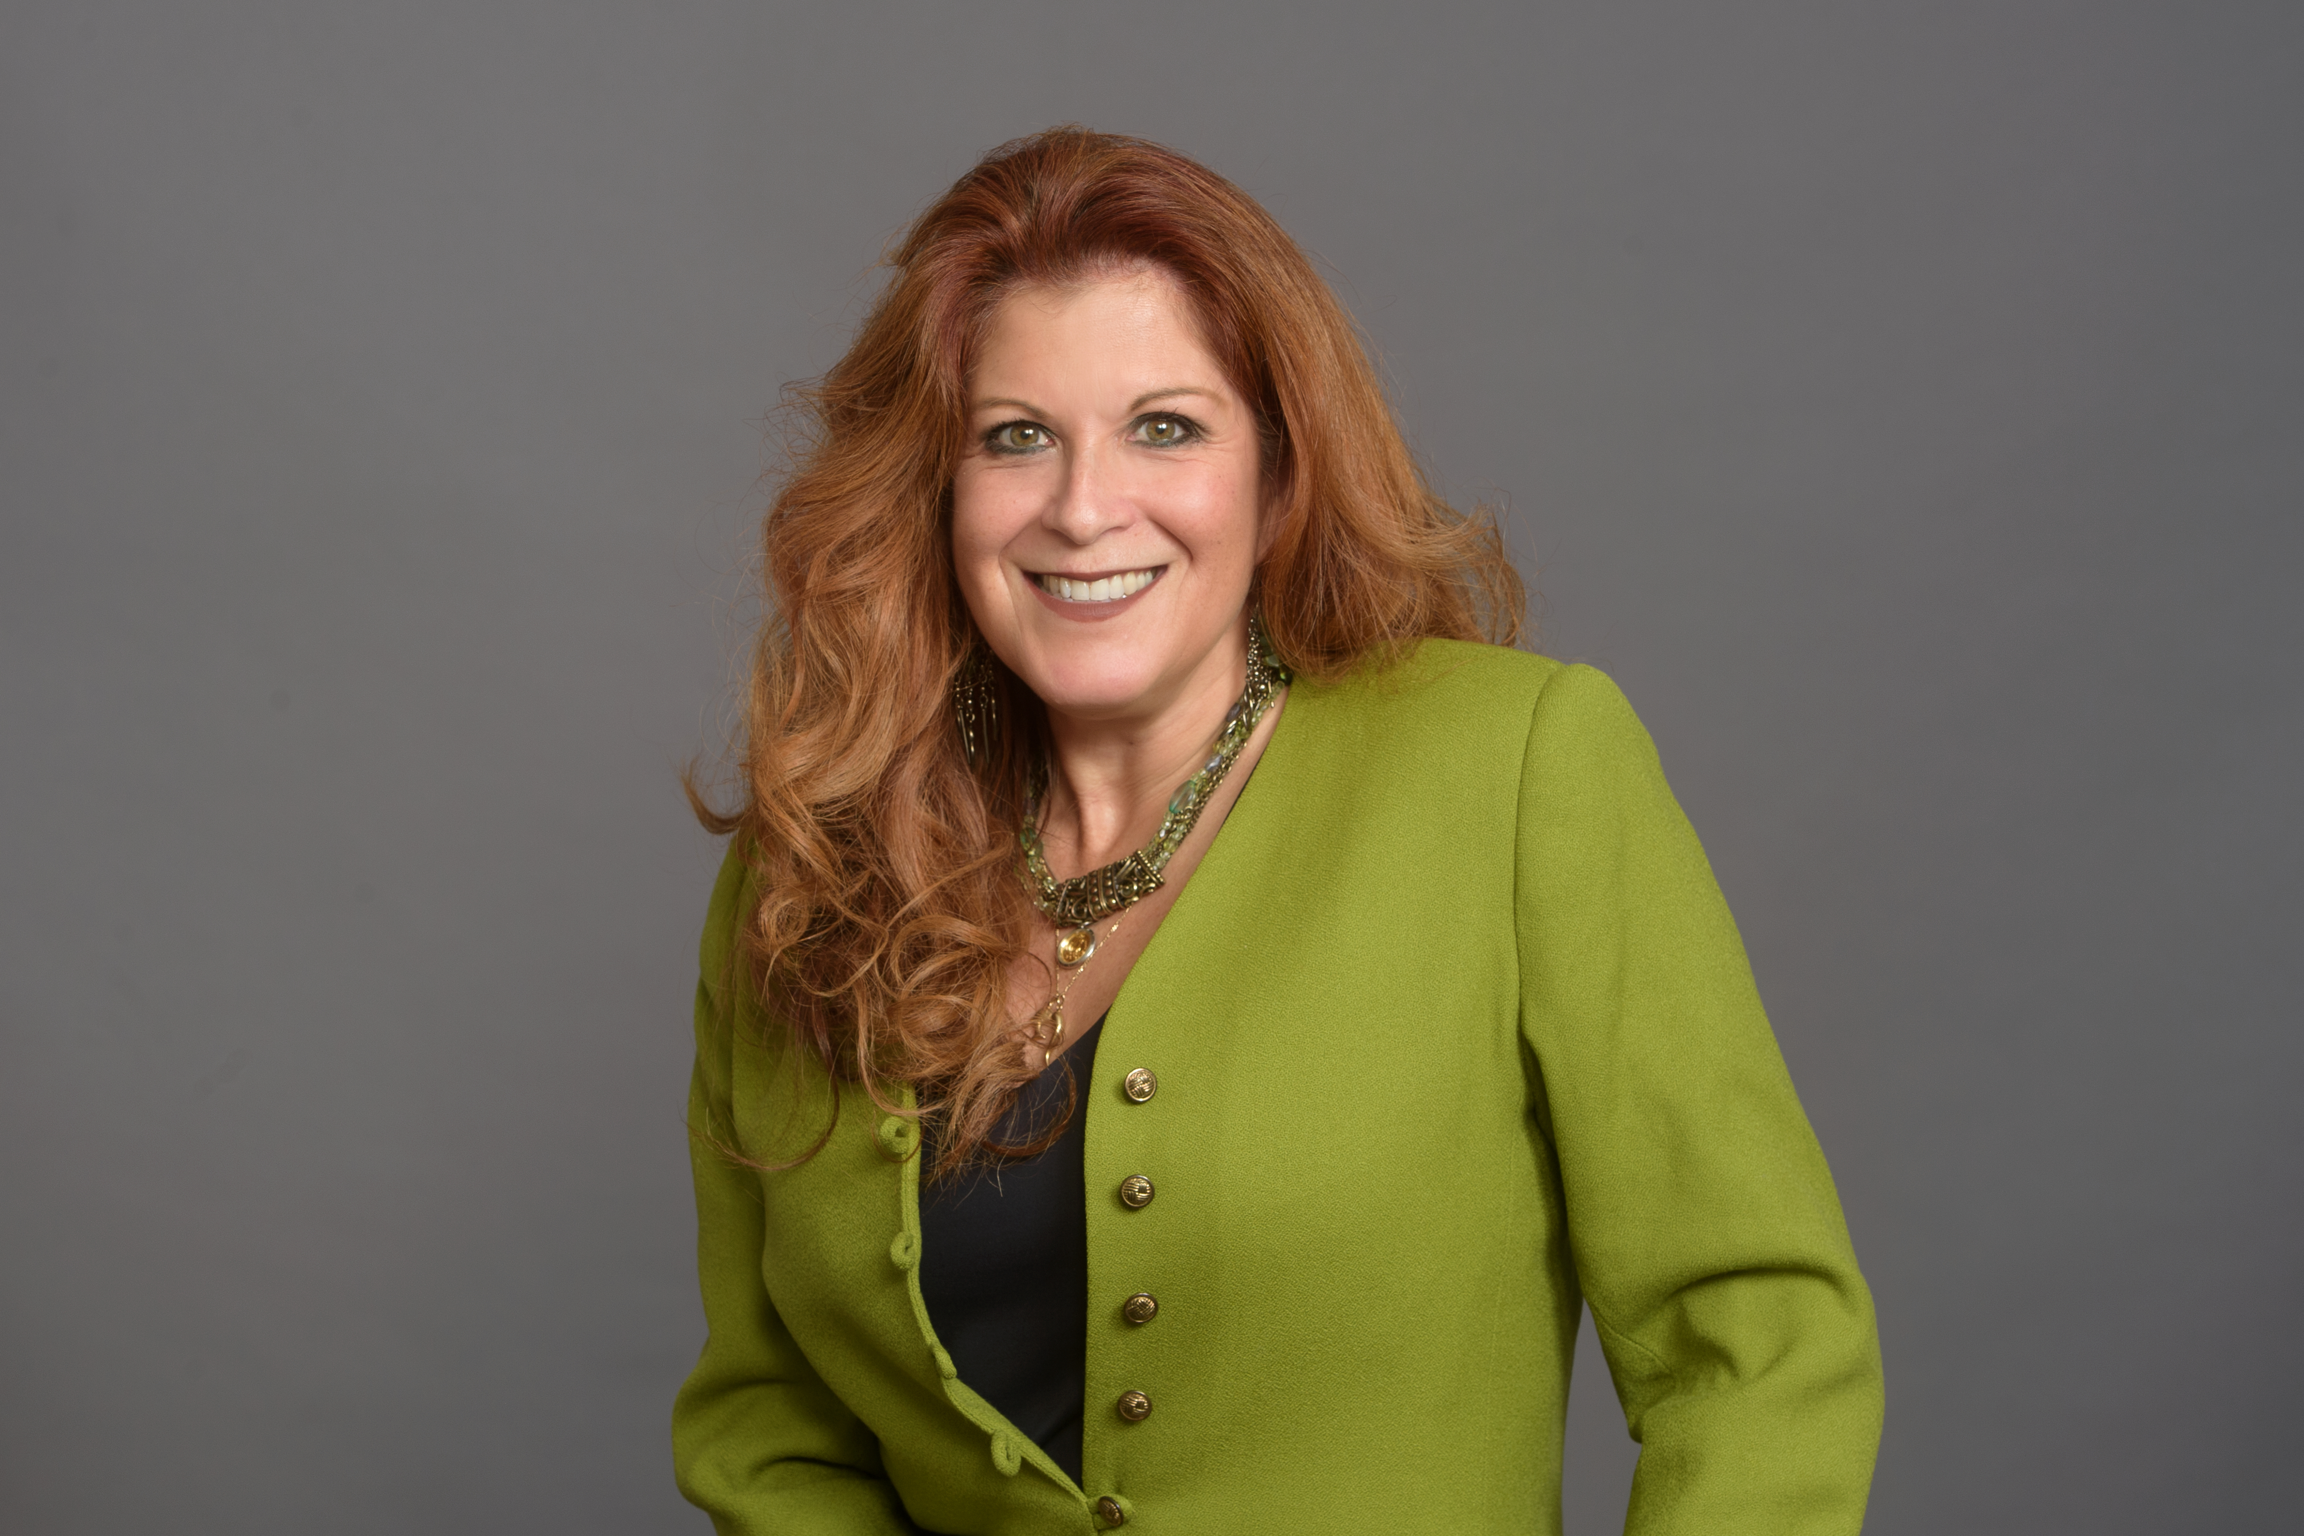
2019 New laws impacting the Idd community Questions
Valley Mountain Regional Center
Board Legislative Committee
Lynda Mendoza, Chair
NOVEMBER 2019

