Slide 1
2019-20 California Budget Overview
Valley Mountain Regional Center Legislative Committee

Slide 2
Topics of Discussion
California Budget Overview and Future Implications
Governor Newsome’s Proposed Spending Plan
Budget Details Impacting I/DD Community & Stakeholders
Department of Developmental Services’ Budget
ARCA Policy & Positions

Slide 3
Legislative Committee Members
Candice Bright, Chairperson (CLASP Representative)
Tom Bowe, VMRC Board President (Ex-officio)
Lynda Mendoza, Board Member
Mohamad Rashid, Board Member
Robert Balderama, Board Member
Dena Hernandez, SCDD North Valley Hills
Daime Hoornaert, CLASP Member
Tony Anderson, VMRC Executive Director
Anthony Hill, VMRC Legal Staff
Angie Shear, VMRC Special Projects Staff

Slide 4
Topics of Discussion
California Budget Overview and Future Implications
Governor Newsome’s Proposed Spending Plan
Budget Details Impacting I/DD Community & Stakeholders
Department of Developmental Services’ Budget
ARCA Policy & Positions

Slide 5
Budget Revenues
Notes:
Personal Income tax account for nearly 70 percent of budget revenue.
Sale tax is the second largest contributor

Slide 6
Budget Allocation
Notes:
Most of the state budget is allocated to education over 52 percent
Health services is about ½ of the allocation for education

Slide 7
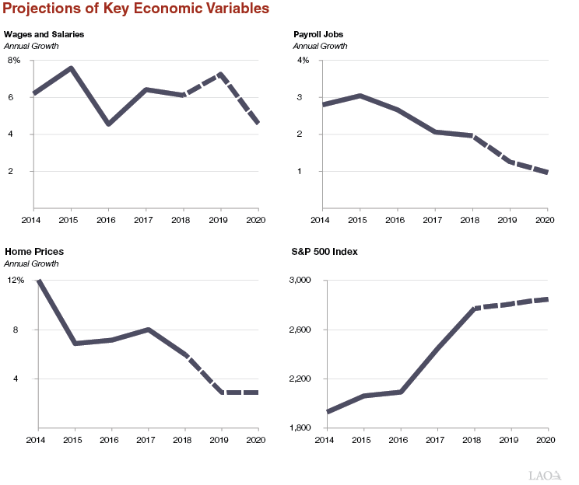
Key Economic Factors
Notes:
Since 2014 Wages and salaries have steadily risen, due to record low unemployment, increase competition between employers seeking workers
In comparison job growth has declined.
Since 2014, Housing growth has declined from 12 percent to below 3 percent
Rapid Growth in Stock Market between 2016- 2018 is leveling off
Recession is always a concern, California must be careful not to take on new commitments.

Slide 8
2019-2020 California Has Record Budget Surplus
Governor Newsome estimates : | $21.4 Billion
Legislative Analyst Office estimates : | $14.5 Billion
Notes:
Largest since 2001-2002 10.3 billion
The next budget year California had a 12.4 billion dollar deficit …… DOT. COM CRASH

Slide 9
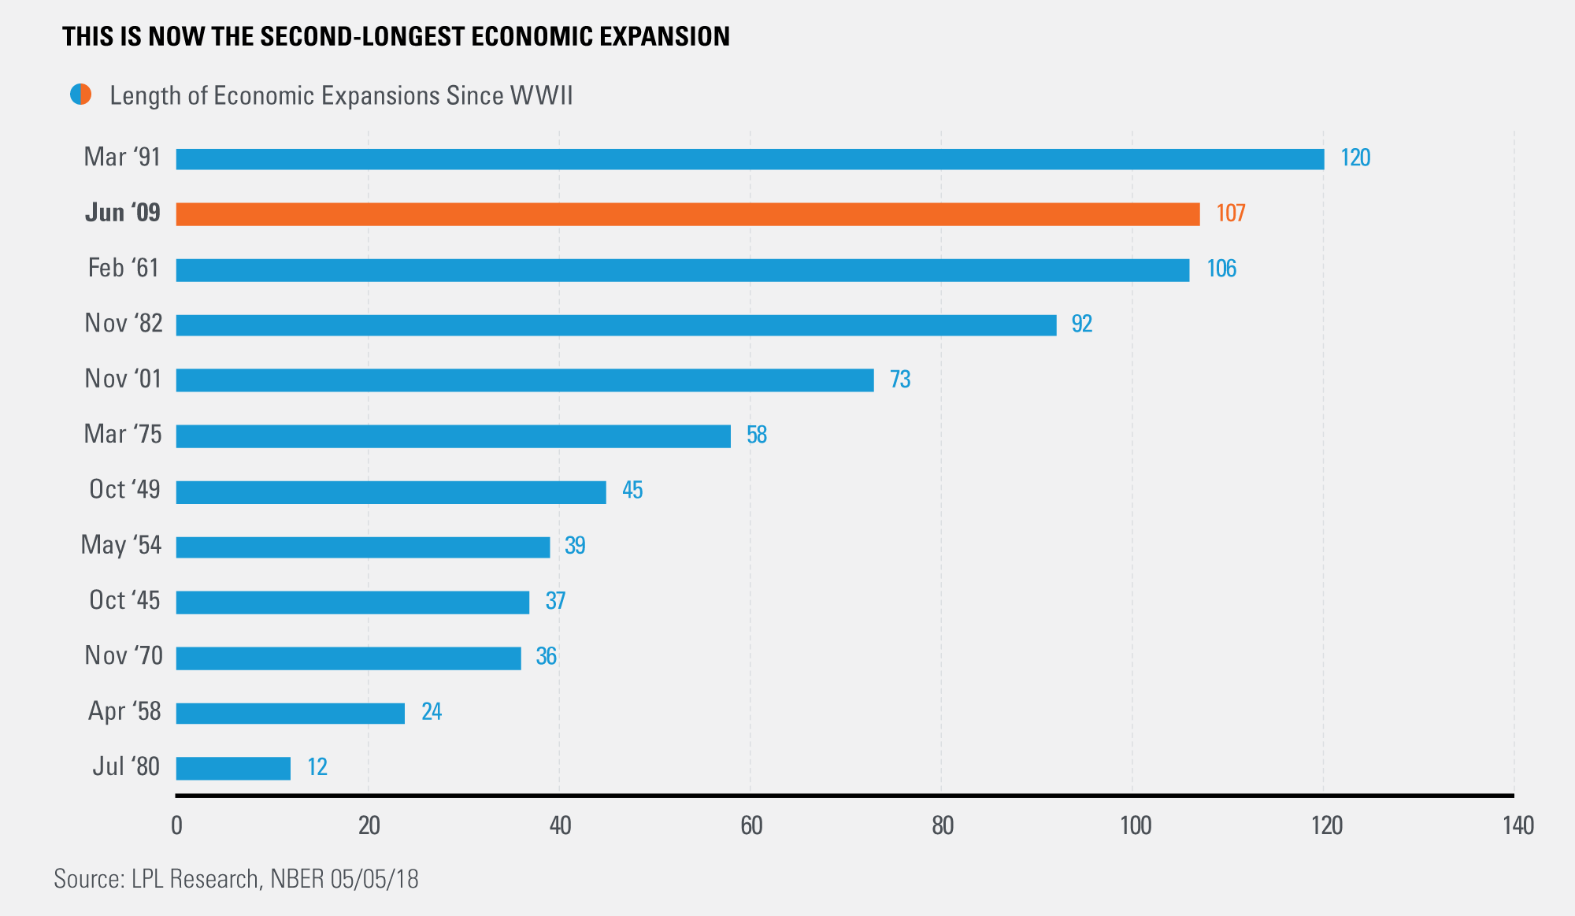
Is a Recession Hiding Around the Corner?
Notes:
We are in the second longest economic expansion, since WWII or over the past 74 years.
WW2 began 1939- ending 1945. Data in this chart reflects 5/5/18. At current we are at 116 months, 9.5 years. ( 5) more months the expansion will surpass the current record of 120 months.

Slide 10
Potential Budgetary Impact During Recession
Notes:
Revenues can drop by 25 Billion dollars. Surpassing the current surplus.

Slide 11
Is California Prepared?
Notes:
This graph assumes California contributes no more than what is required 1.5 percent of general fund revenues and an amount equal to revenues from capital gains related taxes, when such tax revenue is excess 8 percent of general fund revenues. We do not want to tap into reserves, but a severe recession can put great stress on the foundation of California’s budget.

Slide 12
Topics of Discussion
California Budget Overview and Future Implications
Governor Newsome’s Proposed Spending Plan
Budget Details Impacting I/DD Community & Stakeholders
Department of Developmental Services’ Budget
ARCA Policy & Positions

Slide 13
Governor Newsome’s Plan
Notes:
California's booming economy and fiscal stability, gives Governor Newsome the opportunity to propose a budget that has something in it for everyone. Building the foundation for the California dream.

Slide 14
Governor Newsome’s Budget Plan “California For All”
Investments in Building Budget Resiliency
Investments in Emergency Response, Recovery, Preparedness
Investments in Advancing a Prosperous Inclusive Economy
Investment in Modernizing State Government to Meet Current Market Challenges
Investments in Educating and Training California’s Current and Future Workforce
Notes:
Newsome’s proposal includes smart investments to protect our budget, and is forward looking making sure we are prepared for disasters , protecting our small businesses and developing our future workforce.

Slide 15
Investments in Building Budget Resiliency
Notes:
What is the governor’s plan to make the budget foundation strong enough to meet the needs of California during recession?

Slide 16
Investments in Building Budget Resiliency
Notes:
The Governor proposes one-time spending addressing current liabilities, debt and the need to pad reserve accounts. Does any one have any comments about this plan?
4 billion to eliminate debt – transportation accounts, deferrals 4th quarter payments to CalPERS, and June Payroll to the following fiscal year.
4.8 billion for rainy day fund, safety net reserve, special fund for economic uncertainties
4.8 billion to pay down unfunded retirement liabilities, CalPERS and CalSTRS
ADD 13.6 Billion

Slide 17
Investment in Emergency Response, Recovery, & Preparedness ( relief for communities)
Notes:
The governor's believes California can avoid the loss of lives, and reduce direct and indirect expenses involved in dealing with disasters, and recovery efforts afterward.
Currently communities in California are recovering from the impact of wildfires, Chico, and the wildfires in Southern California.
The budget plan includes critical relief for communities struggling to recover
Governor Proposes one time funds to backfill local government for tax losses related to wildfires
Waiving local government share of cost for debris removal related to wildfires
Backfill School reduction in property taxes related to wildfires

Slide 18
Investment in Emergency Response, Recovery,& Preparedness (Prevention/Public Safety)
$50 million grant statewide disaster safety preparedness campaign
$60 million upgrade 911
$13 million to build Earthquake Early Warning Systems
$200 million to augment CALFIRE’s firefighting capabilities
$25 million for pre-positioning local government fire engines
$214 million for increased fire prevention and completion of fuel reduction projects
Notes:
The bulk of the budget plan is intended to improve the emergency response infrastructure on the front end, through public education, improved readiness to respond, upgraded 911, and better coordination of the firefighting capability.

Slide 19
Investments in Advancing a Prosperous & Inclusive Economy
Notes:
Many California’s are feeling the squeeze of stagnant wages, rising cost for housing, health care, childcare, and education

Slide 20
Investments in Advancing a Prosperous & Inclusive Economy
Working Families Tax Credit ($600 million).
Targeted Federal Tax Conformity ($1 billion).
California Community Reinvestment Grants Program ($20 million).
Small Business Technical Assistance Expansion Program ($17 million).
Capital Infusion Program ($3 million).
Notes:
The governor proposes to advance prosperity through the following spending proposals.
600 million working families tax credit can be applied with Earned Income Tax Credit, can be claimed by wage earned and self- employed.
1 billion targeted federal tax conformity, including small business flexibility , capital gains deferral, limitations on fringe benefit deductions, and losses for non- corporate taxpayers
20 million Cannabis Tax, California Reinvestment Grants, intended for mental health treatment, substance abuse treatment, job placement, health and wellness programs for communities disproportionality affected by past federal and state drug policies in California.
17 million Small Business Technical Assistance Expansion Program, provides grants to federally designated non-profit business service providers to provide free or low cost one-on-one consulting and low- cost training to underserved businesses, including women, minorities, and veterans.
3 million capital infusion plan, administered by the Governor’s Office of Business and Economic Development, free one –on –one business consulting

Slide 21
Investments in Modernizing State Government to Meet Current Market Challenges
Notes:
The Governor’s budget states that the state must transform from a passive government model that largely responds to individual statutory and policy mandates to one that establishes measurable customer service benchmarks
The Office of Digital Innovation will have authority to develop and enforce requirements that departments assess their service delivery models and underlying business processes from an end- user perspective. The Office will focus on business process reengineering and leveraging digital innovation
Establish an Innovation Academy

Slide 22
Investments in Modernizing State Government to Meet Current Market Challenges
$36.2 million to establish the Office of Digital Innovation.
$20 million for establishment of Innovation Fund.
$5.8 million for California Highway Patrol to coordinate with DOJ to create task force to reduce organized retail theft.
Notes:
The Office of Digital Innovation will have authority to develop and enforce requirements that state departments implement service delivery models and underlying business processes from an end- user perspective. The Office of Digital Innovation will focus on developing efficient business process and systems and leveraging digital innovation to help state departments better serve the public.
The Authority given to the Office of Digital Innovation is helpful in dealing with pushbacks against the need to change.
5.8 million is intended to get ahead of the rising trend of organized retail theft., losses that cause the rise of insurance cost, and increase of cost of goods.

Slide 23
Investment in Educating and Training California’s Current & Future Workforce
Notes:
The governor believes California needs a workforce today and in the future that is trained, and ready to fuel California’s economy.

Slide 24
Investment in Early Childhood Development
Expands the state’s paid family leave program to cover first six months after birth.
Address barriers to full-day kindergarten ($750 million one-time).
Universal full-day, full year preschool for all income eligible four-year-olds ($124.9 million non-Proposition 98).
Child Savings Account pilot projects that support the development and testing of cost-effective models ($50 million one-time).
Childcare infrastructure, including the education of the childcare workforce (500 million one-time).
Proposition 98 for K-12 schools and community colleges ($80.7 billion).
Proposition 98 to support expanded special education services ( $576 million).
Notes:
In knowing that our children are our future, the Governor’s spending plan invests in our future workforce.

Slide 25
Investments in Higher Learning
Community Colleges, including funding a second year of free Community College education ($402 million ongoing).
California State University for operational costs ($300 million ongoing) with $2 million one-time funding to review potential CSU campus in San Joaquin County.
Expansion of California State University on-campus child care facilities, ( $247 million one-time funding) and $15 million one-time for student hunger and housing initiatives.
University of California for operational costs; student success, and other initiatives ($240 million ongoing) and for deferred maintenance ($138 million one-time).
Grants for higher education institutions serving the Inland Empire and the San Joaquin Valley to implement innovative education strategies that increase postsecondary capacity, reduce achievement gaps ($10 million).
Notes:
To address the need to grow our current workforce, the governor plans to allocating funding for the following:

Slide 26
Investments in Job Training, Apprenticeship
$27 million out of $1 billion in proposed expenditures from the Greenhouse Gas Reduction Fund to increase job training and apprenticeship opportunities within the green economy for workers from disadvantaged communities.
$5.5 million General Fund for a package of programs targeted at improving literacy rates among the offender population. Key elements of the package include a diagnostic remedial reading program, computer-based learning, English as a Second Language courses, teacher mentor program, and literacy coaches.
Notes:
California has implemented regulations and policy to reduce the reliance on businesses that harm our environment. Many of these industries are no longer viable, where many workers have lost their occupation or business. Reducing emission from agriculture equipment, low carbon fuels, energy efficient building materials, the need to rely more on solar energy sources, and renewable energy measures, clean transit systems, low carbon freight and passenger transportation. The Greenhouse Gas Reduction Fund was established in 2012 AB32, though cap-and trade auction proceeds, permits food processors, manufacturers are required to purchase to spew carbon into the environment.

Slide 27
Topics of Discussion
California Budget Overview and Future Implications
Governor Newsome’s Proposed Spending Plan
Budget Details Impacting I/DD Community & Stakeholders
Department of Developmental Services’ Budget
ARCA Policy & Positions

Slide 28
Proposals Impacting Individuals with Developmental Disabilities

Slide 29
Housing Reality of California
Over 50% of California renters pay more than 30% of their income for rent
Notes:
Over 50% of California renters pay more than 30% percent of their income toward for rent , See 2018 Guide to new housing Law – League of California Cities,
Homelessness pervades in both urban and rural committees across the state. Proposition 10- the rent control measure failed. The governor opposed proposition 10.
The Budget includes new spending to address California’s Affordable housing crisis. Many consumers are on SSI or have minimum wage jobs.
The Budget proposes significant investment—$7.7 billion across multiple departments and programs—to address the shortage of affordable housing and support the growing number of homeless and displaced Californians. The budget addresses three aspects of the growing housing crisis: providing shelter, connecting people with necessary social supports, and addressing the severe lack of affordable housing across the state

Slide 30
The Cost of Housing has Outpaced Household Income
Notes:
There is a substantial gap between Median Household rent and Household Income. Rents continue to outpace earnings

Slide 31
Budget Proposals for Affordable Housing
Grants to local communities to build housing and meet higher statewide goals ($750 million):
Community Development (HCD) would develop two new sets of housing production goals: short-term goals and “more ambitious” long-term targets. The budget plan allocates funding to support these changes.
$250 million one-time General Fund for local jurisdictions to develop plans to reach the new short-term goals.
$500 million one-time General Fund as incentive funds, which would be awarded to local jurisdictions as they meet housing production milestones and available to use “for general purposes.”
Notes:
Source Yuba.net, public policy institute of California
Stronger state enforcement of regional housing goals, assure goals are being met.
Funding is allocated to assist local governments in reaching goals, and incentives, for use for “ general purposes.”

Slide 32
Budget Proposals for Affordable Housing (Cont’d)
Expanded loan program to incentivize moderate-income housing development ($500 million).
Proposal to streamline Environmental Control Act, to expedite construction of affordable housing.
Expanded state tax credit program to incentivize low income housing development ( LIHTC, $500 million).
Notes:
Source Yuba.net, public policy institute of California
Expand loan incentives for affordable housing development.
Streamline environmental red tape, slowing down construction of affordable housing units.
Expand tax credits as incentives for development and retention of affordable housing units.

Slide 33
Budget Proposals for Affordable Housing (Cont’d)
One time general fund for local governments to build emergency shelters, navigation centers, and supportive housing for state’s homeless population ($500 million).
General fund ongoing to assist homeless and disabled individuals in applying for disability benefits ($25 million).
Notes:
California accounts for 25 percent of the nations homeless population, at 134,000 on any given night. According to the U.S. Department of Housing and Urban Development, in 2017 26 percent of California’s total homeless population suffered from mental illness, while 18 percent struggled with substance abuse, and 24 percent identified as victims of domestic violence. Navigation centers are short-term respite, not intended to provide long-term housing and is a conduit to connect the homeless population with other services.

Slide 34
Budget Proposals Increases Special Education Funding
More than $576 Million to support expanded Special Education services and school readiness at local education agencies with high percentage of students with disabilities ($186 million of this funding is one time).
Notes:
1975 President Ford passed the IDEA into law, mandating a free appropriate public education for all children with disabilities. IDEA was never fully funding, states continue to absorb the majority of cost. H.R. .2902 IDEA Full Funding Act has not passed. S. 2542 IDEA Full Funding Act has not passed. Has remained in neutral for decades
grants to fund special education and school readiness services not currently included in an individualized education program.
to adopt strategies to improve special education student outcomes identified through the statewide system of support
build upon or expand local multi-tiered systems of support efforts.
to improve coordination between state agencies to better leverage available federal funding for medically related special education costs.

Slide 35
Budget Proposals for Health and Human Services
Notes:
Source Pan_Ethinic Health Network, the budget reflects an estimated decrease in expenditures in the Medi-Cal Program of approximately 2.3 billion over the 2018-2019 budget, lowered than expected Med-Cal caseload and managed care costs.

Slide 36
Budget Proposals for Health Care Funding
$13.2 million Californian’s will receive Medi-Cal services 2019-20 ($100.7 billion).
Budget plan created subsides to reduce cost of health insurance for Californian’s with incomes between 250% and 600 % of the poverty line.
Budget plan creates a state requirement for Californians to carry health insurance or pay a penalty.
Health4All, expands eligibility for comprehensive Medi-Cal coverage for undocumented young adults, ages 19-25 ( $260 million).
New funds for Early Developmental Screening and Trauma Informed Care ($52.5 million).
Budget plan sustains provider payments , supplemental payments and rate increases for doctors, dentists, family planning services, Intermediate Care Facilitates for Developmental Disabled ( $1.05 billion)
Notes:
Governor’ Newsome estimates 6.5 billion dollars savings, as he is anticipated modest Medi-CAL growth. The 6.5 billion is part of the Governor’s estimate of 21.4 billion dollar surplus.
Insurance subsidies are intended to capture people who do not qualify for Medi-Cal, and do not have employment based coverage, and income is to high for low out of pocket cost insurance coverage. Covered California is California’s official health insurance marketplace.
Health4 All currently provides Medi-Cal coverage from birth through 18 for undocumented persons. The Governor's proposal extends Health4All 6 additional years 19-25.
Rate increased for ICFs for developmental disabled, doctors, dentists and family planning services are proposed to continue.
Cal Budget/policy center Pg. 15

Slide 37
Budget Proposals for Health Care Funding (Cont’d)
Prescription Drug Cost – proposes a single payer system, transitioning all pharmacy services for Medi-Cal managed care to a fee- for- service benefit. Administration will seek legislative changes to create bulk purchasing prescription drug program.
$700 million, Increase in Safety Net Reserve fund ( part of $4.8 billion dollar transfer) will be available for CalWORKS and Medi-Cal services and benefits during tough economic times.
Notes:
Cpehn.
org/policy pg. 3

Slide 38
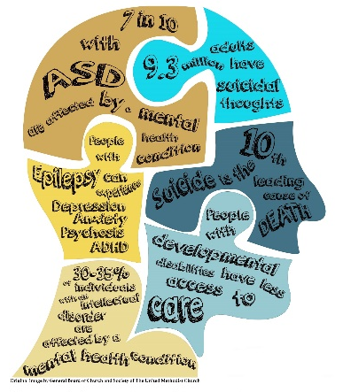
Budget Proposals for Mental Health Services
Mental Health Workforce Investment ($50 million one time funding) to increase training opportunities administered by the Office of Statewide Health Planning and Development.
Early Psychosis Research & Treatment ($25 million).
Whole Person Care ($100 million one time funding) focusing on supportive housing, and coordinating health, behavior health, social services, and care for substance abuse.
No Place Like Home Bond Funding ( $2 billion), expedite services to provide supportive housing for individuals with mental illness, homeless or at risk of homelessness.
Budget proposes changes to 1991 Realignment for County Mental Health increasing FY 2019-20 funding for County mental health program ($70 Million).
Notes:
Cpeh. Early psychosis research and treatment is intended to better detect and intervene when young people have had, or are at high risk of experiencing psychosis.
Whole person care, intended to provide housing and integrated, coordinated service delivery.
No Place Like Home Bond Funding, In November 2018, California voters approved a 2 billion bond program (to be repaid with Mental Services Act revenues for low income housing.
Realignment will increase funding for County mental health programs

Slide 39
Varied Budget Proposals Impacting IDD Community & Stakeholders
IHSS- funding allocation increase from $9.8 billion to $10.9 billion and 10 million funding for Electronic Visit Verification, federal requirement.
SSI/SSP, there is no new increase, but the COLA is restored effective January 1, 2022. FY-19-20 Projects 847,001 disabled recipients.
Department Rehabilitation- increase $5 million and up to $1.5 million additional funding to support information technology upgrades.
Local Law Enforcement Training ( $14.9 million) update, best practices, listening skills, cultural awareness, verbal communication, de-escalation techniques with engaged with person with mental health or homeless issues.
Voluntary taxpayer contribution for Special Olympics is $120,000 in FY 2018-2019 and projected at $250,000 for FY 2019-20.
Budget plan proposes additional ($20) million to support capacity needs of the emergency food delivery system.
Notes:
Cpen.or/policy SSI/SSP is a monthly cash benefit for elderly, blind, or disabled who meet certain income requirements. Grant amount for individuals is $931 monthly and married couples 1,564 monthly, the estimated 2020 federal cola with CPI of 2.5 percent will be passed through to recipients on January 1, 2020.
IHSS is projected to grow 5% percent from 540,078 to 564,330. IHSS is a program designed to meet the in-home care needs of for the elderly, blind and disabled.
Department of rehabilitation is an employment and independent living service resource for people with disabilities, provides vocational assessment and training, job placement, and independent living skills training.
Cpehn.org/policy

Slide 40
Topics of Discussion
California Budget Overview and Future Implications
Governor Newsome’s Proposed Spending Plan
Budget Details Impacting I/DD Community & Stakeholders
Department of Developmental Services’ Budget
ARCA Policy & Positions

Slide 41
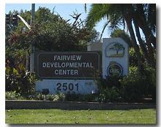
DDS funding is part of the overall budget for Human and Health Services. In addition to the community regional center system, there are two other parts of the DDS budget categories:
Headquarters
Developmental Centers
Notes:
DDS funding is part of the overall budget for Human and Health services, in addition to the community regional center system, there are two other budget categories headquarters and developmental centers.

Slide 42
Headquarter’s Budget Year
Budget year 2019-2020
Headquarter’s Restructure and Reorganization ($ 8.1 million), (54) positions to restructure DDS and realign resource to achieve efficient and effective system wide improvements.
Home and Community Based Assessments ($1.8 million).
Federal Claims Reimbursement System Project ($3.2 million), a multiyear information technology project to replace the legacy federal billing system. This request includes 5.0 position , three-year limited term.
Notes:
The Restructure involves DDS having a office location in Southern California, greater accessibility, with more immediate on the ground
response
Home and Community Based Assessments, for consumers supports FFP
Information technology project supports FFP

Slide 43
Developmental Centers Current Year and Budget Year
Current Year (2018-2019)
Developmental Centers and STAR Home served 514 residents on July 1, 2018, DDS projects a net reduction of 191 residents, with 323 remaining on June 30, 2019.
Governor Newsome proposes a $9.8 million increase to current enacted budget of $394.4 million.
Budget Year (2019-2020)
323 Consumers served in ( 2) developmental centers, (1) state operated community facility, and (4) community based acute crisis homes.
Proposed Budget $309.5 million reflects a net decrease, when compared with current year.
The Governor’s proposal does not include for Capital Outlay funds.
Notes:
A net decrease in population served in developmental centers and STAR Home; Southern Star ( Stabilization, Training, Assistance, and Reintegration) Fairview Developmental Center
Northern STAR ( acute crisis center) home ( Stabilization, Training, Assistance, and Reintegration) , Sonoma Developmental Center ….5 bed, mental health and behavior treatment for severe psychiatric and behavioral conditions in a home like setting. https://www.dds.ca.gov/Sonoma/Programs.cfm
$9.8 million dollar increase in budget, most of the increase is employee related compensation, retirement and pay out balances for separating employees
Budget year decrease mostly due to cost related to the reduction of the population served, current year 514 served, budget year 323 served and supported through operations costs.

Slide 44
Community Regional Center System Current Year and Budget Year
Current Year Budget Changes
356 more Consumers ( Active Status), Total Consumers 345,600
Proposed Adjustment to Budget, (decrease $74.7 million in POS expenditures and $3.2 million decrease in OPS).
Budget Year 2019-20
$7.4 billion for Regional Center system, an increase of $506.2 million.
16,512 more Consumers, or 5 percent as compared with current year.
POS caseload and utilization increased a net of $370.9 million.
Community Care Facilities & Support Services largest expenditure categories.
Notes:
Current Year Changes:
Net Increased by 356 consumers (442 consumers in Active caseload, and a decrease of 86 )
Total budget is now at $6.9 billion (decrease includes a $74.7 million decrease in POS expenditures and a $3.2 million decrease in OPS)
Decrease of $23.6 million ($28.9 million GF) in regional center Operations (OPS) and Purchase of Services (POS) as follows:
OPS decrease of $3.2 million ($27.7 million GF)
POS decrease of $20.4 million ($1.2 million GF)
The decrease in OPS is due to updated caseload and staffing expenditures.
The decrease in POS is primarily attributed to actual expenditures for the January 2018 SB 3 Minimum Wage Increase coming in $89.6 million lower than originally estimated. Estimated expenditures for 2018-19 are $101.2 million.
12,417 active consumers, and 4,095 Early start consumers.

Slide 45
Projected Caseload Growth Early Strat
Notes:
Early start caseload is projected to increase by about 4,095 cases between January 31, 2019 and January 31 ,2020.

Slide 46
Projected Caseload Growth Age 3 & Older
Notes:
Over 3 caseload is projected to increase by 12,417 consumers between January 31, 2019 and January 31, 2020.

Slide 47
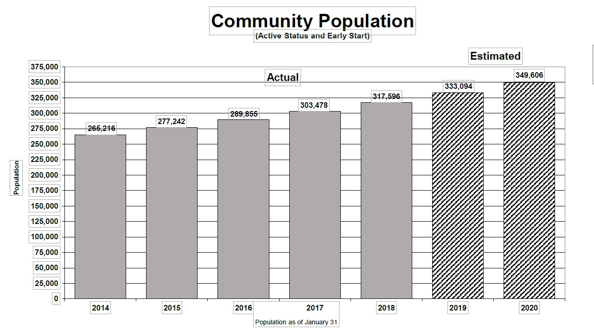
Projected Caseload Over 3 & Early Start
Notes:
Combined case load early start and over 3 is projected to increase between January 2019 and January 2020 by 16, 512 total cases.

Slide 48
DDS Policies that Impact Regional Center OPS Budget FY19/20
Specialized Home Monitoring & Specialized Caseload Ratios
$5.5 million for regional center monitoring ( licensed nurse/behavior specialist) to home ratio 1:4. DDS projects development of 93 Adult Residential Facilities for persons with special health care needs, and 84 Enhanced Behavior support homes and community crisis homes combined in FY 20-19.
$3.8 million to establish 1:25 Service Coordinator to Consumer caseload ratio for high-risk consumers in need of intensive case management and service coordination.
Developmental Center closure/ ongoing workload.
Clinical Staff for Oversight of State Operated Facilities $ 8.3 million for regional center workload associated with Developmental Center closures.
Notes:
Specialized Home Monitoring
Increase of $5.5 million for monitoring of specialized homes by a regional center licensed nurse/behavior specialist-to-home ratio of 1:4. The Department plans to have 93 operational Adult Residential Facilities for Persons with Special Healthcare Needs, and 84 Enhanced Behavioral Supports Homes and Community Crisis Homes combined in 2019-20.
Specialized Caseload Ratios
Increase of $3.8 million ($2.6 million GF) to establish a 1:25 service coordinator-to-consumer caseload ratio for high-risk consumers in need of intensive case management and service coordination for stabilization in the least restrictive setting.
Developmental Center Closure/Ongoing Workload
Clinical Staff for Oversight of State Operated Facilities
Increase of $8.3 million ($3.9 million GF) to continue providing regional center workload associated with the ongoing monitoring and coordination of individuals who transition from Developmental Centers. Funding for Ongoing Workload for the Agnews and Lanterman Developmental Center Closures will be shifted to offset the total costs. The total net impact is$3.0 million.

Slide 49
DDS Policies that Impact Regional Center POS Budget FY19/20
FY 19/20 proposed POS increase ($91.6 million).
Three (3) Community Crisis Homes for children ($4.5 million), regional centers consumers will have access to short-term crisis stabilization services.
Developmental Center Closure, decrease ($21.6 million).
Uniformed Holiday, decrease ($47.8 million).
Increased funding for minimum wage adjustments ($159 million).
Decrease Bridge Funding ($ 42 million) one-time appropriation.
Best Buddies ($1.5 million) ongoing funding.
Notes:
There is a net increase of $91.6 million ($54.8 million GF) as compared to the updated Current Year estimate for the following items:
Impacts from Other Departments,
increase of $39.4 million GF due to reduced cost savings as the transition of responsibility for BHT to DHCS for those enrolled in managed care was completed in the current year. Budget Year cost savings reflect ongoing DHCS reimbursement of BHT services for consumers enrolled in fee-for-service Medi-Cal.
Community Crisis Homes for Children
Increase of $4.5 million GF for a one-time appropriation. Proposed trailer bill language, effective 2019-20, amends Health and Safety Code and the Welfare and Institutions Code to allow community crisis homes to serve children. The crisis homes will provide regional centers with immediate access to short-term stabilization services. The Department plans to develop three community crisis homes at a cost of $1.5 million per home.
Developmental Center Closure
Decrease of $21.6 million ($14.5 million GF decrease) due to the planned closure of the three remaining Developmental Centers.
Uniform Holiday
Decrease of $47.8 million ($28.7 million GF decrease). One-time funding was provided in 2018-19 to delay implementation of the Uniform Holiday Schedule. However, the Department proposes to implement the policy effective July 1, 2019
SB 3 Minimum Wage, January 1, 2019
Increase of $76.0 million ($38.4 million GF) reflects a full-year cost of minimum wage increasing from $11.00 to $12.00 per hour..
SB 3 Minimum Wage, January 1, 2020
Increase of $83.0 million ($41.7 million GF) reflects a half-year cost of minimum wage increasing from $12.00 to $13.00 per hour.
Bridge Funding
Decrease of $42.0 million ($25.0 million GF decrease) for the one-time appropriation.
Best Buddies
The one-time $1.5 million General Fund (GF) provided to Best Buddies International pursuant to the 2018-19 Budget Act is proposed for permanent funding beginning in 2019-20. The funding will support Best Buddies’ delivery of peer-to-peer mentoring and supported employment services throughout the state. Best Buddies will be required to report annually to the Department on the number of consumers served and the types of services provided.

Slide 50
Topics of Discussion
California Budget Overview and Future Implications
Governor Newsome’s Proposed Spending Plan
Budget Details Impacting I/DD Community & Stakeholders
Department of Developmental Services’ Budget
ARCA Policy & Positions

Slide 51
Association of Regional Center Agencies
Who is ARCA?
The Association of Regional Center Agencies (ARCA) represents California’s network of 21 independent, non-profit regional centers that advocate on behalf of and coordinate services for California’s over 346,020 people with developmental disabilities.
The Association also participates in the development of public legislative policy and serves as a focal point for communication, education, training, and prevention services.
Notes:
Number of consumer include early start, over 3, and consumer in developmental centers, through January 2019, according to DDS caseload report dated February 11, 2019.

Slide 52
Association of Regional Center Agencies
Budget Position
Rate Study Implementation
Safety Net Proposals
Uniform Holiday Schedule
Home and Community-Based Services Assessments
FY 2019-20 – Regional Center Quality Assurance and Service Coordination
Specialized Home Monitoring
Specialized Caseload Ratio
DDS Headquarters Enhancements
Headquarters Restructure and Reorganization
Replacement of Federal Billing System
Notes:
Rate Study Implementation
California embarked on a comprehensive study of service provider rates in 2016 that is due to the Legislature in March 2019. Statute requires the study to put forth rate recommendations that take into account sustainability, quality, transparency, an adequate supply of service providers, and methods to incentivize better service outcomes. There is great anticipation the rate study will deliver a roadmap for future service delivery, but also concern that its spring release will leave little time during the FY 2019-20 Budget deliberations for full implementation of its recommendations. Since the commitment to the study was made in 2016, the Consumer Price Index has risen approximately 8% and California’s Wage Index has grown by 12%. In order to prevent interruptions in service delivery that could result from delayed implementation due to ongoing inflationary pressures, ARCA joins other members of the Lanterman Coalition in urging an 8% rate increase for service providers this year as a down payment towards full implementation of the rate study recommendations.
Regional Center Operations
Most funding for regional center Operations is calculated using an antiquated formula based on old assumptions about the staffing needed to carry out the work of a regional center, as well as outdated salary and benefit levels for those positions. Ultimately, the Developmental Services Task Force will be the venue for recommendations related to correcting the overall formula. In the meantime, due to the same inflationary pressures facing service providers, regional centers continue to be unable to meet statutorily-required caseload ratios that are consistent with California’s long-standing commitment to the federal government. Stability for regional centers entails adequate additional funding to meet caseload ratios as well as an 8% down payment for service coordination and other essential supportive services regional centers provide.
FY 2018-19 – Purchase of Service
The Governor’s budget reflects a $74.4 million reduction in POS in FY 2017-18, primarily due to lower-than-expected utilization of funds budgeted for increases in the state minimum wage. Only direct service staff at or below the state minimum wage level were eligible for these increases. Service providers in more than 20 of the highest cost jurisdictions in California are required to pay higher local minimum wages. They are largely ineligible for additional funding that other providers receive when the statewide minimum wage increases because these providers are required by the higher local minimum wage ordinances to pay above statewide minimum wage. For example, service providers with at least 25 staff members in the City of Los Angeles were required to pay at least $12.00 per hour (the current statewide minimum wage) beginning July 2017 and at least $13.25 per hour beginning July 2018. They were last eligible for rate adjustments due to minimum wage increases when it was $11.00 per hour.
ARCA recommends the reduction in POS attributable to lower-than-expected utilization of funds budgeted for increases in the state minimum wage be reappropriated to FY 2019-20. Consistent with the original intent of the funds budgeted for this purpose, ARCA recommends the adoption of trailer bill language to allow those providers with employees earning local minimum wage to be eligible for rate adjustments they would have otherwise received due to increases in the statewide minimum wage if a higher local minimum wage was not in effect.
Safety Net Proposals
Sonoma Developmental Center closed at the end of 2018. Fairview Developmental Center and the General Treatment Area of Porterville Developmental Center are scheduled for closure soon, which will leave very limited capacity in state-operated facilities for people with developmental disabilities. This provides a significant opportunity to strengthen the capacity of the community to better support people who present with the most challenging behavioral and psychiatric support needs, many of whom are children. The closer to an individual’s home community that short-term intensive supports can be provided, the greater the likelihood that in the long-term the person can fully reintegrate with their friends, family, and community. ARCA supports the proposals to establish three Community Crisis Homes (CCHs) for children, as well as three additional Stabilization, Training, Assistance, and Reintegration (STAR) Homes and another Crisis Assessment Stabilization Team.
Uniform Holiday Schedule
ARCA opposes the reinstatement of the Uniform Holiday Schedule, with 14 mandatory statewide furlough days. This policy robs people with developmental disabilities of the consistent support they need to work and achieve independence, while placing additional pressure on their families to fill the gap in services. This amounts to a rate cut for service providers and forces dedicated direct support professionals, many of whom are paid minimum wage, to take unpaid days off. This proposal to implement a Recession-era Budget cut at a time when the state is flush with funds is unreasonable and should be rejected.
Home and Community-Based Services Assessments
Since the signing of the Lanterman Act in the 1960s, regional centers have been focused on providing services to help people with developmental disabilities reach their full potential as members of their communities. Federal policy requiring services be provided in integrated community settings is in alignment with that principle. All states have until March 2022 to evaluate service settings, make necessary modifications, and certify they meet the federal expectation for promoting inclusion. Given the size of California’s service system for people with developmental disabilities, ARCA supports the proposal that would provide DDS with funding to contract for the routine onsite visits necessary to establish federal compliance. The state should, however, remain the decision-maker for broad policy considerations related to overall federal compliance (e.g., determining how to update statutes or regulations that conflict with federal expectations, etc.).
FY 2019-20 – Regional Center Quality Assurance and Service Coordination
Specialized Home Monitoring
As noted above, with the closure of developmental centers and the increased focus on community integration, even for people with the most challenging medical and behavioral support needs, the community safety net continues to strengthen. Adult Residential Facilities for Persons with Special Health Care Needs (ARFPSHNs), in conjunction with Enhanced Behavioral Supports Homes (EBSHs) and CCHs, provide residential options for those with significant ongoing support needs. It is critically important for these homes to have access to intensive clinical support and monitoring provided by regional centers. ARCA supports the proposed long-term funding for regional center nurses and behavioral specialists to carry out these functions.
Specialized Caseload Ratio
ARCA appreciates and supports the proposal to fund nearly 50 positions statewide to meet the intensive service coordination needs, through smaller caseloads, of those individuals with the most complex needs. On a short-term basis, some people require a high level of service coordination time in order to achieve community stability. This proposal would allow regional centers to provide enhanced supports to those most in need of them.
For the larger population they support, regional centers continue to struggle to hire and retain skilled staff, in part because of outdated and insufficient funding formulas, resulting in caseload ratios that are not in legal compliance. One driver of this dynamic is that every new service coordinator position is funded far below the cost of actually employing staff members. With each new position authorized, the gap between budgeted and actual service coordination costs grows. ARCA requests all service coordination positions be funded at the more reasonable salaries ($55,000 per year with no assumed salary savings) and benefit rates (34%) assumed in the specialized caseload ratio policy in the FY 19-20 Governor’s Budget.
DDS Headquarters Enhancements
Headquarters Restructure and Reorganization
California’s developmental services system works through a combination of: 1) Ongoing direct service delivery provided to people with developmental disabilities by service providers; 2) Individual service coordination, clinical support, and local community engagement offered by regional centers; and, 3) DDS support for statewide budgeting, monitoring, and planning. The dramatic decline in developmental center populations provides an opportunity to explore how DDS can better support the 99.8% of people with developmental disabilities who reside in community-based settings today. As investments are needed throughout the developmental services system to improve service delivery, ARCA supports improvements to the efficiency, effectiveness, and support that DDS provides for regional centers only in conjunction with adequate funding for service providers and regional center staff for critical functions related to service coordination, resource development, quality assurance, finance, and risk mitigation.
California’s developmental services system is unique, as it offers a true entitlement to needed services, and also because the system of regional centers was intentionally created to ensure responsiveness to local needs and priorities through independent nonprofits. Any efforts to refine California’s system of service delivery should stay true to these fundamental tenets.
Replacement of Federal Billing System
California’s system of service delivery to people with developmental disabilities relies on nearly $3 billion in federal funding, most of which must be billed for discreet services provided to specific individuals. Given the age of DDS’s electronic federal billing system and the potential interruption in funding if it fails, ARCA supports the proposal to work towards eventually replacing this legacy accounting system.

Slide 53
Association of Regional Center Agencies: Rate Study Implementation
Study began in 2016 and is due to the Legislature in March 2019.
The study must make rate recommendations related to sustainability, quality, transparency, achieve an adequate supply of service providers, and methods to incentivize better service outcomes.
We want a roadmap for success but concerned there’s not enough time for full implementation of its recommendations.
The Consumer Price Index has risen approximately 8% and California’s Wage Index has grown by 12% since the study began.
ARCA joins other members of the Lanterman Coalition in urging an 8% rate increase for service
Notes:
California embarked on a comprehensive study of service provider rates in 2016 that is due to the Legislature in March 2019.
Statute requires the study to put forth rate recommendations that take into account sustainability, quality, transparency, an adequate supply of service providers, and methods to incentivize better service outcomes.
There is great anticipation the rate study will deliver a roadmap for future service delivery, but also concern that its spring release will leave little time during the FY 2019-20 Budget deliberations for full implementation of its recommendations.
Since the commitment to the study was made in 2016, the Consumer Price Index has risen approximately 8% and California’s Wage Index has grown by 12%.
In order to prevent interruptions in service delivery that could result from delayed implementation due to ongoing inflationary pressures, ARCA joins other members of the Lanterman Coalition in urging an 8% rate increase for service providers this year as a down payment towards full implementation of the rate study recommendations.

Slide 54
Association of Regional Center Agencies: Rate of Day program Closures
Notes:
there was a significant decrease in Day/Work Program closures between Fiscal Years 2015-2016 and 2016-2017. However, the closures and loss of program slots again increased in FY2017-18, which resulted in people waiting for services. This is largely due to economic changes since 2016, including an 8% increase in the consumer price index and a ~12% increase in California’s wage index.

Slide 55
Association of Regional Center Agencies: Regional Center Operations
Funding for regional center Operations is calculated using an antiquated that has outdated salary and benefit levels for those positions.
The DS Task Force will be the venue for recommendations related to correcting the overall formula.
Regional centers continue to be unable to meet statutorily-required caseload ratios .
ARCA joins other members of the Lanterman Coalition in urging an 8% rate increase for service coordination
Notes:
Regional Center Operations
Most funding for regional center Operations is calculated using an antiquated formula based on old assumptions about the staffing needed to carry out the work of a regional center, as well as outdated salary and benefit levels for those positions. Ultimately, the Developmental Services Task Force will be the venue for recommendations related to correcting the overall formula. In the meantime, due to the same inflationary pressures facing service providers, regional centers continue to be unable to meet statutorily-required caseload ratios that are consistent with California’s long-standing commitment to the federal government. Stability for regional centers entails adequate additional funding to meet caseload ratios as well as an 8% down payment for service coordination and other essential supportive services regional centers provide.

Slide 56
Association of Regional Center Agencies: FY 2018-19 – Purchase of Service
The proposal is to reduce the CY budget by $74.4 because of lower-than-expected utilization of funds budgeted for increases in the state minimum wage.
Only direct service staff at or below the state minimum wage level were eligible for these increases. Service providers in more than 20 of the highest cost jurisdictions in California are required to pay higher local minimum wages.
They are largely ineligible for additional funding that other providers receive when the statewide minimum wage increases because these providers are required by the higher local minimum wage ordinances to pay above statewide minimum wage.
ARCA recommends moving the unspent funds to this BY budget and allow those providers with employees earning local minimum wage to be eligible for rate adjustments they would have otherwise received due to increases in the statewide minimum wage if a higher local minimum wage was not in effect.
Notes:
FY 2018-19 – Purchase of Service
The Governor’s budget reflects a $74.4 million reduction in POS in FY 2017-18, primarily due to lower-than-expected utilization of funds budgeted for increases in the state minimum wage. Only direct service staff at or below the state minimum wage level were eligible for these increases. Service providers in more than 20 of the highest cost jurisdictions in California are required to pay higher local minimum wages. They are largely ineligible for additional funding that other providers receive when the statewide minimum wage increases because these providers are required by the higher local minimum wage ordinances to pay above statewide minimum wage. For example, service providers with at least 25 staff members in the City of Los Angeles were required to pay at least $12.00 per hour (the current statewide minimum wage) beginning July 2017 and at least $13.25 per hour beginning July 2018. They were last eligible for rate adjustments due to minimum wage increases when it was $11.00 per hour.
ARCA recommends the reduction in POS attributable to lower-than-expected utilization of funds budgeted for increases in the state minimum wage be reappropriated to FY 2019-20. Consistent with the original intent of the funds budgeted for this purpose, ARCA recommends the adoption of trailer bill language to allow those providers with employees earning local minimum wage to be eligible for rate adjustments they would have otherwise received due to increases in the statewide minimum wage if a higher local minimum wage was not in effect.

Slide 57
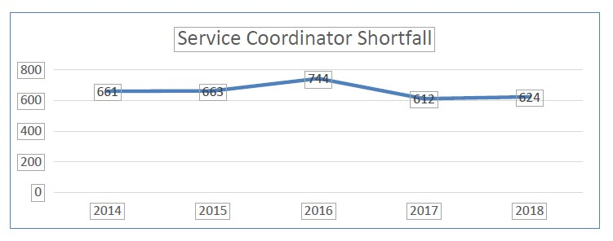
Association of Regional Center Agencies: Rate of Day program Closures
Notes:
The core direct service of regional centers (RCs) is service coordination, which serves as a constant in people’s lives and provides ongoing guidance to them and their families in setting goals and accessing services. Out-dated funding formulas mean RCs receive only 60% of the funding needed for each new service coordinator position.
The path forward for addressing this complex problem is the Developmental Services Task Force. But until their recommendations can be shaped and implemented, regional centers need a minimum of an 8% down payment for service coordination and other essential supportive services, to make up for inflationary losses.

Slide 58
Association of Regional Center Agencies: Safety Net Proposals
Sonoma Developmental Center closed at the end of 2018. Fairview Developmental Center and the General Treatment Area of Porterville Developmental Center are scheduled for closure soon, which will leave very limited capacity in state-operated facilities for people with developmental disabilities.
This provides a significant opportunity to strengthen the capacity of the community to better support people who present with the most challenging behavioral and psychiatric support needs, many of whom are children.
The closer to an individual’s home community that short-term intensive supports can be provided, the greater the likelihood that in the long-term the person can fully reintegrate with their friends, family, and community.
ARCA supports the proposals to establish three Community Crisis Homes (CCHs) for children, as well as three additional Stabilization, Training, Assistance, and Reintegration (STAR) Homes and another Crisis Assessment Stabilization Team.
Notes:
Safety Net Proposals
Sonoma Developmental Center closed at the end of 2018. Fairview Developmental Center and the General Treatment Area of Porterville Developmental Center are scheduled for closure soon, which will leave very limited capacity in state-operated facilities for people with developmental disabilities.
This provides a significant opportunity to strengthen the capacity of the community to better support people who present with the most challenging behavioral and psychiatric support needs, many of whom are children.
The closer to an individual’s home community that short-term intensive supports can be provided, the greater the likelihood that in the long-term the person can fully reintegrate with their friends, family, and community.
ARCA supports the proposals to establish three Community Crisis Homes (CCHs) for children, as well as three additional Stabilization, Training, Assistance, and Reintegration (STAR) Homes and another Crisis Assessment Stabilization Team.

Slide 59
Association of Regional Center Agencies: Uniform Holiday Schedule
ARCA opposes the reinstatement of the Uniform Holiday Schedule, with 14 mandatory statewide furlough days.
This policy robs people with developmental disabilities of the consistent support they need to work and achieve independence, while placing additional pressure on their families to fill the gap in services.
This amounts to a rate cut for service providers and forces dedicated direct support professionals, many of whom are paid minimum wage, to take unpaid days off. This proposal to implement a Recession-era Budget cut at a time when the state is flush with funds is unreasonable and should be rejected.
Notes:
Uniform Holiday Schedule
ARCA opposes the reinstatement of the Uniform Holiday Schedule, with 14 mandatory statewide furlough days. This policy robs people with developmental disabilities of the consistent support they need to work and achieve independence, while placing additional pressure on their families to fill the gap in services. This amounts to a rate cut for service providers and forces dedicated direct support professionals, many of whom are paid minimum wage, to take unpaid days off. This proposal to implement a Recession-era Budget cut at a time when the state is flush with funds is unreasonable and should be rejected.
ARCA supports the proposals to establish three Community Crisis Homes (CCHs) for children, as well as three additional Stabilization, Training, Assistance, and Reintegration (STAR) Homes and another Crisis Assessment Stabilization Team.

Slide 60
Association of Regional Center Agencies: Home and Community-Based Services Assessments
Regional centers are focused on providing services to help people with developmental disabilities reach their full potential as members of their communities. Federal policy requiring services be provided in integrated community settings is in alignment with that principle.
All states have until March 2022 to evaluate service settings, make necessary modifications, and certify they meet the federal expectation for promoting inclusion.
Given the size of California’s service system for people with developmental disabilities, ARCA supports the proposal that would provide DDS with funding to contract for the routine onsite visits necessary to establish federal compliance.
However DDS should remain the decision-maker for broad policy considerations related to overall federal compliance.
Notes:
Home and Community-Based Services Assessments
Since the signing of the Lanterman Act in the 1960s, regional centers have been focused on providing services to help people with developmental disabilities reach their full potential as members of their communities.
Federal policy requiring services be provided in integrated community settings is in alignment with that principle. All states have until March 2022 to evaluate service settings, make necessary modifications, and certify they meet the federal expectation for promoting inclusion.
Given the size of California’s service system for people with developmental disabilities, ARCA supports the proposal that would provide DDS with funding to contract for the routine onsite visits necessary to establish federal compliance.
The state should, however, remain the decision-maker for broad policy considerations related to overall federal compliance (e.g., determining how to update statutes or regulations that conflict with federal expectations, etc.).

Slide 61
Association of Regional Center Agencies: FY 2019-20 – Regional Center Quality Assurance and Service Coordination - Specialized Home Monitoring
…even for people with the most challenging medical and behavioral support needs, the community safety net continues to strengthen.
Adult Residential Facilities for Persons with Special Health Care Needs (ARFPSHNs), in conjunction with Enhanced Behavioral Supports Homes (EBSHs) and CCHs, provide residential options for those with significant ongoing support needs.
It is critically important for these homes to have access to intensive clinical support and monitoring provided by regional centers. ARCA supports the proposed long-term funding for regional center nurses and behavioral specialists to carry out these functions.
Notes:
FY 2019-20 – Regional Center Quality Assurance and Service Coordination - Specialized Home Monitoring
As noted above, with the closure of developmental centers and the increased focus on community integration, even for people with the most challenging medical and behavioral support needs, the community safety net continues to strengthen. Adult Residential Facilities for Persons with Special Health Care Needs (ARFPSHNs), in conjunction with Enhanced Behavioral Supports Homes (EBSHs) and CCHs, provide residential options for those with significant ongoing support needs. It is critically important for these homes to have access to intensive clinical support and monitoring provided by regional centers. ARCA supports the proposed long-term funding for regional center nurses and behavioral specialists to carry out these functions.

Slide 62
Association of Regional Center Agencies: FY 2019-20 – Regional Center Quality Assurance and Service Coordination - Specialized Caseload Ratio
This proposal adds nearly 50 positions statewide
This proposal would allow regional centers to provide enhanced supports to those most in need of them.
Regional centers continue to struggle to hire and retain staff, in part because of outdated and insufficient funding formulas.
With each new position authorized, the gap between budgeted and actual service coordination costs grows.
ARCA requests all service coordination positions be funded at the more reasonable salaries ($55,000 per year with no assumed salary savings) and benefit rates (34%) assumed in the specialized caseload ratio policy in the FY 19-20 Governor’s Budget.
Notes:
FY 2019-20 – Regional Center Quality Assurance and Service Coordination - Specialized Caseload Ratio
ARCA appreciates and supports the proposal to fund nearly 50 positions statewide to meet the intensive service coordination needs, through smaller caseloads, of those individuals with the most complex needs. On a short-term basis, some people require a high level of service coordination time in order to achieve community stability. This proposal would allow regional centers to provide enhanced supports to those most in need of them.
For the larger population they support, regional centers continue to struggle to hire and retain skilled staff, in part because of outdated and insufficient funding formulas, resulting in caseload ratios that are not in legal compliance. One driver of this dynamic is that every new service coordinator position is funded far below the cost of actually employing staff members. With each new position authorized, the gap between budgeted and actual service coordination costs grows. ARCA requests all service coordination positions be funded at the more reasonable salaries ($55,000 per year with no assumed salary savings) and benefit rates (34%) assumed in the specialized caseload ratio policy in the FY 19-20 Governor’s Budget.

Slide 63
Association of Regional Center Agencies: DDS Headquarters Enhancements: Headquarters Restructure and Reorganization
Our system combines ongoing direct service delivery, service coordination, clinical support, and local community engagement, and support for statewide budgeting, monitoring, and planning.
This is the time to explore how DDS can better support the 99.8% of people with IDD in community-based settings today.
ARCA supports improvements to the efficiency, effectiveness, and support that DDS provides for regional centers only in conjunction with adequate funding for service providers and regional center staff for critical functions related to service coordination, resource development, quality assurance, finance, and risk mitigation. Any efforts to refine California’s system of service delivery should ensure responsiveness to local needs and priorities through independent nonprofit regional centers.
Notes:
DDS Headquarters Enhancements
Headquarters Restructure and Reorganization
California’s developmental services system works through a combination of: 1) Ongoing direct service delivery provided to people with developmental disabilities by service providers; 2) Individual service coordination, clinical support, and local community engagement offered by regional centers; and, 3) DDS support for statewide budgeting, monitoring, and planning. The dramatic decline in developmental center populations provides an opportunity to explore how DDS can better support the 99.8% of people with developmental disabilities who reside in community-based settings today. As investments are needed throughout the developmental services system to improve service delivery, ARCA supports improvements to the efficiency, effectiveness, and support that DDS provides for regional centers only in conjunction with adequate funding for service providers and regional center staff for critical functions related to service coordination, resource development, quality assurance, finance, and risk mitigation.
California’s developmental services system is unique, as it offers a true entitlement to needed services, and also because the system of regional centers was intentionally created to ensure responsiveness to local needs and priorities through independent nonprofits. Any efforts to refine California’s system of service delivery should stay true to these fundamental tenets.

Slide 64
Association of Regional Center Agencies: DDS Headquarters Enhancements: Replacement of Federal Billing System
California’s system of service delivery to people with developmental disabilities relies on nearly $3 billion in federal funding, most of which must be billed for discreet services provided to specific individuals.
Given the age of DDS’s electronic federal billing system and the potential interruption in funding if it fails, ARCA supports the proposal to work towards eventually replacing this legacy accounting system.
Notes:
DDS Headquarters Enhancements - Replacement of Federal Billing System
California’s system of service delivery to people with developmental disabilities relies on nearly $3 billion in federal funding, most of which must be billed for discreet services provided to specific individuals. Given the age of DDS’s electronic federal billing system and the potential interruption in funding if it fails, ARCA supports the proposal to work towards eventually replacing this legacy accounting system.

Slide 65
Thank You!

