Slide 1
Introduction to the Regional Center System
Oral Health for People with Developmental Disabilities
September 29, 2018
Tony Anderson
Executive Director
Valley Mountain Regional Center

Slide 2
A Brief History of the Regional Centers
Before mid-1960’s
    Institutional Care (turn away and don’t look back)
    Few Local Services
Piloting of Regional Centers—1965 (Gov.Pat Brown)
    Lanterman Regional Center (Southern California) and
    The Arc San Francisco - to become known as Golden Gate Regional Center
Lanterman Developmental Disabilities Act—1967, and 1969 (Gov Ronald Reagan)
    Statewide Regional Center System Established
    21 Regional Centers, each one covering a different geographic region. The centers are the first stop for persons with developmental disabilities and their families seeking help to obtain local supports and services.
State of California Supreme Court 1984 ARC v DDS
    Entitlement: Right to Supports

Slide 3
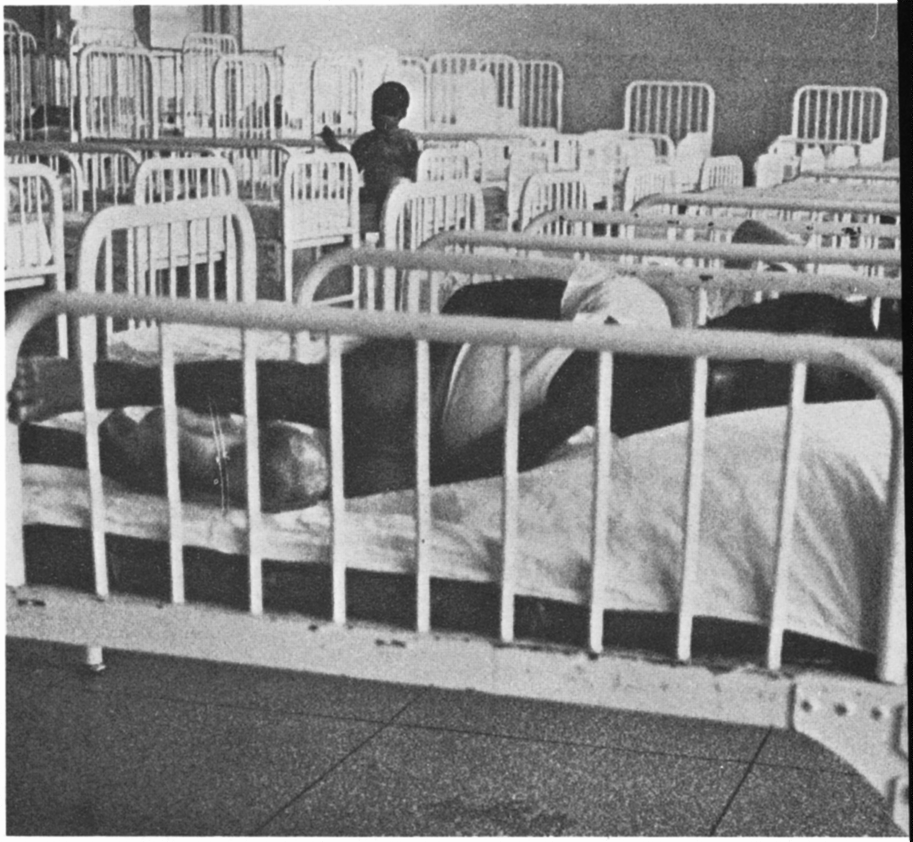
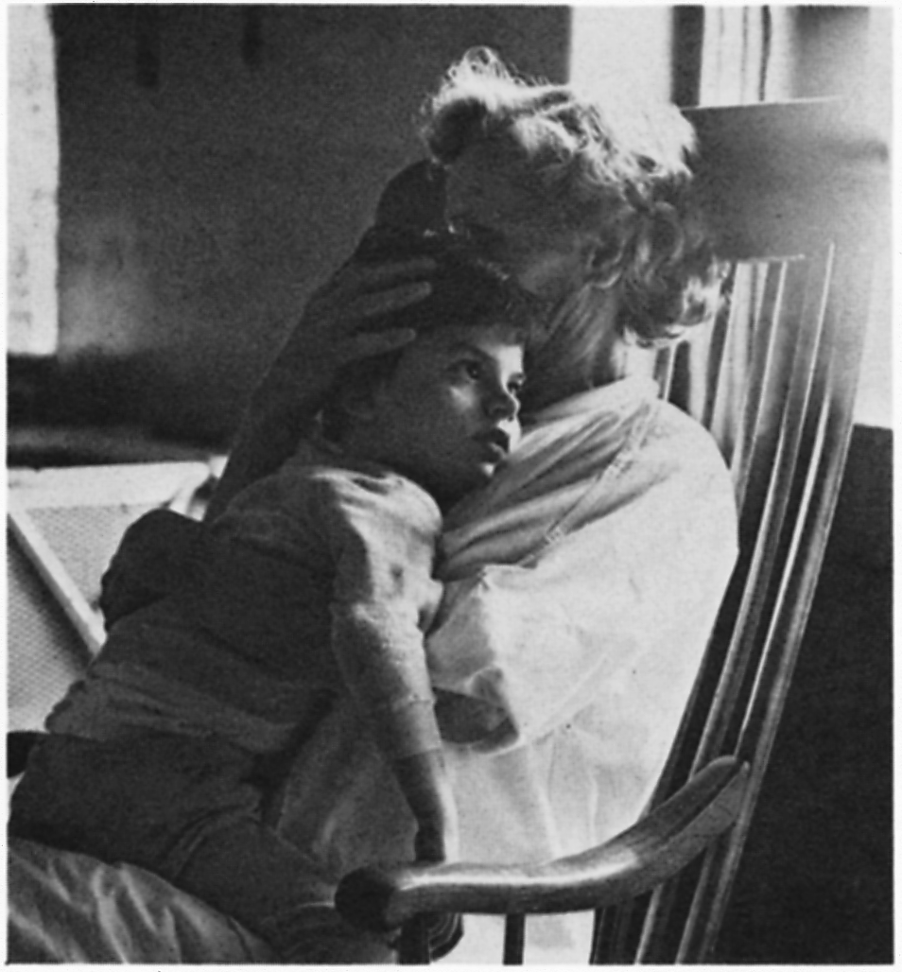

Slide 4
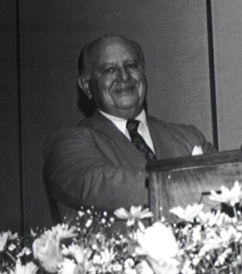
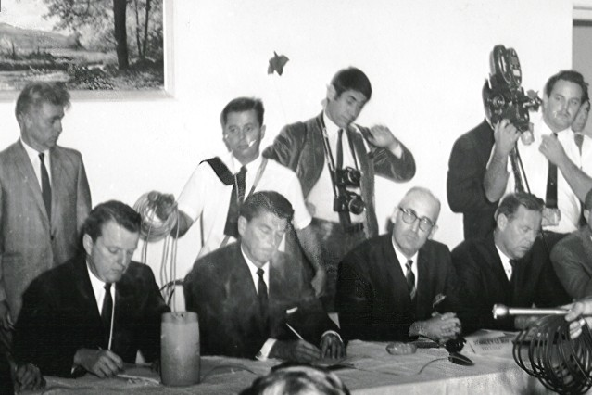
California Parents Get the Lanterman Act
1967: After years of advocacy with Frank Lanterman, the chair of the powerful Ways and Means Committee, parent advocates in California finally got the first regional center pilots (Golden Gate Regional Center & Lanterman Regional Center) approved and signed by Governor Pat Brown.
1969: The Lanterman Act establishing the regional center system was championed by Frank Lanterman, Alan Short, and signed by Governor Ronald Reagan.

Slide 5
Statewide Developmental Services: Regional Centers
California is the only state that provides developmental services as an individual entitlement.
The state is in the process of closing all state-operated developmental centers, except for the secure treatment area at the Porterville Developmental Center and the Canyon Springs community facility.
By the end of 2018-19, the Department estimates it will be providing community services to approximately 333,000 individuals with developmental disabilities.
In the developmental centers, the estimated population, as of July 1, 2018, is 547 residents. The population is expected to decrease to 361 residents by June 30, 2019, as additional residents transition to receiving services through the regional centers.
The Budget includes $7.3 billion ($4.4 billion General Fund) for support of developmental services.

Slide 6



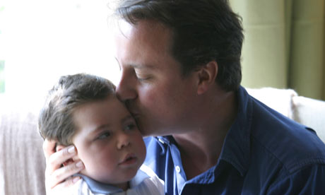

Slide 7
A Brief History of
Valley Mountain Regional Center
Established in 1974 as an off shoot of Alta CA Regional Center
    We served 944 in 1974 compared to the 14,000+ we serve today.
    Initially staff came from Alta RC but in in 1980 VMRC took over the staff from Community Care Services Branch of Dept. of Social Services
    1993-94
    • Implemented California Early Start Program for 0-3 year olds
    • Coffelt Settlement Agreement implemented
    • Total Caseload: 5668, a 500% increase
    1996-97
    • VMRC adopts Foster Grandparent/Senior Companion Program

Slide 8
Mission
The mission of Valley Mountain Regional Center (VMRC) is to support people with developmental disabilities as they enrich their lives through choices and inclusion. VMRC is committed to securing quality, individualized services in collaboration with families and the community.

Slide 9
Consumer Population % Over 1 Year
VMRC Serves 14,000+ Individuals in San Joaquin, Stanislaus, Amador, Calaveras and Tuolumne Counties
Consumer Ethnicity as of January 2017 Consumer Ethnicity as of January 2018

Slide 10
Our Region
San Joaquin County= 55.6%
Stanislaus County= 36.0%
Tuolumne County= 3.5%
Calaveras County= 2.4%
Amador County= 2.1%
Other= 0.3%

Slide 11
Our 330 Staff
Social Workers
Psychologists
Nurses
Physicians
Behavioral Specialists
And a small administrative staff for accounting, technology, administrative support, etc.

Slide 12
Our Services
Respite
Residential
Adult Day Programs
Transportation
Infant Development Services
Clinical
Diagnostic Services

Slide 13
Case Management
Service Coordination
Resource Development
Special Projects
Support Teams

Slide 14
Case Management Teams
Early Start
Children
Transition
Adult
Deflection

Slide 15
Clinics
Occupational Therapy Clinic- evaluates consumers for mobility devices, looks at seating and positioning
Developmental Gait Clinic- primarily young consumers, goal is to make gait more normal
Environmental Evaluations- evaluating housing and vehicles for possible modification to enable consumer to live in a safe environment.
Psychiatric Services- in person and via telemedicine

Slide 16
Infant/Toddler must:
Be between birth and 36 months of age
Need early intervention services
Meet one of two eligibility criteria
-Significant Developmental
Delay
-Established Risk Condition
with a known probability
of causing a disability
or delay, or a solely low
incidence disability
High Risk for developmental disabilities
Early Start
Serves over 2100 children under the age of 3 and their families
Eligibility for Early Start is not the same as for consumers over age 3.
Significant Developmental Delay
In one or more of the following skill areas:
Cognitive
Self-Help/Adaptive
Physical (fine and gross motor)
Communication (receptive and expressive)
Social-Emotional

Slide 17
Referrals and Intake
Established Risk Conditions:
Certain Chromosome and Genetic Disorders
    Down Syndrome
Head or Central Nervous System Injuries
TBI
Near Drowning Survivor
Certain Congenital Malformations
Microcephaly

Slide 18
Referrals and Intake
Early Start—45 day timeline
Referrals received from many community sources
Referrals made to VMRC directly or to SELPA’s or FRN—parents must agree
Assessments completed
If deemed eligible, an Individual family Service Plan is developed
If deemed ineligible, the ES case is closed and the child may be referred to Prevention Resource & Referral Service (through FRN)

Slide 19
Foster Grandparent and Senior Companion Programs
VMRC received a grant from the Department of Developmental Services.
  The program is for senior citizens 55 years or older on a limited income
  The volunteers assist our consumers 1:1 as a tutor or mentor in the classroom or day program
  All volunteers are fingerprinted through the FBI
The volunteers receive a monthly stipend

Slide 20
Eligibility Diagnosis
Intellectual Disability
Autism
Cerebral Palsy
Epilepsy
Other condition requiring treatment similar to Intellectual Disability
Onset prior to age 18
Expected to continue indefinitely
Significant limitation in at least 3 areas:
Communication
Self-Care
Learning
Mobility
Self-Direction
Economic Self-Sufficiency
Capacity for Independent Living

Slide 21
VMRC Service Coordinators Respond to an Oral Health Survey
Oral Health is the number priority problem
The results indicate that just over 12% of our consumers in our region have a current unmet dental need
the impact is spread evenly amongst our children and adults.
30% focused on the lack of capacity and availability of care,
23% remarked on serious examples of not accessing sedation services when needed,
23% identified the challenges related to Denti-Cal insurance and reimbursements.

Slide 22
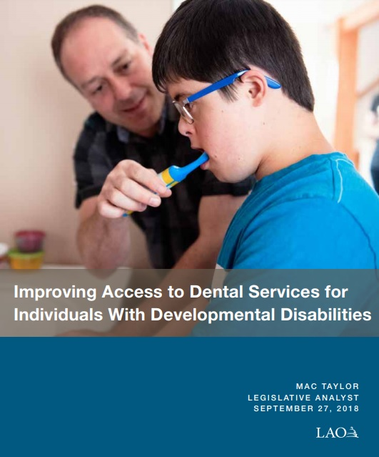
The LAO Sept 2018 Report
Regional Centers (RCs) Coordinate Services—Including Dental Care—for Individuals With Developmental Disabilities.
Consumers Largely Pay for Dental Services With State-Funded Dental Insurance
Traditional Approach to Dental Care Not Designed With DDS Consumers in Mind.
Many Consumers Lack Routine Dental Care.
Low Denti-Cal Provider Participation and Denti-Cal Payment Structure Limit Access for Consumers.
RCs and DDS Have Taken Steps to Address Consumers’ Dental Needs, Yet Access Remains a Problem

Slide 23
The LAO Sept 2018 Report: Findings
Assessment—Dental Coordination at RCs Effective, but Currently Insufficient in its Use Statewide:
Assessment—Denti-Cal Benefit and Rate Structure Limits DDS Consumers’ Access:
Assessment—Too Few Dental Providers Willing and Able to Serve Consumers:
Notes:
Assessment—Dental Coordination at RCs Effective, but Currently Insufficient in its Use Statewide:
• Require the administration to submit a plan to the Legislature to increase the number of dental coordinators at RCs statewide. The administration should consider using DDS’ existing community resource development funds to fully or partially support the plan.
Assessment—Denti-Cal Benefit and Rate Structure Limits DDS Consumers’ Access:
• Authorize behavior management benefit for DDS consumers eligible for Denti-Cal.
• Improve access to periodontal treatment for DDS consumers eligible for Denti-Cal:
Modify or eliminate the current treatment authorization request requirement for scaling and root planing benefit for DDS consumers.
Modify or eliminate the limit on periodontal maintenance for DDS consumers.
Restore the prior Denti-Cal rate for periodontal maintenance.
Assessment—Too Few Dental Providers Willing and Able to Serve Consumers:
Consider authorizing a pilot program that would provide a supplemental payment to Denti-Cal providers who have undergone training to treat DDS consumers.
• Expand RDHAPs’ scope of practice.
• Consider requiring the administration to submit a plan targeting the use of DDS’ community resource development funds to develop additional dental resources. Potential components of the plan might include:
Increasing dental coordination at RCs, as noted above.
Increasing service provision at clinics, such as federally qualified health centers.
Increasing the number of VDHs.
• Consider providing incentives for dentists to practice house-call dentistry

Slide 24
The LAO Sept 2018 Report
Assessment—Dental Coordination at RCs Effective, but Currently Insufficient in its Use Statewide:
• Require the administration to submit a plan to the Legislature to increase the number of dental coordinators at RCs statewide. The administration should consider using DDS’ existing community resource development funds to fully or partially support the plan.
Notes:
Assessment—Dental Coordination at RCs Effective, but Currently Insufficient in its Use Statewide:
• Require the administration to submit a plan to the Legislature to increase the number of dental coordinators at RCs statewide. The administration should consider using DDS’ existing community resource development funds to fully or partially support the plan.
Assessment—Denti-Cal Benefit and Rate Structure Limits DDS Consumers’ Access:
• Authorize behavior management benefit for DDS consumers eligible for Denti-Cal.
• Improve access to periodontal treatment for DDS consumers eligible for Denti-Cal:
Modify or eliminate the current treatment authorization request requirement for scaling and root planing benefit for DDS consumers.
Modify or eliminate the limit on periodontal maintenance for DDS consumers.
Restore the prior Denti-Cal rate for periodontal maintenance.
Assessment—Too Few Dental Providers Willing and Able to Serve Consumers:
Consider authorizing a pilot program that would provide a supplemental payment to Denti-Cal providers who have undergone training to treat DDS consumers.
• Expand RDHAPs’ scope of practice.
• Consider requiring the administration to submit a plan targeting the use of DDS’ community resource development funds to develop additional dental resources. Potential components of the plan might include:
Increasing dental coordination at RCs, as noted above.
Increasing service provision at clinics, such as federally qualified health centers.
Increasing the number of VDHs.
• Consider providing incentives for dentists to practice house-call dentistry

Slide 25
The LAO Sept 2018 Report
Assessment—Denti-Cal Benefit and Rate Structure Limits DDS Consumers’ Access:
• Authorize behavior management benefit for DDS consumers eligible for Denti-Cal.
• Improve access to periodontal treatment for DDS consumers eligible for Denti-Cal:
Modify or eliminate the current treatment authorization request requirement for scaling and root planning benefit for DDS consumers.
Modify or eliminate the limit on periodontal maintenance for DDS consumers.
Restore the prior Denti-Cal rate for periodontal maintenance.
Notes:
Assessment—Dental Coordination at RCs Effective, but Currently Insufficient in its Use Statewide:
• Require the administration to submit a plan to the Legislature to increase the number of dental coordinators at RCs statewide. The administration should consider using DDS’ existing community resource development funds to fully or partially support the plan.
Assessment—Denti-Cal Benefit and Rate Structure Limits DDS Consumers’ Access:
• Authorize behavior management benefit for DDS consumers eligible for Denti-Cal.
• Improve access to periodontal treatment for DDS consumers eligible for Denti-Cal:
Modify or eliminate the current treatment authorization request requirement for scaling and root planing benefit for DDS consumers.
Modify or eliminate the limit on periodontal maintenance for DDS consumers.
Restore the prior Denti-Cal rate for periodontal maintenance.
Assessment—Too Few Dental Providers Willing and Able to Serve Consumers:
Consider authorizing a pilot program that would provide a supplemental payment to Denti-Cal providers who have undergone training to treat DDS consumers.
• Expand RDHAPs’ scope of practice.
• Consider requiring the administration to submit a plan targeting the use of DDS’ community resource development funds to develop additional dental resources. Potential components of the plan might include:
Increasing dental coordination at RCs, as noted above.
Increasing service provision at clinics, such as federally qualified health centers.
Increasing the number of VDHs.
• Consider providing incentives for dentists to practice house-call dentistry

Slide 26
The LAO Sept 2018 Report
Assessment—Too Few Dental Providers Willing and Able to Serve Consumers: Consider authorizing a pilot program that would provide a supplemental payment to Denti-Cal providers who have undergone training to treat DDS consumers.
• Expand RDHAPs’ scope of practice.
• Consider requiring the administration to submit a plan targeting the use of DDS’ community resource development funds to develop additional dental resources. Potential components of the plan might include: (1) Increasing dental coordination at RCs, as noted above. (2) Increasing service provision at clinics, such as federally qualified health centers. (3) Increasing the number of VDHs.
• Consider providing incentives for dentists to practice house-call dentistry
Notes:
Assessment—Dental Coordination at RCs Effective, but Currently Insufficient in its Use Statewide:
• Require the administration to submit a plan to the Legislature to increase the number of dental coordinators at RCs statewide. The administration should consider using DDS’ existing community resource development funds to fully or partially support the plan.
Assessment—Denti-Cal Benefit and Rate Structure Limits DDS Consumers’ Access:
• Authorize behavior management benefit for DDS consumers eligible for Denti-Cal.
• Improve access to periodontal treatment for DDS consumers eligible for Denti-Cal:
Modify or eliminate the current treatment authorization request requirement for scaling and root planing benefit for DDS consumers.
Modify or eliminate the limit on periodontal maintenance for DDS consumers.
Restore the prior Denti-Cal rate for periodontal maintenance.
Assessment—Too Few Dental Providers Willing and Able to Serve Consumers:
Consider authorizing a pilot program that would provide a supplemental payment to Denti-Cal providers who have undergone training to treat DDS consumers.
• Expand RDHAPs’ scope of practice.
• Consider requiring the administration to submit a plan targeting the use of DDS’ community resource development funds to develop additional dental resources. Potential components of the plan might include:
Increasing dental coordination at RCs, as noted above.
Increasing service provision at clinics, such as federally qualified health centers.
Increasing the number of VDHs.
• Consider providing incentives for dentists to practice house-call dentistry

Slide 27
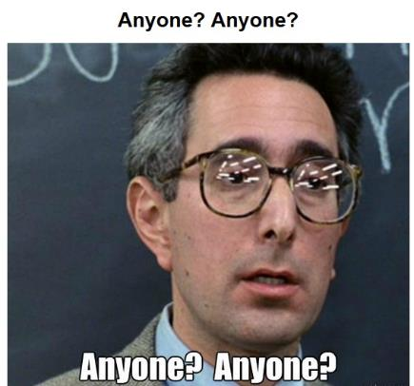
Questions?
                Tony Anderson
Executive Director
The Valley Mountain Regional Center
tanderson@vmrc.net
Twitter: @vmrctweet
https://twitter.com/vmrctweet
Facebook:
https://www.facebook.com/ValleyMountainRegionalCenter/
LinkedIn:
https://www.linkedin.com/company/valley-mountain-regional-center/

