Slide 2
State Budget Overview
Health and Human Services Overview
Department of Developmental Services Budget Items:
Current Year (CY)
Budget Year (BY)
Developmental Centers and Head Quarters
Future Issues
Other Important Services
Questions

Slide 3
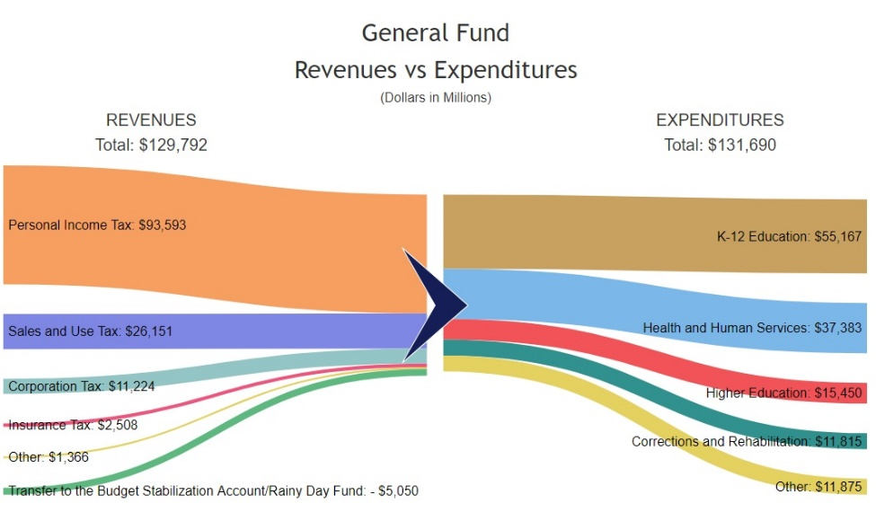
State Budget Overview
The 2018-19 Governor’s Budget proposes spending of $190.3 billion in total state funds,
$131.7 billion from the General Fund,
$56.1 billion from special funds,
and $2.5 billion from bond funds.
Brings the Rainy Day Fund to the maximum level allowed under the State Constitution.

Slide 4
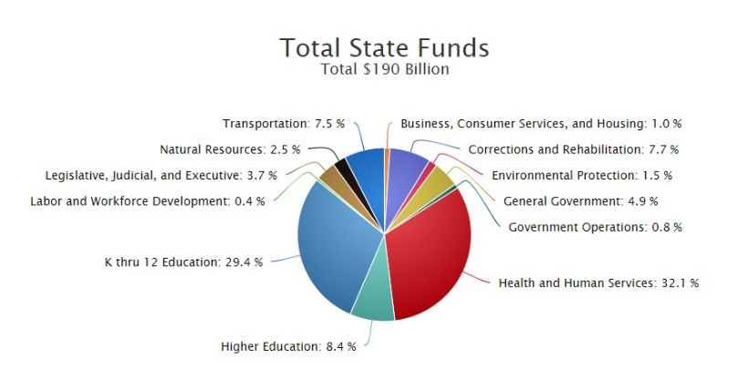
State Budget Overview
Health and Human Services makes up 32.1% of the total fund budget at $6.1 Billion
While K-12 Education is by far the largest state funds allocation it makes up 29.4% of the total funds.

Slide 5
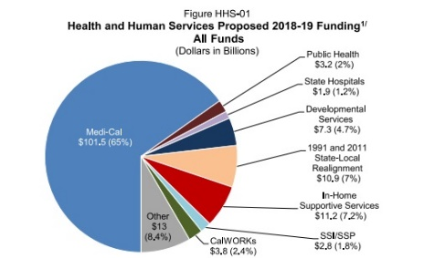
Health and Human Services Overview
ACA Optional Expansion: State’s cost-sharing ratio for the ACA optional Medi-Cal expansion will increase to 6 percent, The Budget assumes costs of $17.7 billion ($1.4 billion General Fund) in 2017-18 and $22.9 billion ($1.6 billion General Fund) in 2018-19 for the 3.9 million people.
Minimum Wage Increase: increase in IHSS expenditures of $260.3 million ($119.4 million General Fund) and a decrease in CalWORKs expenditures of $1.2 million General Fund to reflect the impact of the increase in the state minimum hourly wage from $11.00 to $12.00, effective January 1, 2019.
Average monthly CalWORKs caseload is estimated to be 401,000 families in 2018-19, an 11-percent decrease from the 2017 Budget Act projection. Due to an improving economy, caseload has decreased every year from a recent peak of 587,000 in 2010-11.

Slide 6
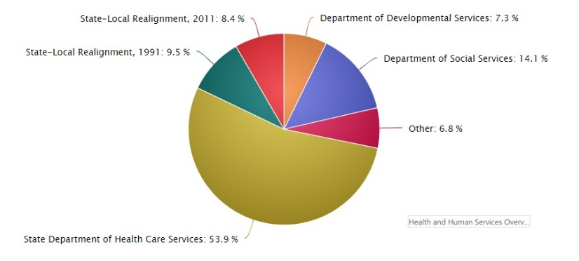
Health and Human Services Overview
This pie chart represents $61.1 billion of expenditures within this Agency area. These amounts do not include federal funds, certain non-governmental cost funds, or reimbursements.
The DDS portion is 7.3% of the total HHS State funds budget at $4.4 billion.
Including federal funds the allocation is $7.3 billion.
The DHCS is listed at about $33 billion – includes the state’s Medi-Cal program.

Slide 7
In-Home Support Services Overview
The Budget includes $11.2 billion ($3.6 billion General Fund) for the IHSS program in 2018-19,
a 7.7-percent increase in General Fund costs over the revised 2017-18 level.
Average monthly caseload in this program is estimated to be 545,000 recipients in 2018-19,
a 5.4-percent increase from the 2017 Budget Act projection.
General Fund costs in this program have more than doubled since 2010-11, while caseload has increased 26 percent.
an increase of $27.8 million GF to reflect revised workload and budget assumptions to reflect a new average number of cases a social worker can manage (including the federal Fair Labor Standards Act overtime regulations).
The workload and budget assumptions will be reexamined as part of the 2020-21 budget.
IHSS Provider Paid Sick Leave—The Budget includes $29.9 million General Fund to reflect implementation of eight paid sick leave hours for IHSS providers beginning on July 1, 2018.

Slide 8
In-Home Support Services Overview
Additional highlights as reported by Marty Omoto, CDCAN…
MINIMUM WAGE INCREASE
Increase in IHSS spending of $260.3 million ($119.4 million State General Fund) to reflect the impact of the increase in the state minimum hourly wage from $11.00 to $12.00, effective January 1, 2019 (the increase that took effect January 1, 2018 was already included in the 2017-2018 State Budget passed last June.
CONTINUED RESTORATION OF 7% REDUCTION IN SERVICE HOURS:
Governor’s proposed 2018-2019 State Budget continues the restoration of the 7% across the board reduction in service hours for all IHSS recipients.
ELECTRONIC VISIT VERIFICATION:
No funding proposal for implementing this federal requirement was in the Governor’s proposed 2018-2019 State Budget.
The California Department of Social Services intends to convene a stakeholder group to review responses received from interested vendors from the recent “Request for Information” regarding how California might implement the federal “Electronic Visit Verification” requirement.
Likewise there was no funding proposal for implementation of this requirement under the Department of Developmental Services budget either.

Slide 9
Supplemental Security Income/ State Supplemental Payment (SSI/SSP) Overview
The federal SSI program provides a monthly cash benefit to eligible aged, blind, and disabled persons who meet the program’s income and resource requirements. In California, the SSI payment is augmented with an SSP grant.
These cash grants assist recipients with basic needs and living expenses. The federal Social Security Administration administers the SSI/SSP program, making eligibility determinations, computing grants, and issuing combined monthly checks to recipients.
The state-only Cash Assistance Program for Immigrants (CAPI) provides monthly cash benefits to aged, blind, and disabled legal noncitizens who are ineligible for SSI/SSP due solely to their immigration status.
The Budget includes $2.8 billion General Fund for the SSI/SSP program.
This represents a 1.2-percent decrease ($34.9 million) from the revised 2017-18 budget.
The average monthly caseload in this program is estimated to be 1.3 million recipients in 2018-19, a slight decrease from the 2017-18 projection.
The SSI/SSP caseload consists of 70 percent disabled persons, 28.6 percent aged, and 1.4 percent blind.
Effective January 2018, maximum SSI/SSP grant levels are $910 per month for individuals and $1,532 per month for couples.
The federal cost of living adjustments based on the current Consumer Price Index growth factors are 2 percent for 2018 and a projected 2.6 percent for 2019.
As a result, the maximum SSI/SSP monthly grant levels will increase by approximately $20 and $29 for individuals and couples, respectively, effective January 2019.
CAPI benefits are equivalent to SSI/SSP benefits, less $10 per month for individuals and $20 per month for couples.

Slide 10
Department of Rehabilitation (DoR) Overview
VOCATIONAL REHABILITATION SERVICES Services to persons with disabilities (PWD) through vocational rehabilitation professionals in district and branch offices DoR uses a federal Order of Selection process, which gives priority to persons with the most significant disabilities. Eligible PWD may receive vocational assessment, assistive technology, vocational and educational training, job placement, and independent living skills training.
The Promoting the Readiness of Minors in Supplemental Security Income grant
The CA Innovations Program
Fund Code | Fund | Actual 2016-17* | Estimated 2017-18* | Proposed 2018-19*
0001 | General Fund | $62,568 | $64,604 | $64,649
0311 | Traumatic Brain Injury Fund | $1,060 | $1,114 | $892
0600 | Vending Stand Fund | $2,361 | $2,361 | $2,361
0890 | Federal Trust Fund | $371,541 | $382,709 | $384,472
0995 | Reimbursements | $7,494 | $7,680 | $7,680
Total Expenditures (All Funds) |  | $445,024 | $458,468 | $460,054

Slide 11
Department of Rehabilitation (DoR) Overview
INDEPENDENT LIVING SERVICES The Department funds, administers, and supports 28 non-profit independent living centers in communities located throughout California. Each independent living center provides services necessary to assist consumers to live independently and be productive in their communities. Core services consist of
information and referral,
peer counseling,
benefits advocacy,
independent living skills development,
housing assistance,
personal assistance services,
transition services to community based living,
transition services to postsecondary life for youth,
and personal and systems change advocacy.
TRAUMATIC BRAIN INJURY (TBI) Program
a coordinated post-acute care service model for persons with TBI, including supported living, community reintegration, vocational supportive services, public awareness, and support for family, friends, and professionals within the TBI community.

Slide 12
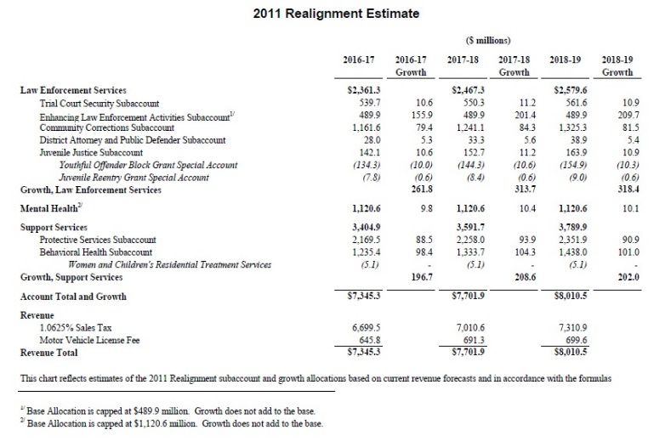
Mental Health Overview

Slide 13
Mental Health Overview (CBHDA.org)
Revenue Forecasts. Several major sources of behavioral health revenues are as follows for the 2018-19 budget year:
1991 Realignment. Revenue for the mental health estimate is $1.12 billion and $10 million in growth which will be redirected to Social Services for IHSS.
2011 Realignment. The Behavioral Health Subaccount is estimate is $1.44 billion and $101 million in growth.
Mental Health Services Act (MHSA). The MHSA revenues are $2.2 billion.
Continuum of Care Reform (CCR). The budget includes $238 million, compared to $217 million last year, to continue implementation of CCR
Incompetent to Stand Trial (IST): The budget proposes $114 million GF to increase the state-county partnership to address the growing waitlist for felony defendants found IST.
$100 million GF over three years will be made available for community alternatives for mental health treatment to increase diversion and reduce referrals to the Department of State Hospitals (DSH).
The budget proposes to prioritize contracts with the 15 counties with the highest volume of referrals to DSH to create up to 640 alternative, community-based placements.
The budget establishes a goal of reducing felony IST referrals to DSH by 30%.
Mental Health Services Oversight and Accountability Commission (MSHOAC). The Budget proposes $2.5 million a year for two years from MHSA funds for the OAC to provide consulting services to assist counties in developing Innovation Plans that incorporate ways to address IST populations.

Slide 14
Department of Developmental Services (DDS) Overview
California is the only state that provides developmental services as an individual entitlement.
The state is in the process of closing all state-operated developmental centers, except for the secure treatment area at the Porterville Developmental Center and the Canyon Springs community facility.
By the end of 2018-19, the Department estimates it will be providing community services to approximately 333,000 individuals with developmental disabilities.
In the developmental centers, the estimated population, as of July 1, 2018, is 547 residents. The population is expected to decrease to 361 residents by June 30, 2019, as additional residents transition to receiving services through the regional centers.
The Budget includes $7.3 billion ($4.4 billion General Fund) for support of developmental services.
a net increase of $368 million ($248.3 million GF) from the updated 2017-18 budget, or a 5.3 percent total fund increase.

Slide 15
DDS Regional Centers Overview
Here’s how the administration describes the regional centers:
Regional centers provide intake, assessment, eligibility determination, resource development, and case management services.
The centers also work with the thousands of businesses and individuals providing developmental services in the community.
The regional center budget reflects costs of $3.8 billion General Fund in 2017-18 and $4.1 billion General Fund in 2018-19, a year-over-year increase of $319.6 million General Fund.
A significant portion of the increase, $97.6 million General Fund, is attributable to the increasing state minimum wage.
Current Year Changes
CASELOAD (no estimated change for CY)
The FY 2017-18 May Revision estimated the Regional Center Community Caseload to be 317,837 consumers for January 31, 2018. The November Estimate continues to estimate the January 31, 2018 caseload to be 317,837.
PURCHASE OF SERVICE - $ 39.4 million decrease (.7% decrease)
$ 39.4 million decrease to Purchase of Services is primarily due to less than projected POS expenditure from under-utilization of SB 3 minimum wage funds.
OPERATIONS - $54 thousand increase (0.008% increase)
$54 thousand increase is due to a slight increase in the Intermediate Care Facility – Developmentally Disabled (ICF-DD) Administration Fees.

Slide 16
DDS Regional Centers Overview
Budget Year Proposals
The following increases and decreases are in comparison to the revised budget for FY 2017-2018.
CASELOAD (a 4.8% increase)
The FY 2018-19 November Estimate anticipates the Regional Center Community Caseload to be 333,024 consumers for January 31, 2019. This is an increase of 15,187 consumers over the 317,837 consumers projected for January 31, 2018.
That comes to about 42 people a day and Autism continues to be the highest growth diagnosis in the system which means about every hour of every day a child or adult with Autism enters the developmental disabilities service system.

Slide 17
DDS Regional Centers Overview
Budget Year Proposals
PURCHASE OF SERVICE - $329.9 million increase (6.04% increase)
$290 million increase over current fiscal year for caseload and utilization growth (a 6.1% increase).
$305 million is due to expenditure increases in the base with a corresponding $15.3 million decrease in utilization change/growth.
The $62.4 million increase in the Community Care Facility Base is driven by Staff Operated CCFs for Adults and DSS-Licensed Special Residential Facilities for Habilitation.
The $47.8 million increase in the Day Program Base is due to continued growth in Adult Development Center, Behavior Management Program, and Infant Development Program.
The $92.7 million increase in the Supported Living Base reflects continued growth primarily in Community Integration Training Program, Personal Assistant, and Supported Living Services, which total more than 80% of all expenditures
The $51 million increase in In-Home Respite Services Agency Base reflects continued growth.
The main cost drivers for Transportation Utilization and Growth are Transportation Company, Transportation-Additional component, and Transportation-Public/Rental Car Agency/Taxi. These service codes make up over 90% of Transportation expenditures.
The $18.4 million increase in Miscellaneous Base is due to continued growth in Specialized Therapeutic Services for children under age 3, and Interdisciplinary Assessments.
• $13 million increase is expected from the elimination of the respite cap.
• $27.6 million increase in continuation costs for Developmental Center residents. There is a $19.8 million increase due to an increase in the number of developmental center residents that will be moving into the community in 20172018. There is a $4.9 million increase anticipated for supported living continuation costs.

Slide 18
DDS Regional Centers Overview
Budget Year Proposals - POS
DDS Highlights the following Adjustments:
Transition of BHT Services to DHCS $47 million decrease ($47 million GF decrease) in POS to implement the transition of consumers without an ASD Diagnosis who receive BHT services. This includes full year cost savings for those who receive BHT services on a fee-for-service basis who will transition to DHCS on March 1, 2018, as well as those children who receive these services through Medi-Cal Managed Care that will transition to DHCS on July 1, 2018. See Revised Major Assumptions.
Community Placement Plan (CPP) - DC Closure $2.8 million increase ($3.7 million GF increase) in DC Closure-specific CPP funding to fund placement expenditures for additional DC movers.
Uniform Holiday $5.6 million decrease ($2.9 million GF decrease) to re-implement the 14-day uniform holiday schedule. See Revised Major Assumptions.
Senate Bill (SB) 3, Chapter 4, Statutes of 2016, Minimum Wage Increase $178.5 million increase ($97.6 million GF increase) in POS to reflect full-year costs of the state-mandated hourly minimum wage increase from $10.50 to $11.00 that was effective January 1, 2018, as well as the increase from $11.00 to $12.00 that is effective January 1, 2019. See Revised Major Assumptions.
Best Buddies $1.6 million decrease ($1.6 million GF decrease) due to the removal of 2017-18 onetime funding.
Safety Net Resources $5.6 million decrease ($5.6 million GF decrease) due to the removal of one-time funding provided in 2017-18 for the Community Services Program to develop safety net resources.

Slide 19
DDS Regional Centers Overview
Budget Year Proposals - OPS
OPERATIONS – $31.4 million increase over Current year (4.7% increase)
• $30.8 million increase in staffing due to additional staffing from increased caseload.
• $.65 million increase in Federal Compliance to meet HCBS Waiver requirements and projects.

Slide 20
DDS Developmental Centers Overview
In 2015, the Administration announced the planned closure of the three remaining developmental centers: Sonoma, Fairview and the general treatment area of Porterville.
Sonoma is scheduled to close in December 2018 and no longer receives federal funding for its intermediate care facility units.
On July 1, 2016, the Department entered into settlement agreements with the federal Centers for Medicare and Medicaid Services to continue federal funding for individuals residing at Fairview and the general treatment area at Porterville through 2020-21.
The Department’s ongoing compliance with the provisions of the settlement agreements will allow the continued receipt of federal funding for intermediate care facility units at both centers.
The Budget assumes federal funding will continue for both Fairview and Porterville.
FY 2017-18 (Current Year)
The actual DC population on July 1, 2017, was 795 residents. The Department projects an ending population of 537 residents on June 30, 2018.
The Governor’s Budget updates the 2017 enacted budget to $494.8 million ($366.6 million GF); a net increase of $28.8 million ($18.4 million GF increase). The net increase is a combination of the following adjustments:
Operations Expenditures
• Net increase of $4.5 million ($2.6 million GF increase), which reflects an increase of 7.3 million in Personal Services and OE&E expenditures to care for an additional 42 residents as compared to the enacted budget, offset by a $2.8 million reduction in lease revenue bond payments.
Employee Compensation and Retirement
• Increase of $17.2 million ($11.1 million GF increase) for compensation and retirement adjustments approved through the collective bargaining process and included in Item 9800 - Employee Compensation Adjustments.
Sonoma and Fairview Lump Sum Payouts
• Increase of $7.1 million ($4.7 million GF increase) to fund lump sum leave balance payouts for separating employees.

Slide 21
DDS Developmental Centers Overview
FY 18-19 (Budget Year): The Governor’s Budget proposes a total of $375.6 million ($292 million GF) for the State Operated Residential and Community Facilities Program; a net decrease of $119.2 million ($74.7 million GF decrease) from the revised current year budget. The net decrease reflects the following adjustments:
Operations Expenditures: Decrease of $120.5 million ($74.8 million GF decrease) as compared to the revised current year budget for decreases in Personal Services and OE&E due to resident placements, offset by an increase in lease revenue bond payments. Within this adjustment is an increase of $5.6 million GF and 53.2 positions to operate two additional STAR homes as part of the Department’s safety net plan.
Employee Compensation and Retirement: Increase of $0.6 million ($0.4 million GF increase) for compensation and retirement adjustments approved through the collective bargaining process as compared to the revised current year budget. In total, the Governor’s Budget includes $17.8 million ($11.5 million GF) for employee compensation and retirement adjustments in 2018-19.
Centralized Functions at Headquarters: Decrease of $2.1 million ($1.6 million GF decrease) to transfer 15.5 positions from the State Operated and Community Facilities Program to Headquarters for statewide oversight positions and activities that will continue beyond closure of the developmental centers as detailed in a related BCP.
Sonoma and Fairview Lump Sum Payouts: Increase of $2.2 million ($0.8 million GF increase) above the revised current year budget to fund lump sum leave balance payouts for separating employees. In total, the Governor’s Budget proposes $9.3 million ($5.7 million GF) in 2018-19 to fund lump sum leave payouts.
Sonoma and Fairview Security Costs: Increase of $0.6 million ($0.5 million GF increase) to provide physical security measures during warm shut down.
CAPITAL OUTLAY he 2017 enacted budget includes $3.7 million GF to install a nitrate removal system at Porterville. The system will remove excess nitrates from well water to meet statemandated safe drinking water requirements, thereby providing a safe, reliable, and efficient potable water delivery system. There are no changes proposed to this project. The Governor’s Budget does not include a proposal for capital outlay funds in 2018-19.

Slide 22
DDS Headquarters Overview
FY 2016-2017 (Current Year) : The Governor’s Budget reflects an increase of $2.2 million ($1.3 million GF increase) over the enacted budget for employee compensation and retirement adjustments. The total updated 2017-18 Headquarters budget is $63.2 million ($36.2 million GF).
FY 2017-2018 (Budget Year): The Governor’s Budget proposes total Headquarters operations funding in 2018-19 of $67.6 million ($39.6 million GF). This is a net increase of $4.4 million ($3.4 million GF increase) over the updated 2017-18 budget, reflecting a $0.2 million increase ($0.2 million GF increase) due to changes in employee compensation and retirement adjustments. The increase also reflects expenditures and positions from the following three Budget Change Proposals (BCPs):
Clinical Staff for Community Homes Oversight - $2 million ($1.4 million GF) to fund 9.0 positions to increase clinical staff and expertise within Headquarters to support development and ongoing monitoring of Adult Residential Facilities for Persons with Special Health Care Needs, Enhanced Behavioral Supports Homes, and Community Crisis Homes.
Centralize Statewide Activities for Developmental Services The Department requests approval to shift $2.1 million ($1.6 million GF) and 15.5 positions from the State Operated Residential and Community Services Program to Headquarters for statewide oversight positions and activities that will continue beyond closure of the developmental centers.
Establish Internal Audit Unit The Department requests $295,000 ($178,000 GF) and 2.0 positions to establish an internal audit unit. In addition to initial planning activities, the requested resources will complete general internal audit assignments such as delegated contract audits from the Department of General Services and the State Leadership Accountability Act review from the Department of Finance. Further, the resources will serve as liaisons during audits conducted by outside entities such as the California State Auditor, the Department of Finance, and the State Controller’s Office.

Slide 23
ARCA Budget Positions
Restoration of the social recreation and camp services
Funds and a process to address unmat service provider fiscal requirements
Reinvestment of funds from the disposal of developmental center land into affordable housing
$39.4 million in POS in FY 17-18, primarily due to lower than expected utilization of funds budgets for increases in the state minimum wage: These funds should be re-appropriated and reinvested in developmental services system in order to finance the start-up of program to meet unmet needs.
Uniform holiday schedule reinstituted on a statewide basis, with 14 mandatory furlough days being set by the department: The policy should be rejected due to its impact on service provides as well as individuals with developmental disabilities and their families.

Slide 24
ARCA Budget Positions
Regional Center Operations: All case management position should be funded at the higher salaries assumed in the caseload ratio relief policy item for the 2016-2017 Budget.
All regional centers need additional staff resources (i.e., resource development, case management, project management, and IT to implement the self-determination program.
Implementation of the Statewide Minimum Wage Funding: The process for adjusting service provider rates in response to change in statewide ,minimum wage should be modified to allow rates for service providers in areas with a higher local minimum wage to be incrementally adjusted. DDS Loan Authority: The proposed increase in DDS general fund loan authority should be supported.

Slide 25
Chapter 52, Statutes of 2017 (SB 97), increased the minimum number of direct care services hours in skilled nursing facilities from 3.2 to 3.5 hours per patient day, effective July 1, 2018.
It also specifies that a minimum of 2.4 hours per patient day must be provided by certified nurse assistants.
The Budget includes $4.5 million in 2018-19 to support the expansion of training slots for the certified nursing assistant workforce to support facilities in meeting this requirement.
This includes one-time funding of $2 million (Proposition 98 General Fund) from the Strong Workforce Program and $2.5 million from existing training programs within the Employment Development Department.

Slide 26
Q&A

