Slide 1
Valley Mountain Regional Center
Bi-Annual All Staff
December 19, 2017 San Joaquin Office of Education
Tony Anderson
Executive Director
Notes:
WELCOME by Candace
San Andreas
Tony
Emily*
Daime*
Candice
Anthony
Lynda
Dena
Claire*
Modesto
Tony
Emily*
Daime*
Claire*
Candice
Anthony
Lynda
Dena
Mo
Stockton
Robert
Tony
Emily*
Daime*
Claire*
Candice
Anthony
Lynda
Dena
Angie
Registration

Slide 2
VMRC Legislative Committee
Hellos and Farewells
Events and Trainings
A Year in Review in Pictures
Staff Surveys from Kinetic Flow
Department of Developmental Services Priorities List
Crystal Ball: Looking Ahead
Notes:
Candace

Slide 3
Notes:
Candace

Slide 4
We Also Welcomed the Following New Staff:
Linda DeLaurenti
Amanda Dominguez
Cee Vang
Brieann Ruebel
Alyssa Picone
Ryan Lee
Donna McWithey
Silka Guerra
Timothy Mangrich
Aurelia Vazquez
Xinh Pham
Christene Adams
Julie Vangvichit
Nicole Byington
Cristina Cano
Kayla Vang
Patricia Briones Gomez
Heather Gake
Annacristina Valencia
Chandrea Washington
Richard Urban
Paulina Rodriguez Cruz
James Shorter
Deanna Nava
Bao Fang
Michele Poaster
Lawrence Henderson
Rena Ieng
Albert Garcia
Corinne De Diego
Stephanie Medina
Mari Bel Trujillo
Heaven Richardson
Jennell Johnson
Houa Vang
Anna Martinez
Johnson Vang
Stephanie Rodriguez Melena
Amber Elkins
Whitney Larot
Tatiana Supnet
My Nguyen
Bud Mullanix
Edythe Garbarini
Donna Sioson
Janelle Anhorn
Lindsay Fernando
Zang Vang
Cindy Montoya
Tony Anderson

Slide 5
and we said Farewell to the Following Staff:
Paul Billodeau
Kasey Hines
Daniel Kaufmann
Cindy-Quynh Le
Valbina De La Torre Salgado
Sunjum Hundai
Lori Meeker
Diane Ricucci
Abel Ornelas
Kevin Rose
Farhad Latifi
William Rutgers
Shireen Farsi
Holly Diaz-Bach
Sandra Du Puy
Sandi Brophy
Jennifer Perrault
Judith Rhodes
Loren Bach
Sandra Du Puy
Penny Speight
Brigette Clement
Scott Rickey
Alyssa Picone
Aurelia Vazquez
Annacristina Valencia
Chandrea Washington

Slide 6
Educating the New Director
Observed Clinics with Mary
Visited Foster Grandparents with Mara
Visited several homes and day programs and other community programs
Visited Several Early Start Programs with Tara
Met with all staff
Visited Mental Health partners in Stanislaus and San Joaquin Counties
Met with labor several times
Surveys responses various topics to inform me
Meetings with outside groups including SAC6 and CLASP etc.
Notes:
Dena

Slide 7
Events and Trainings
The Home and Community Based Services New Rules (200+ attendees)
Social Worker Appreciation Day
Dental Crisis Brainstorming and Presentation – in-House
Self-Determination Symposiums (450+ attendees)
Management Restructuring Presentation – in-House
Board of Directors Annual Meeting with Stockton Mayor
Diversity Training (400+ attendees)
Cultural Connections Fair (600+ attendees)
Management Classes by Bud
Legislative Outcomes Presentations (100 attendees)
Notes:
Dena

Slide 8
The Year in Review in Pictures
The Home and Community Based Services New Rules (200+ attendees)
Social Worker Appreciation Day
Dental Crisis Brainstorming and Presentation – in-House
Self-Determination Symposiums (450+ attendees)
Management Restructuring Presentation – in-House
Board of Directors Annual Meeting with Stockton Mayor
Diversity Training (400+ attendees)
Cultural Connections Fair (600+ attendees)
Management Classes by Bud
Legislative Outcomes Presentations (100 attendees)
Notes:
Dena

Slide 9
A Year in Pictures

Slide 10
A Year in Pictures

Slide 11
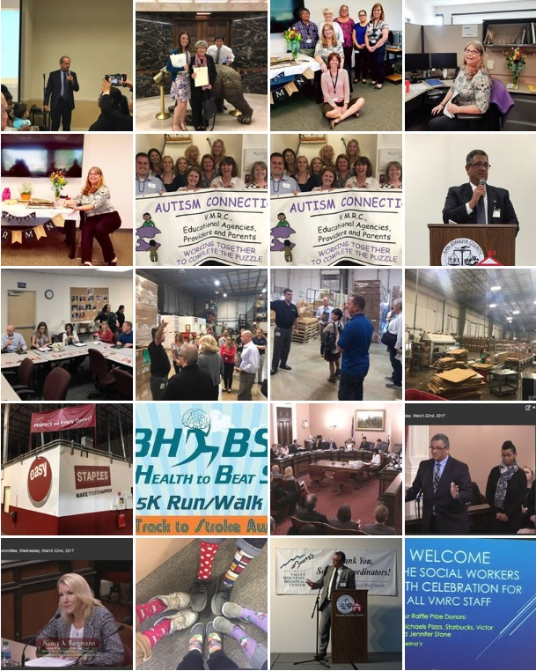
A Year in Pictures

Slide 12
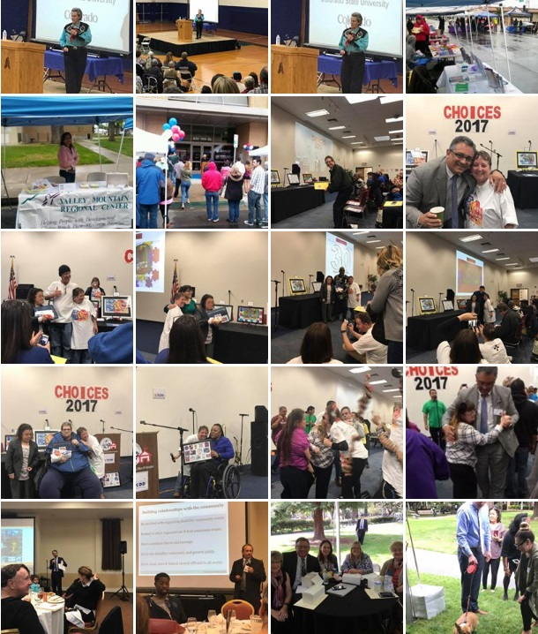
A Year in Pictures

Slide 13
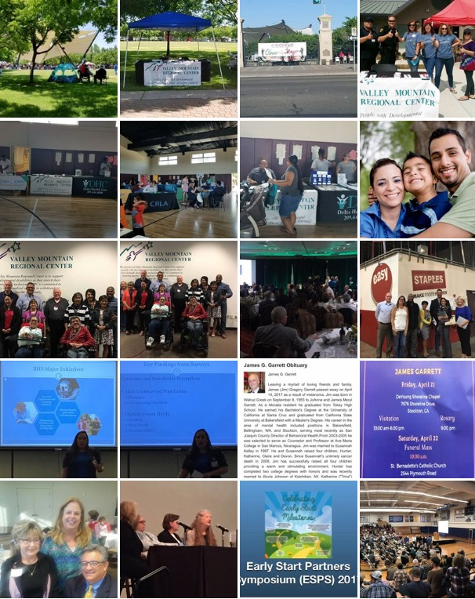
A Year in Pictures

Slide 14
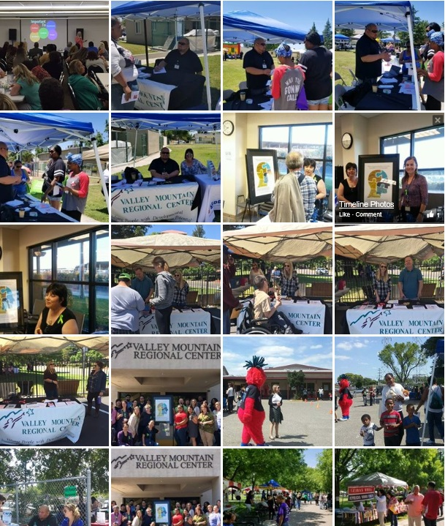
A Year in Pictures

Slide 15
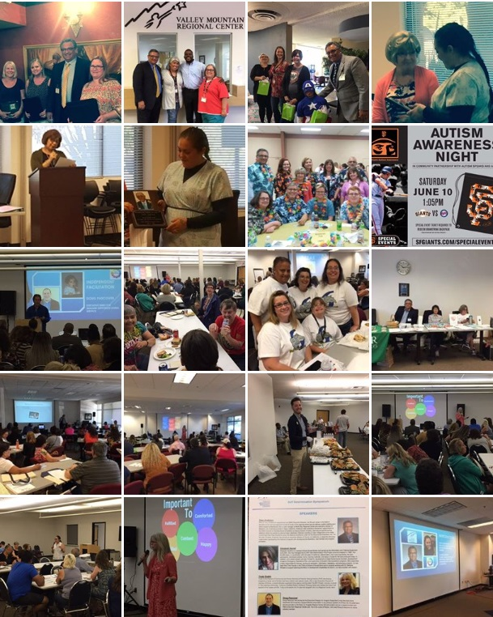
A Year in Pictures

Slide 16
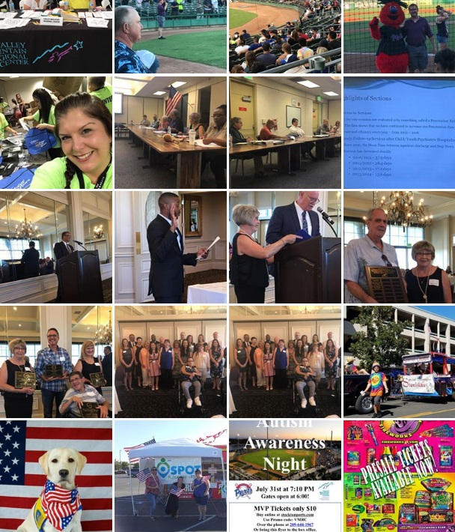
A Year in Pictures

Slide 17
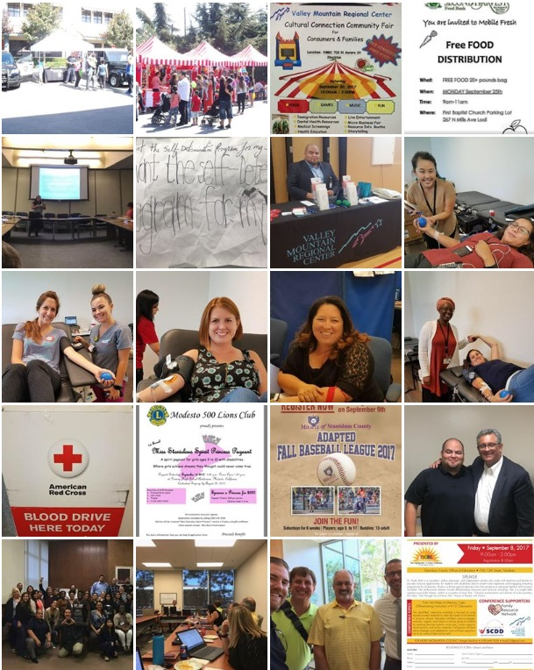
A Year in Pictures

Slide 18
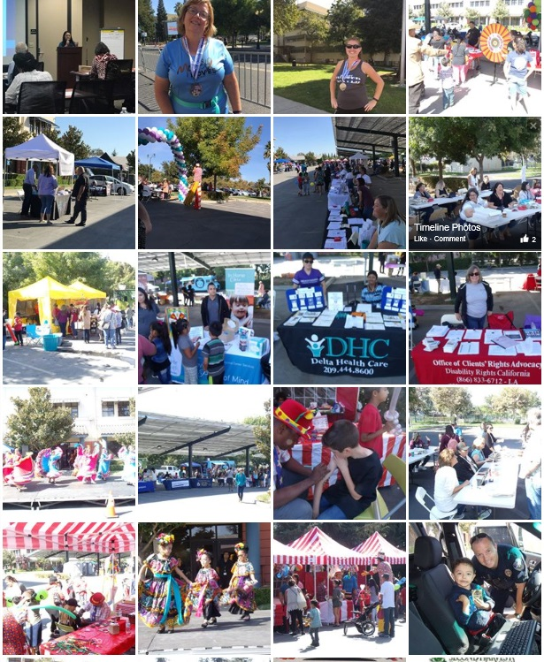
A Year in Pictures

Slide 19
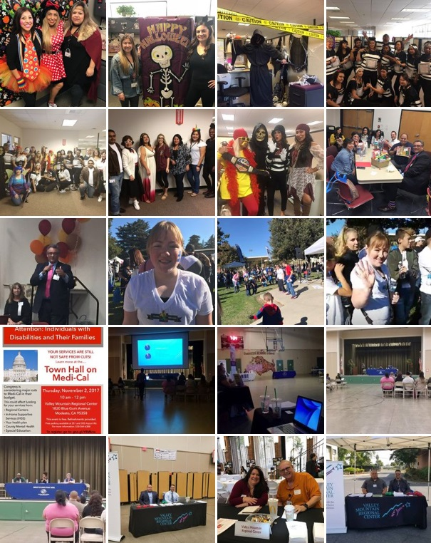
A Year in Pictures

Slide 20
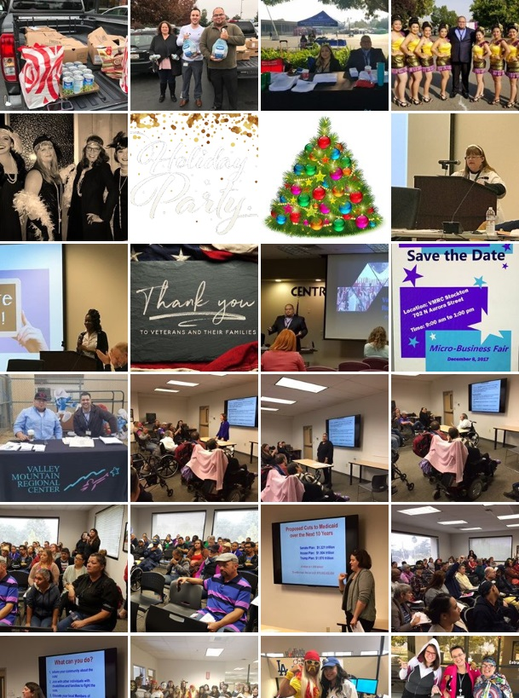
A Year in Pictures

Slide 21
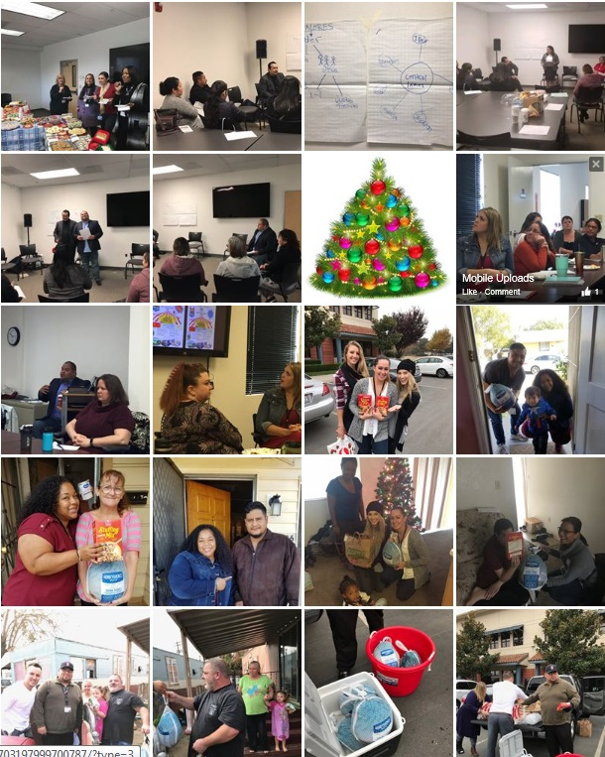
A Year in Pictures

Slide 22
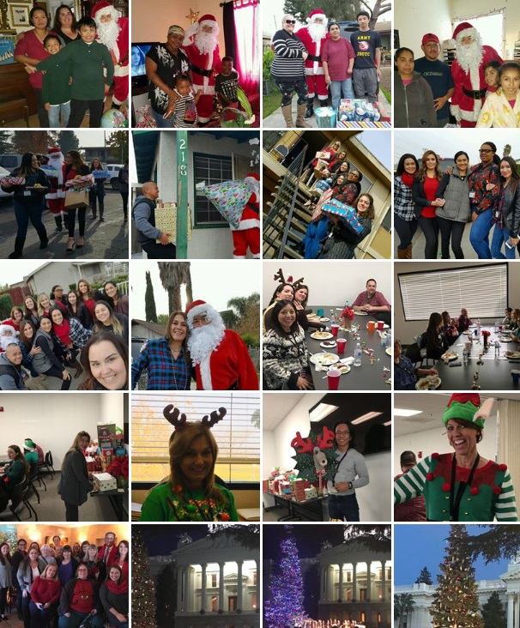
A Year in Pictures

Slide 23
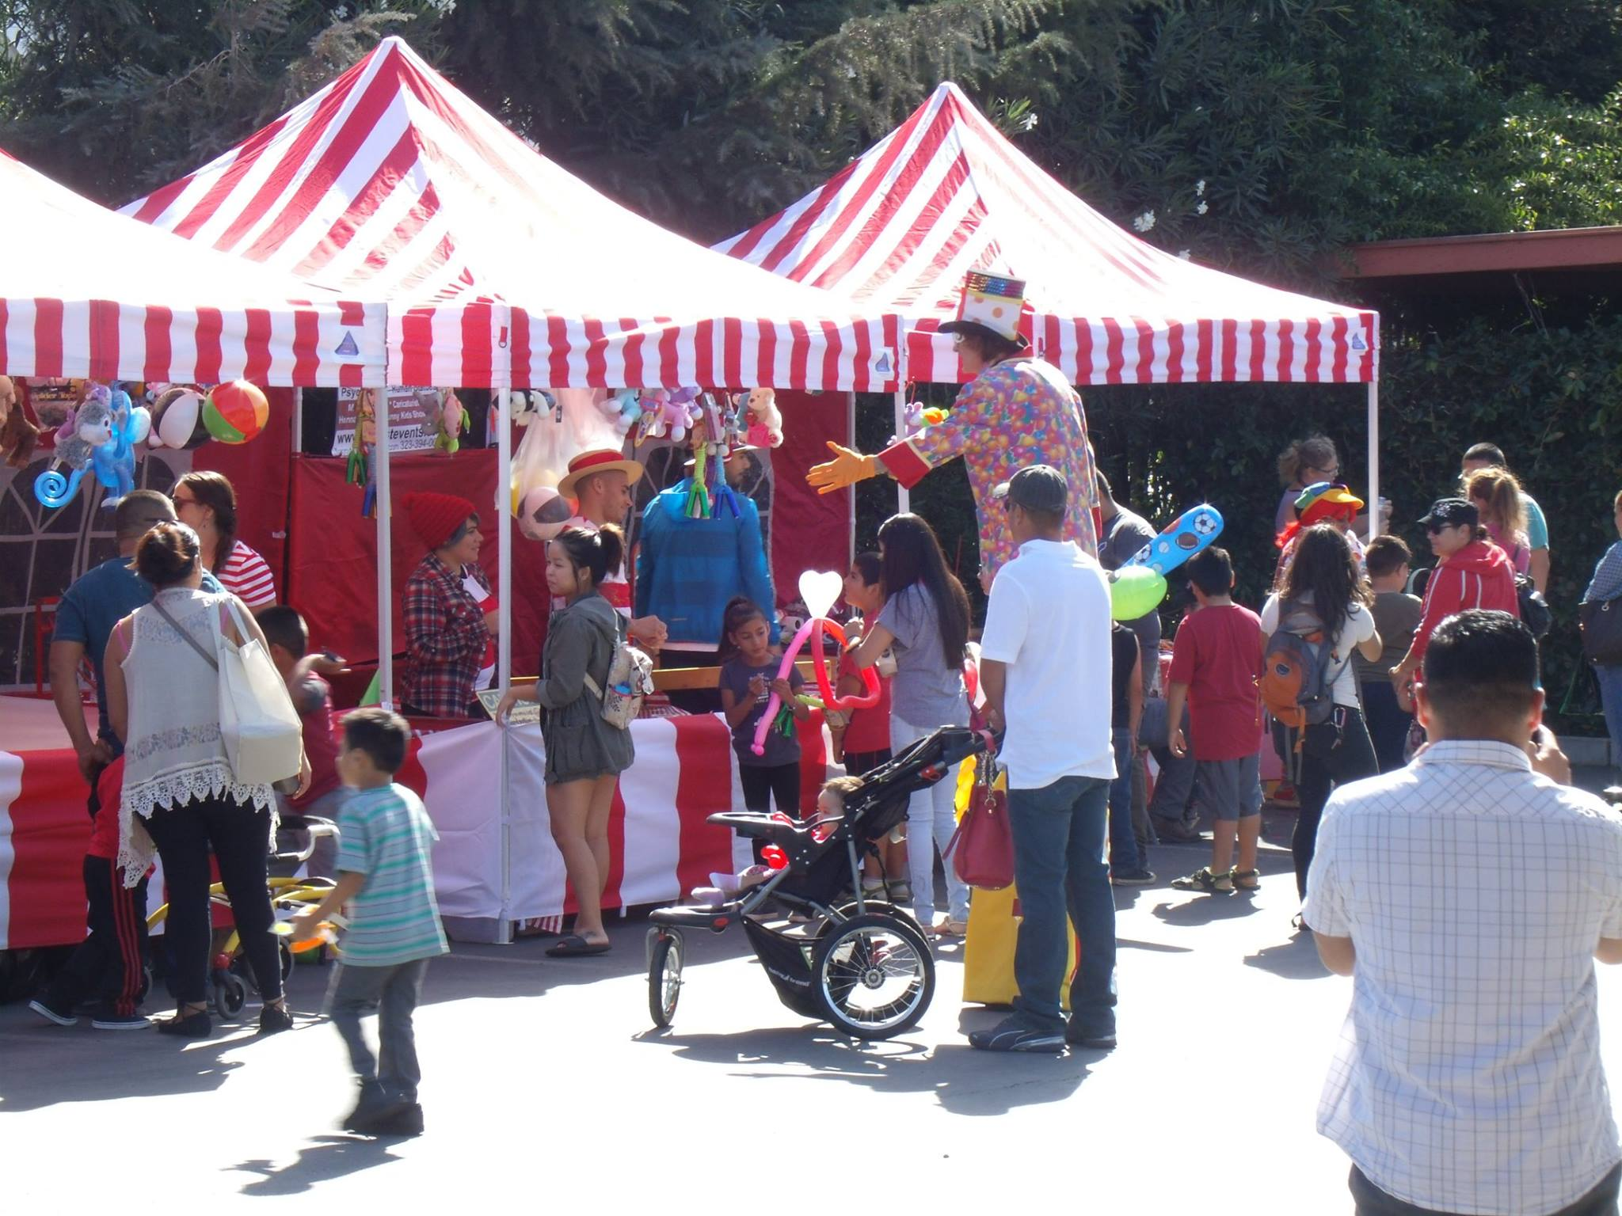
Notes:
Dena

Slide 24
Survey Results: Kinetic Flow
VMRC received over 50% Agreement on 52 of the 58 (compared to 44 in 2014) metrics and 75% or higher agreement on 26 measures (18 in 2014).
VMRC received the highest scores for…
I care about and am committed to doing the best Job I can each day. (98%)
I know what is expected of me at work. (92%)
I feel that the work I do supports the vision of the organization in serving people with developmental disabilities. (91%)
I feel like what I do makes a difference to the people VMRC supports. (90%)

Slide 25
Survey Results: Kinetic Flow
VMRC received the lowest scores for…
Upper Management fosters a team approach within our agency. (49%)
Upper Management is open to suggestions for improvement. (47%)
There is a culture of trust at the regional center. (47%)
Upper Management is open to input from the staff. (46%)
The communication across organizational boundaries within the regional center enables us to perform our jobs effectively. (46%)
I am fairly compensated for what I do. (43%)

Slide 26
Survey Results: Kinetic Flow
Fifty-six percent (56%) of employees definitely want to continue working at VMRC for at least the next two years, while an additional thirty-two percent (32%) “Yes, maybe” want to continue to work for the regional center for the next two years; a notable increase over 2014.
Overall, the regional center demonstrated improvement on 40of 49 core metrics, with four (4) metrics that remained unchanged, and five (5) metrics that declined slightly.
Satisfaction Analysis
For comparison purposes, analysis looked at each office and department compared to 2014 scores; detailed findings are available in the complete report.

Slide 27
DDS Stated Priorities and Initiatives
New Legislation and Funding -implementation
Home and Community-Based Services Regulations
Reducing Inequity/Disparities in Our System
Self-Determination Program
New Community Service Models
Safety Net Plan
Rate Study
Competitive Integrated Employment
Developmental Services Task Force

Slide 28
Crystal Ball: Looking Ahead
Self-Determination – Probably within the first quarter of the year
Developmental Center Closures:
Sonoma DC scheduled to close by December 2018
Fairview DC by 2019
Porterville DC General Treatment Area by December 2021
Advocates will press hard to retain the money saved and DDS will continue focus on crisis and enhanced behavioral services
HCBS – Person Centered Planning and Thinking will become even more important as a requirement in receiving federal funds. Compliance due date March 2022.
There will probably be a significant tax bill that makes Medicaid spending on developmental disabilities vulnerable.
Disparities in the expenditures for culturally diverse population will continue to be a focus of our legislature
Housing, Employment and Dental Care will round out the top priorities of the department and the legislature.
Governor ends his term and congress enters mid-term elections.
Notes:
Dena

Slide 29
Major Initiatives for 2018
Person – Centered Planning and Thinking
The VMRC Training and Development Work Group will begin to layout a blueprint for agency wide learning.
We will enter the action phase for addressing the oral health crisis in our region.
The provider community is ready to implement its professional development plan.
The VMRC Board legislative Committee will engage our community in self-advocacy and public policy awareness and action.
The board of directors will increase its committee work, travel the region better, and increase transparency.
Increase organizational communications with Two All Staff Meetings a year and two all management meetings a year.
Social Media strategic plan and full implement
Notes:
Dena

Slide 30
QUESTIONS
Notes:
All
Candace & Tony close the events

